Slide 1
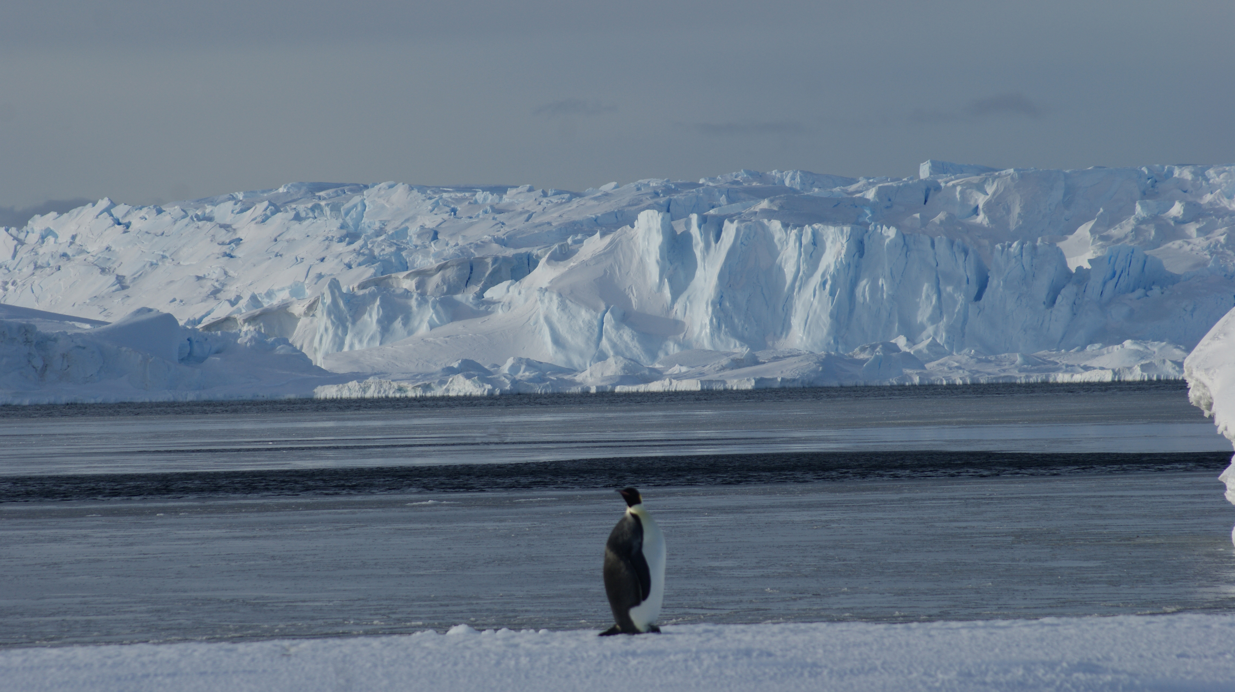
Cryo-sismicité côtière en Terre Adélie : effet des marées sur la dynamique du glacier de l'Astrolabe
D. Zigone
Institut Terre et Environnement de Strasbourg
C. Groult, G. Barruol, A. Maggi, F. Provost, J-P. Malet, C. Hibert & E. Le Meur

Slide 2
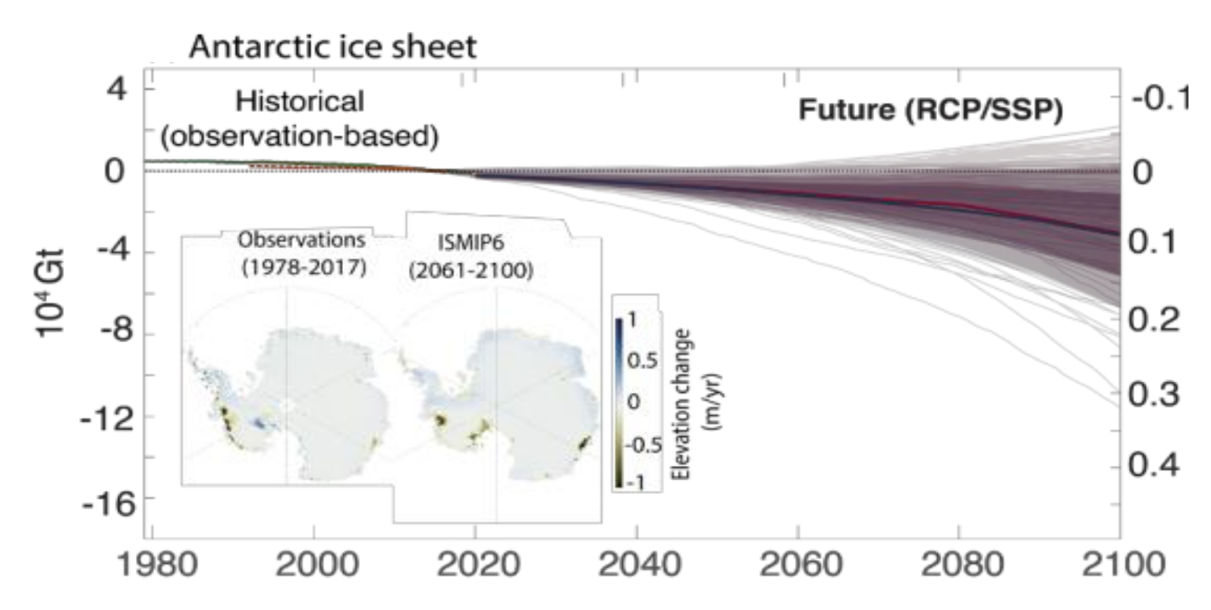
1. General Context
IPCC, AR6 (2021)

Slide 3
1. Contexte Général
Vulnérabilité des glaciers côtiers Antarctique au changement climatique :
Présence de langues flottantes => sensibles à la dynamique de l'océan (marées, houles), et à son réchauffement. L'intrusion d'eau chaude sous-glaciaire influence la fonte basale et augmente la vulnérabilité de la calotte glaciaire.
Les études de télédétection fournissent des informations clés sur l'écoulement de la glace à grande échelle et sur la position des lignes d’échouages, mais elles ne décrivent pas les processus à petite échelle qui contrôlent la dynamique des glaciers cotiers Antarctique (topographie, crevasses, propriétés géologiques, frictionnelles et hydrologiques du substratum rocheux).

Slide 4
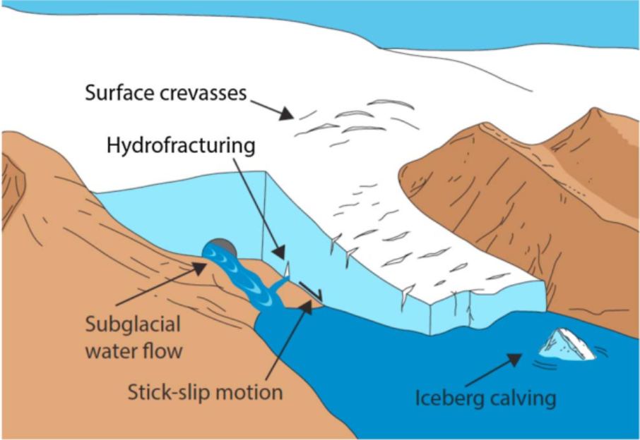
1. General Context
The cryosphere is seismicaly active:
Icequakes
basal events
glacial tremors
Calving events
There is a need for new methods to detect, classify and later locate all these seismic signals.
(Podolskiy & Walter, 2016).

Slide 5
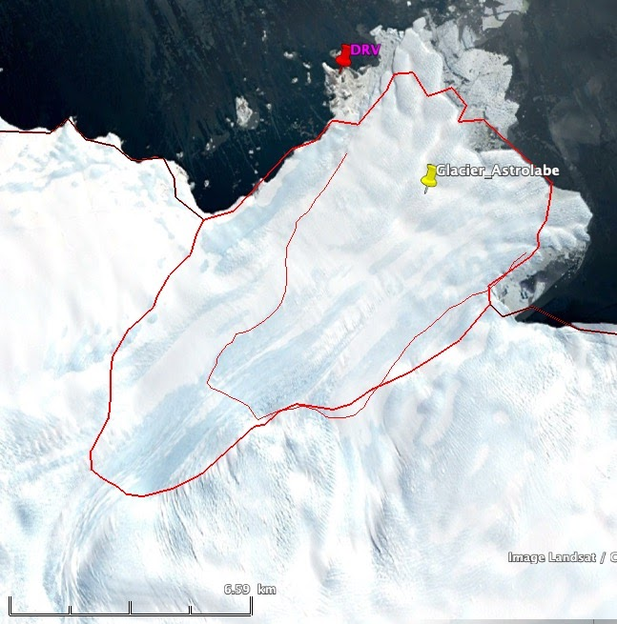
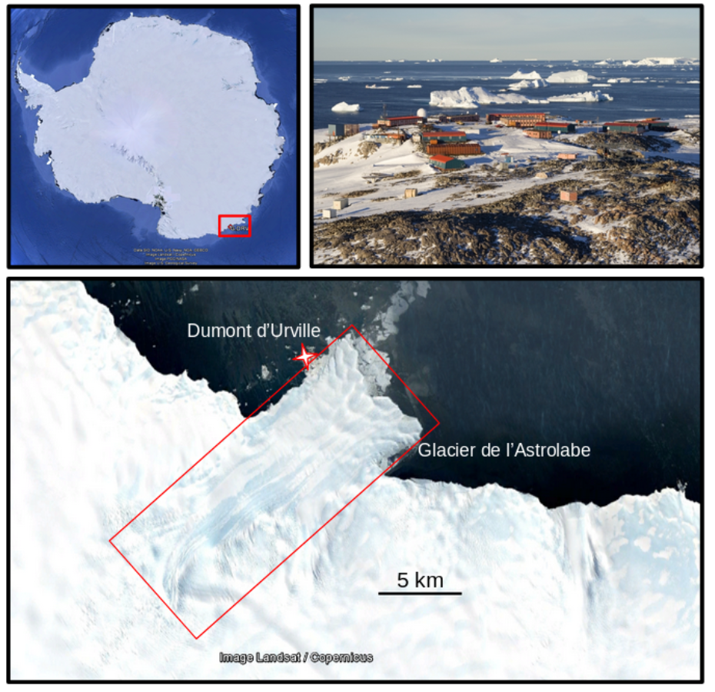
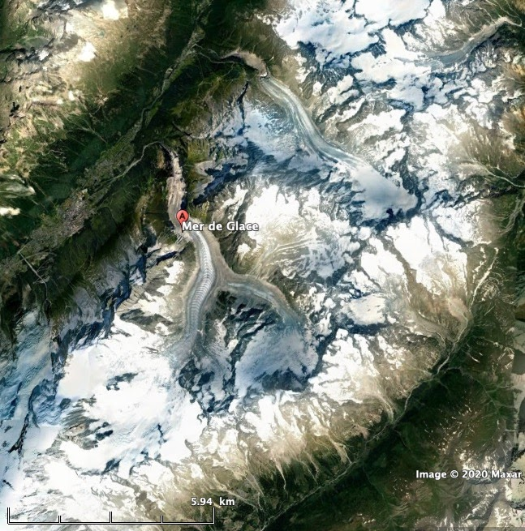
2. The Astrolabe Glacier

Slide 6
2. The Astrolabe Glacier
(m/yr)
From F. Provost & J-P. Malet (pers. Communication)

Slide 7
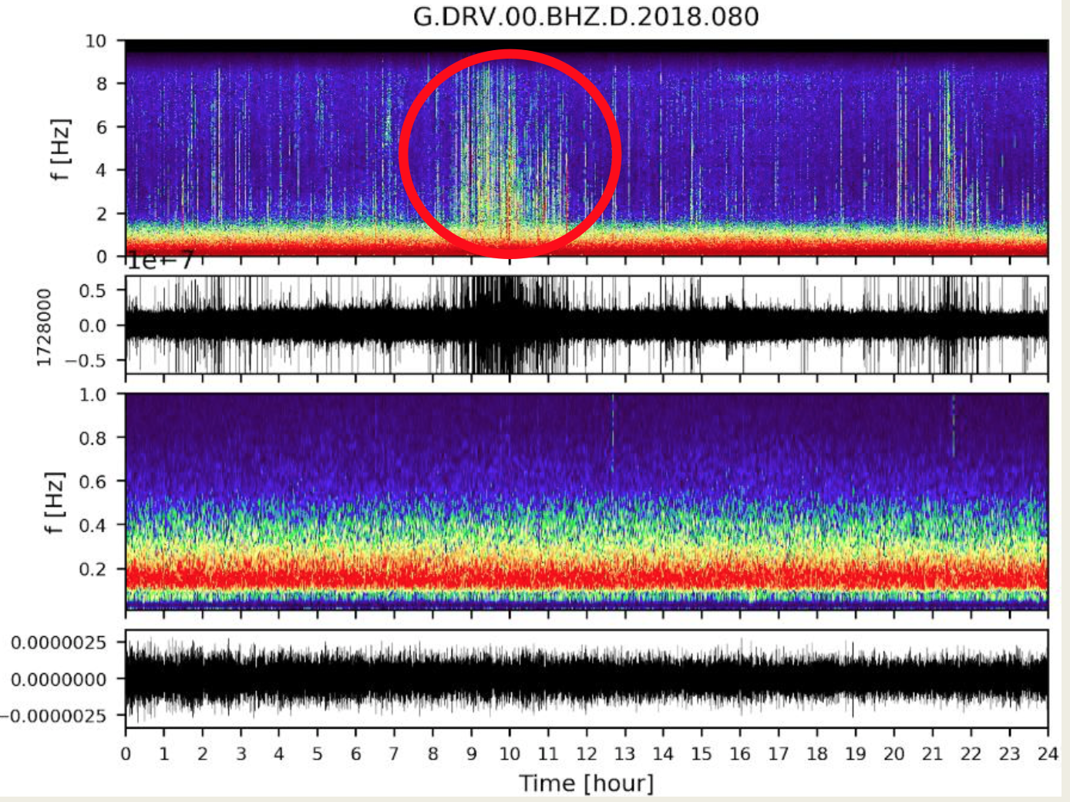
3.1 Cryosismicity
Clear burst of seismic activity between 2 and 8Hz
Duration ~ 2-3h
1 to 3 times a day
Visible of consecutives days with a time shift
Appear all year round with seasonality

Slide 8
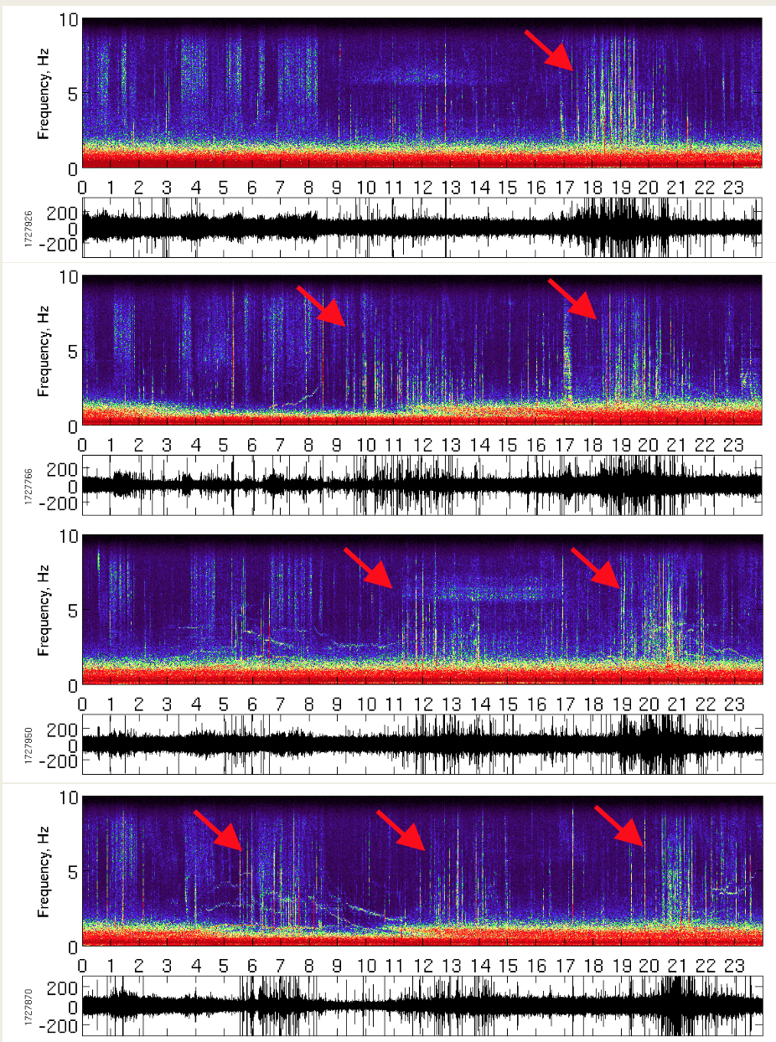
3.1 Cryosismicity
29 Jan. 2018
Clear burst of seismic activity between 1 and 8Hz
Duration ~ 2-3h
1 to 3 times a day
Visible of consecutives days with a time shift
Appear all year round
30 Jan. 2018
31 Jan. 2018
01 Feb. 2018
Stage M2 C. Groult

Slide 9
3.1 Cryosismicity
29 Jan. 2018
Clear burst of seismic activity between 1 and 8Hz
Duration ~ 2-3h
1 to 3 times a day
Visible of consecutives days with a time shift
Appear all year round
30 Jan. 2018
Tidal modulation of cryoseismic activity
31 Jan. 2018
=> Computed the seismic energies between 2 and 4Hz during 2018 to build time series that can be compared to tidal forcing
01 Feb. 2018
Stage M2 C. Groult

Slide 10
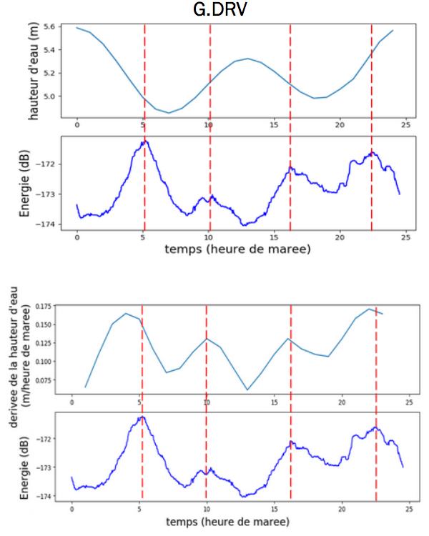
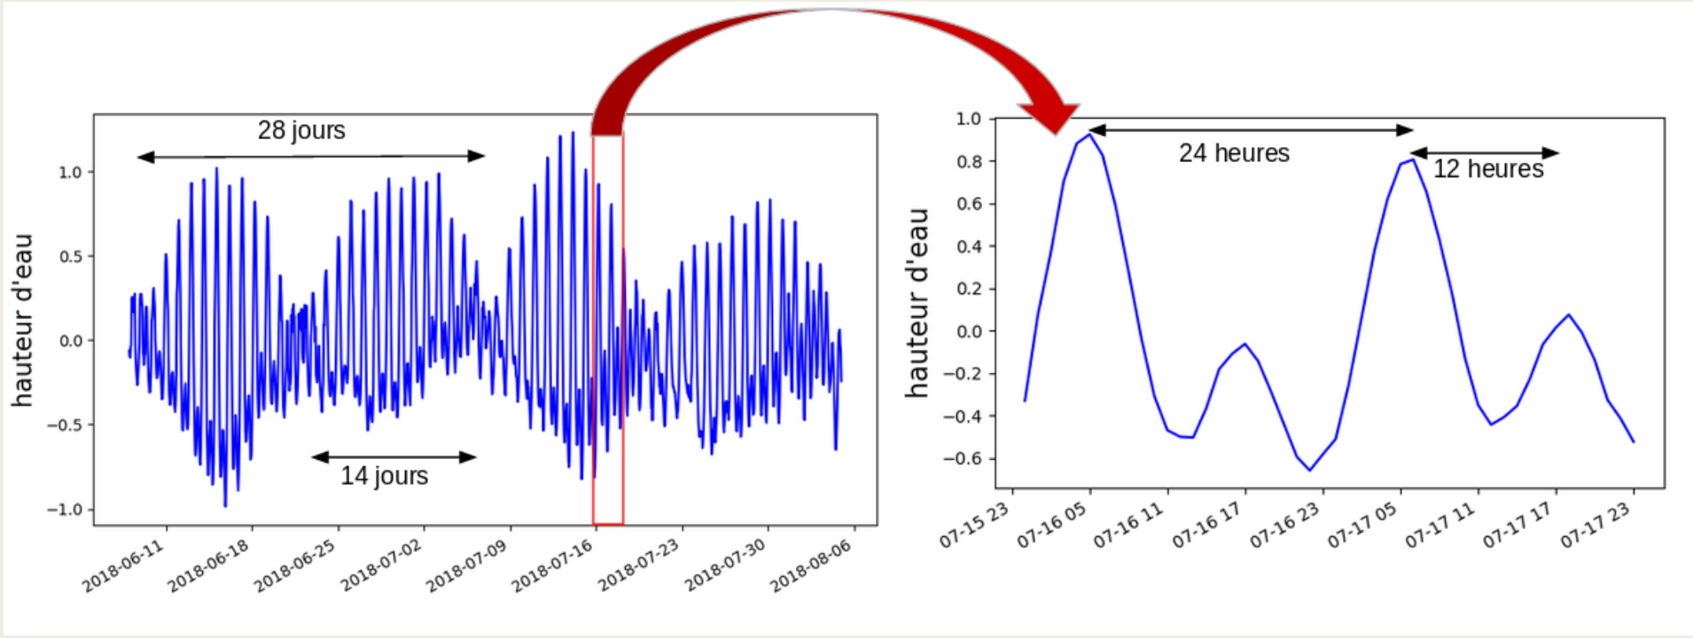
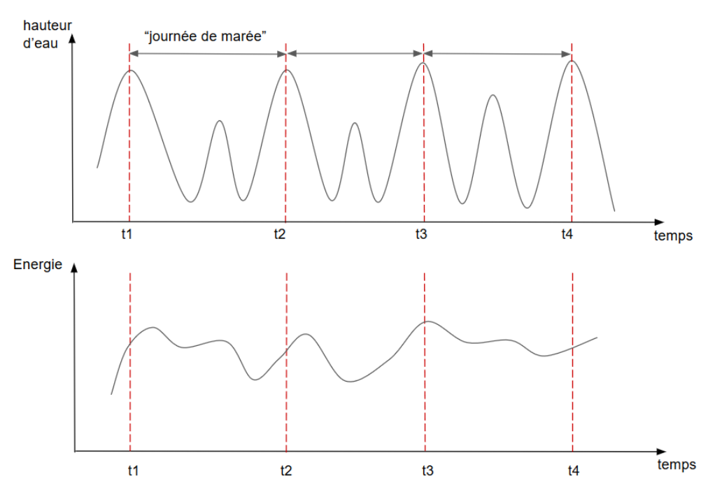
3.2 Tidal Modulation
Moyenne des « journées de marée » sur un an
Découpage des signaux de hauteur d’eau et d’énergie sismique en « journées de marée »
Stage M2 C. Groult

Slide 11
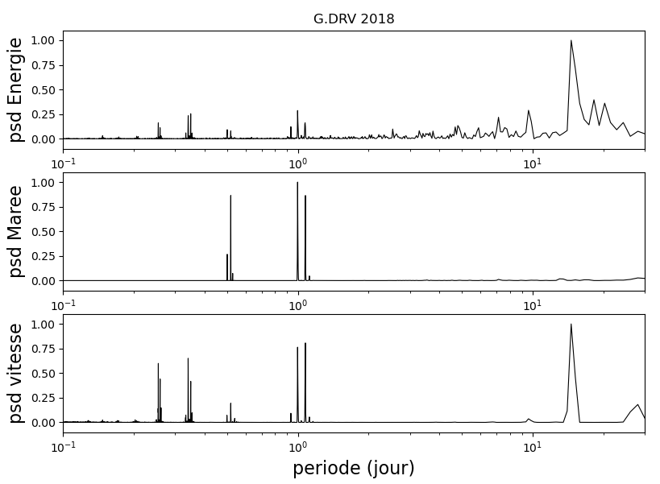
3.2 Tidal Modulation
Clear modulation of the of cryoseismic activity by the tidal forcing with all the harmonics of the forcing recorded in the icequake activity for year 2018.
Strain accommodation at the grounding line?
G. Barruol, communication personnelle
Stage M2 C. Groult

Slide 12
3.2 Tidal Modulation – STA/LTA
G. Barruol, communication personnelle

Slide 13
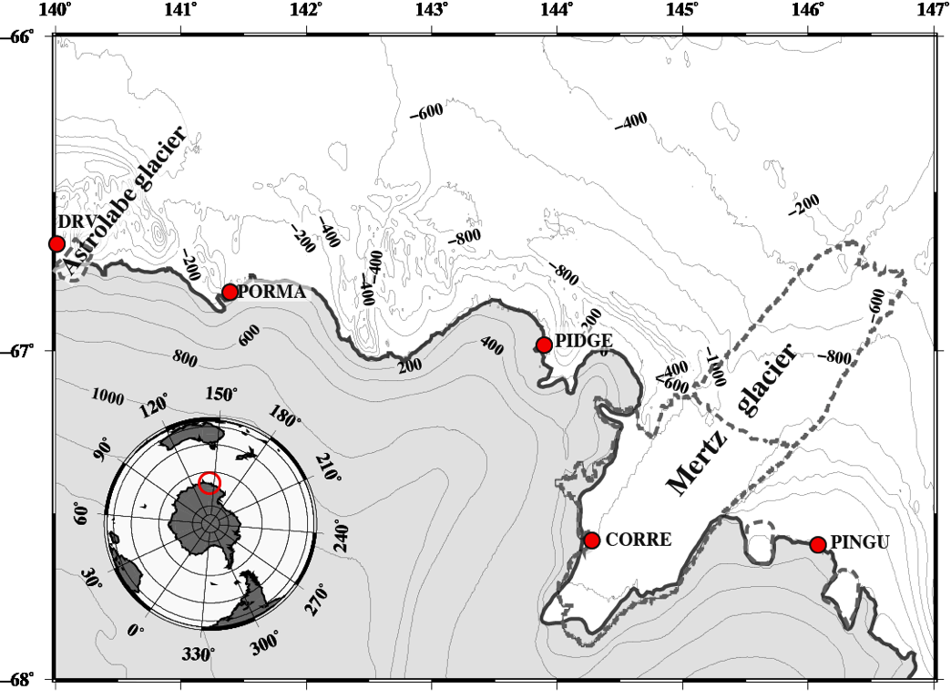
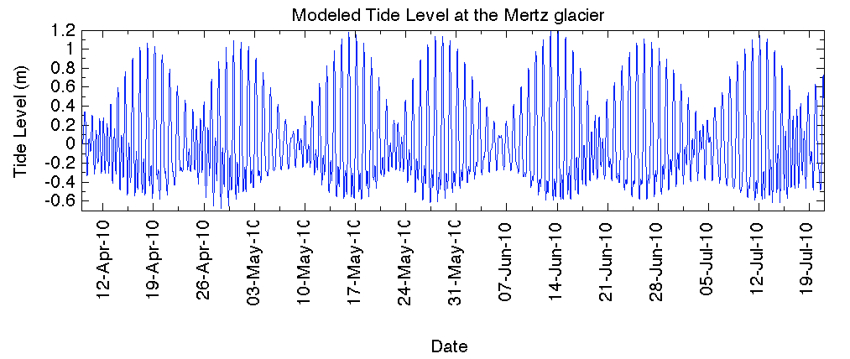
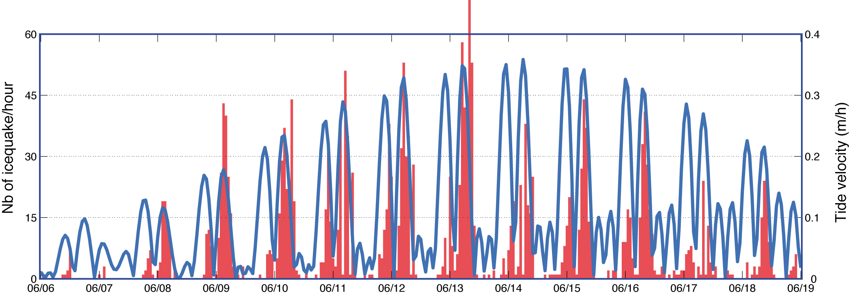
3.2 Tidal Modulation
Icequakes (nb/h)
Tide height (m)
Tide velocity
& icequakes
Barruol et al. (2013)

Slide 14
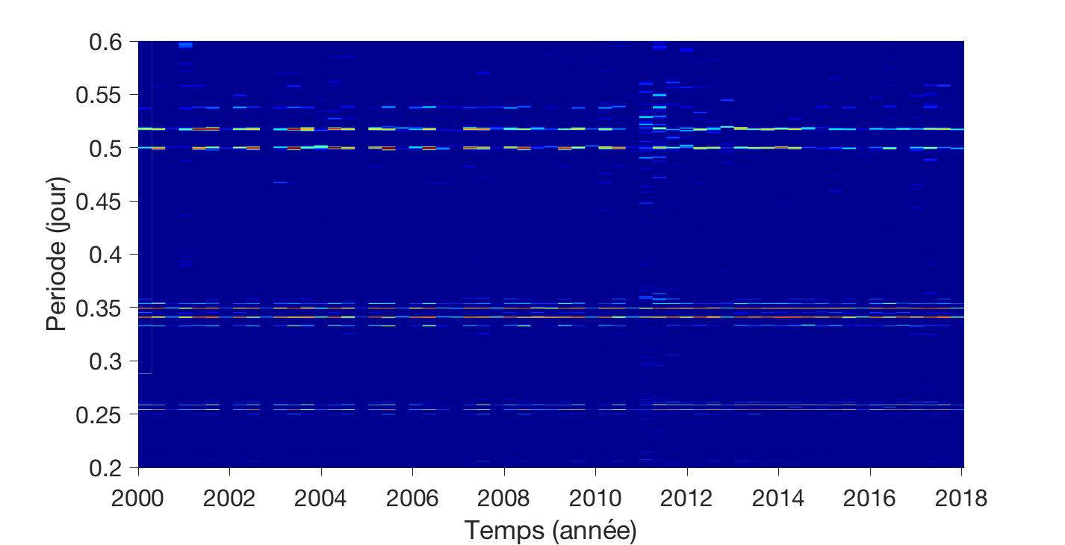
3.3. Tidal Modulation time evolution
Stage M2 C. Groult

Slide 15
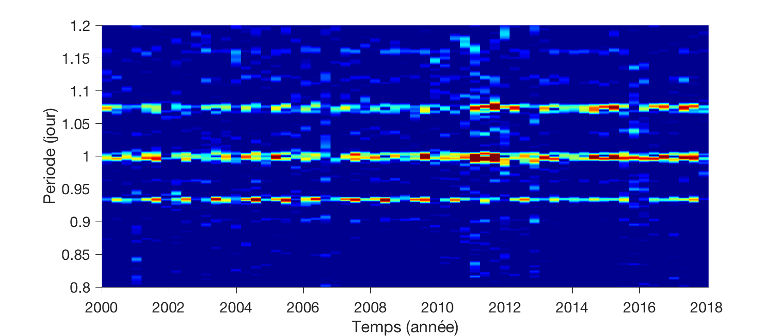
3.3. Tidal Modulation time evolution
Stage M2 C. Groult

Slide 16
3.3. Tidal Modulation time evolution
2 pics for the fortnightly forcing with clear time evolution
Scientific Questions:
Which process explains those time evolution?
Non linearity?
Ice Rheology => role of visco-elasticity?
Role of the geometry of the shelf?
Stage M2 C. Groult

Slide 17
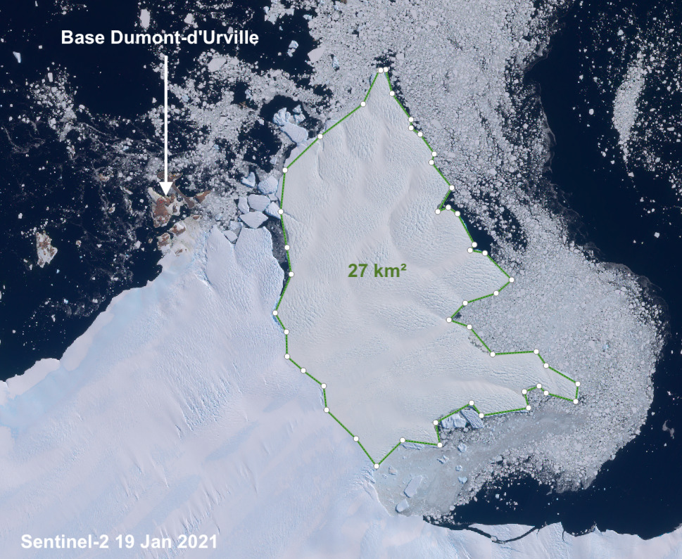
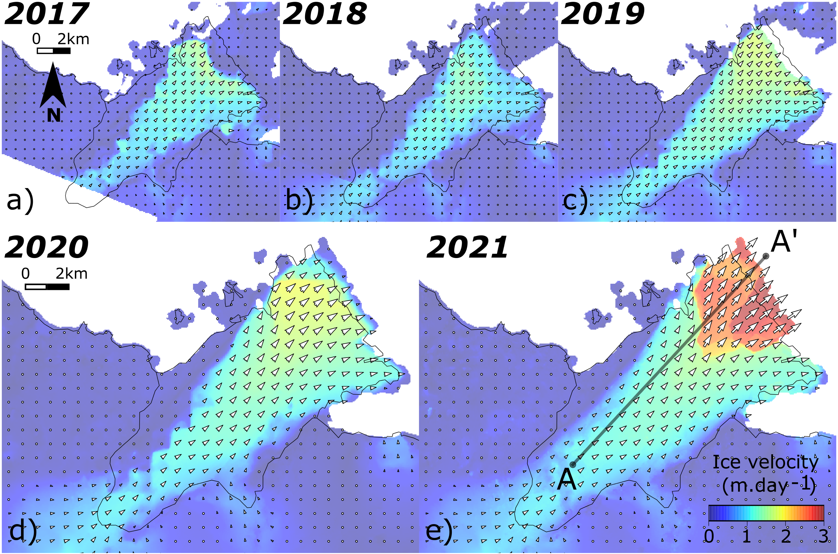
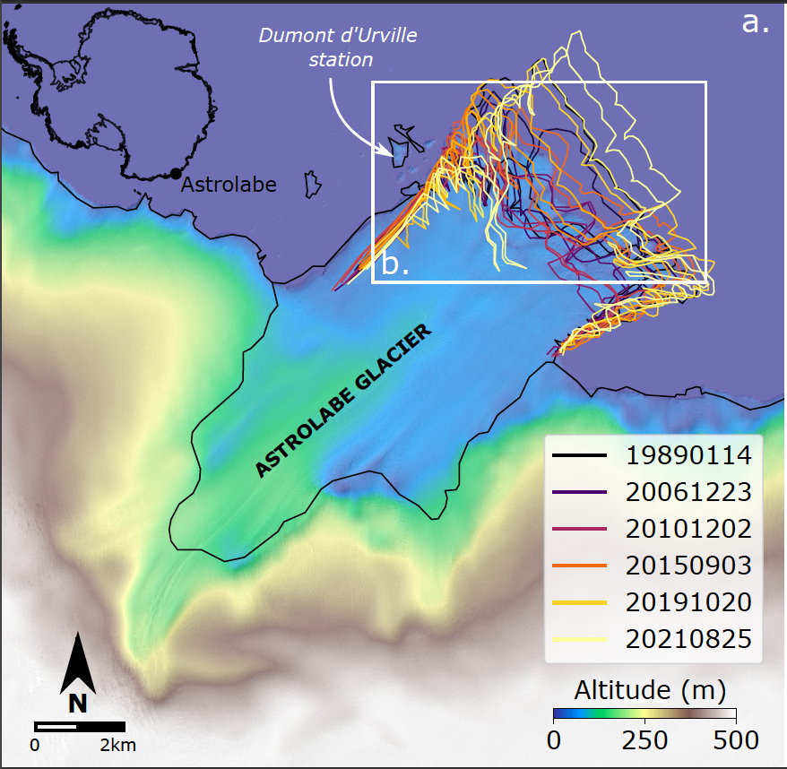
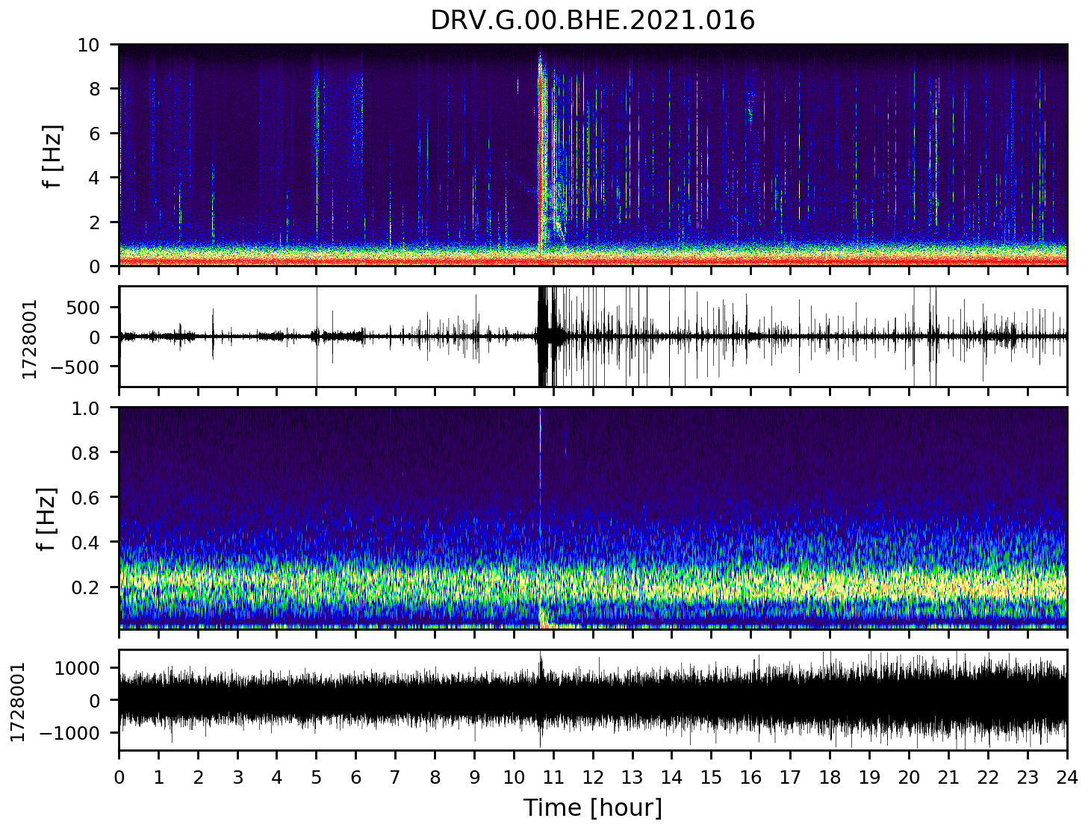
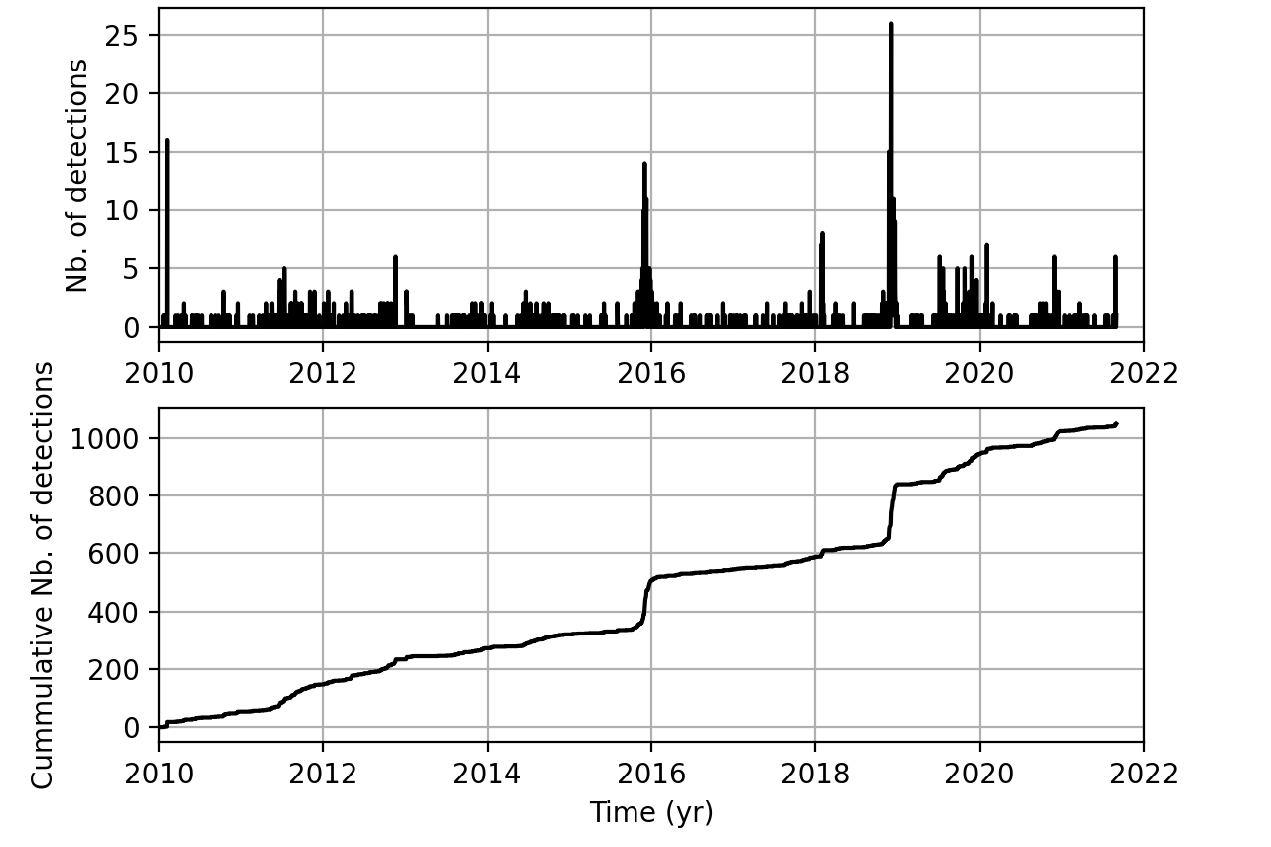
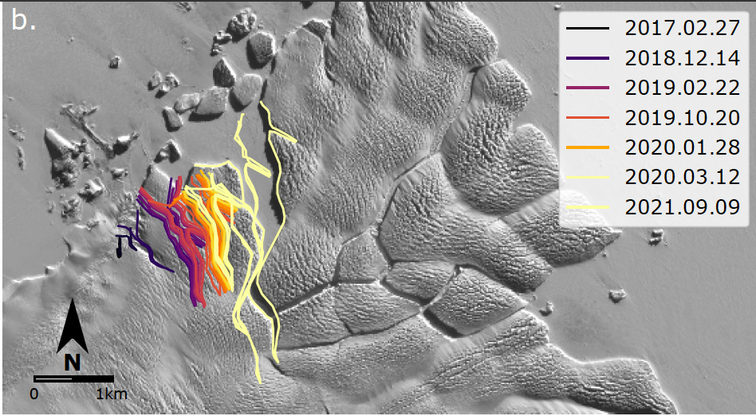
3.4 Calving
Poster: Monitoring ice-calving at the Astrolabe glacier (Antarctica) with seismological and Sentinel-2 satellite data.
Floriane Provost, Jean-Philippe Malet, Dimitri Zigone, Emmanuel Le Meur, Clément Hibert

Slide 18
4. Summary and Future Plans
Clear seismic cryogenic signal modulated by tidal forcing
mode I fractures opening and closing during tidal charge and discharge?
All the harmonics of the tidal forcing visible in the seismic energy with clear time evolution for the fortnightly forcing
Role of the large calving events?
Ro
Now we need to better detect and classify all those signals with a better network and ML methods

Slide 19
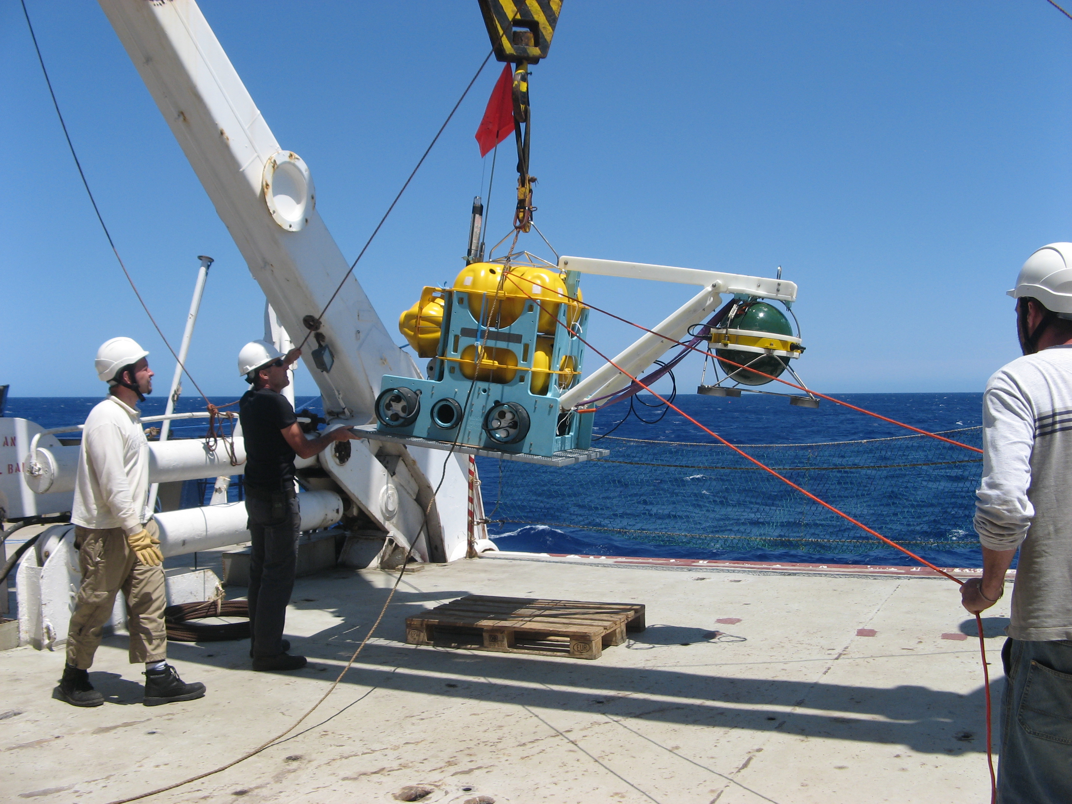
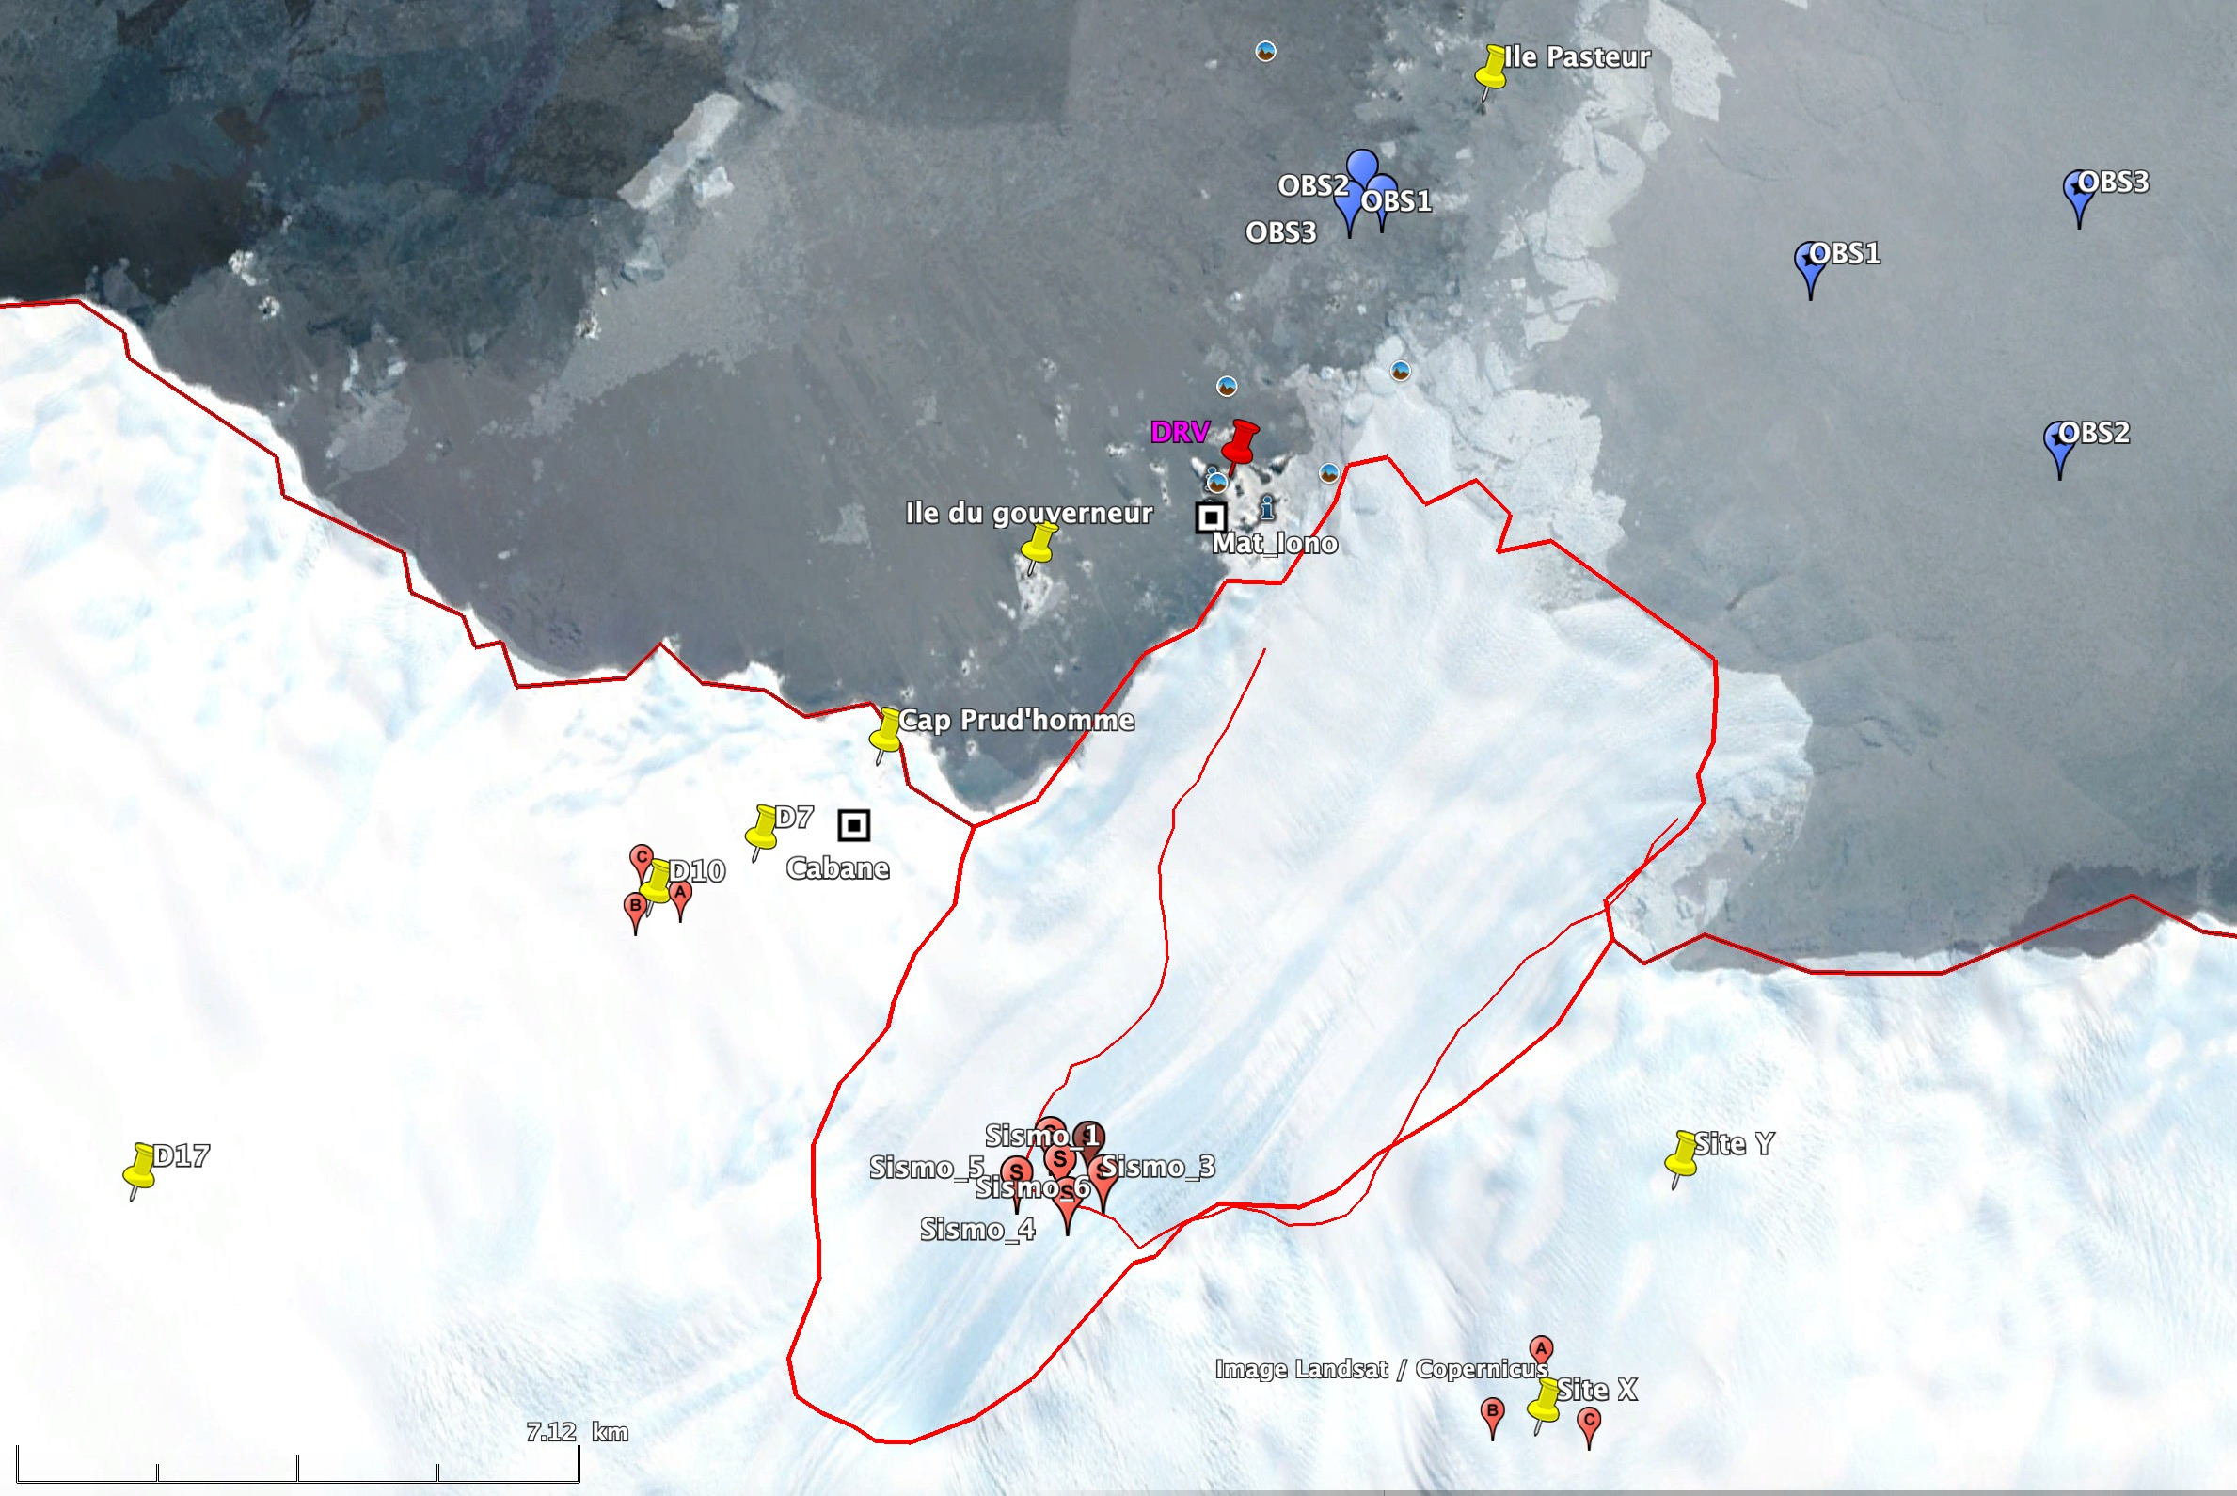
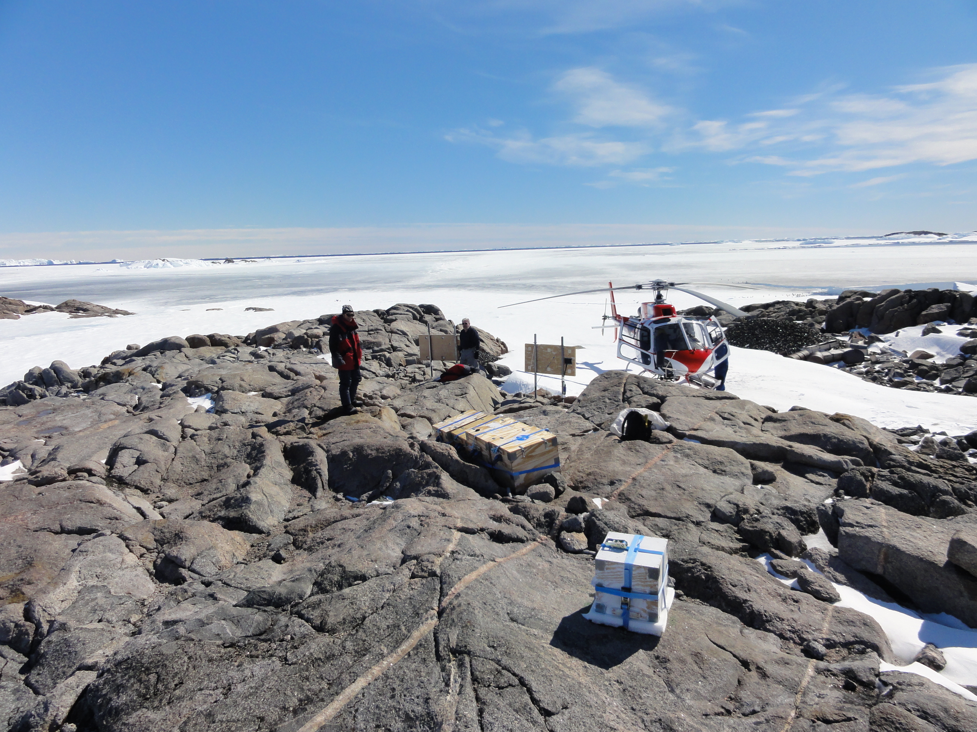
Future Plans: SEIS-ADELIVE & ANR CRYOS-TA
Astrolabe glacier
Projects SEIS-ADELICE & ANR CRYOS-TA
Cryoseismology on the Astrolabe glacier
Objectives:
Brittle/ductile transition
Basal gliding
Subglacial hydrology
Ocean/ice interaction
Rifting and calving processes
Deployment of land and ocean bottom seismometers (OBS)
Associated with GPS from DACOTA project (E. Le Meur)

Slide 20
Merci

Slide 21
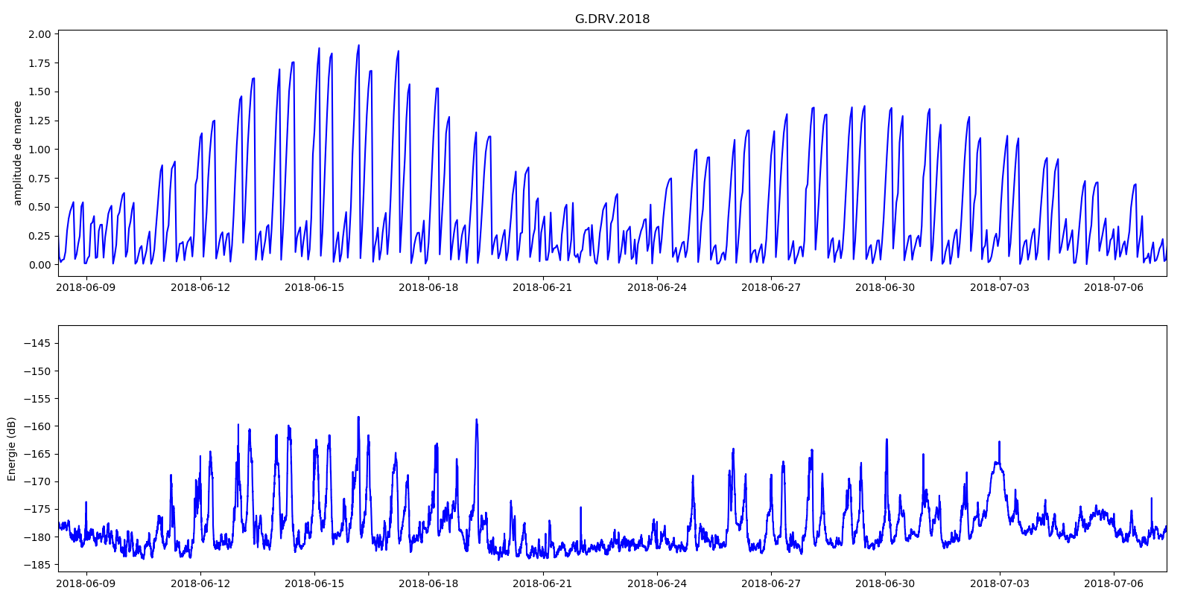
3.2 Tidal Modulation
Stage M2 C. Groult

Slide 22
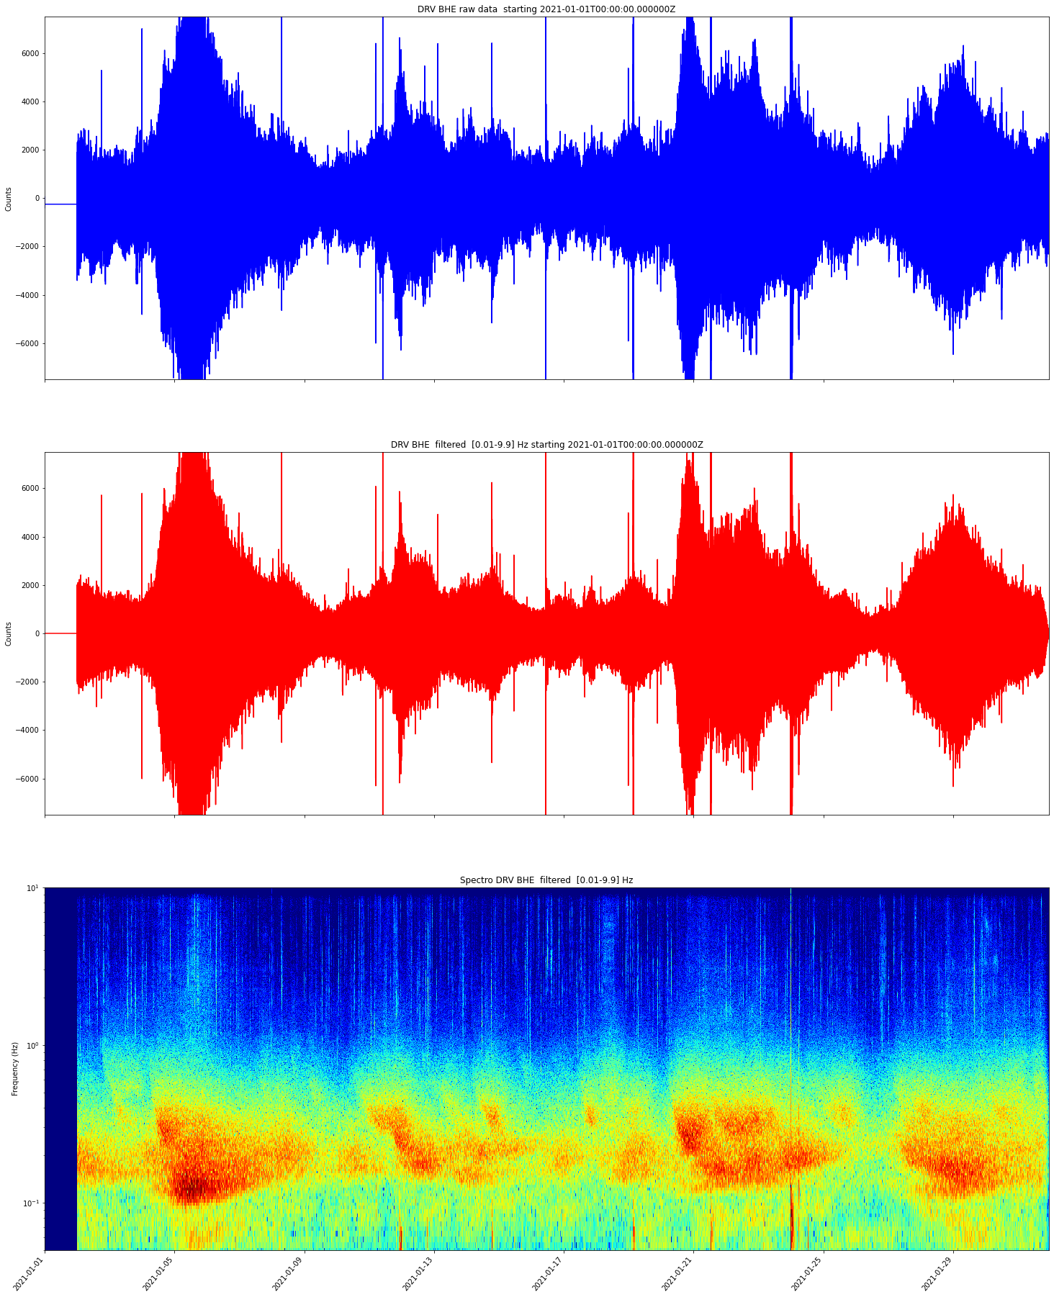
3. Cryosismicity
DRV East seismogram
Icequakes, 1-10Hz
Secondary microseisms, 1-10s
Primary microseisms, 10-20s
G. Barruol, communication personnelle

Slide 23
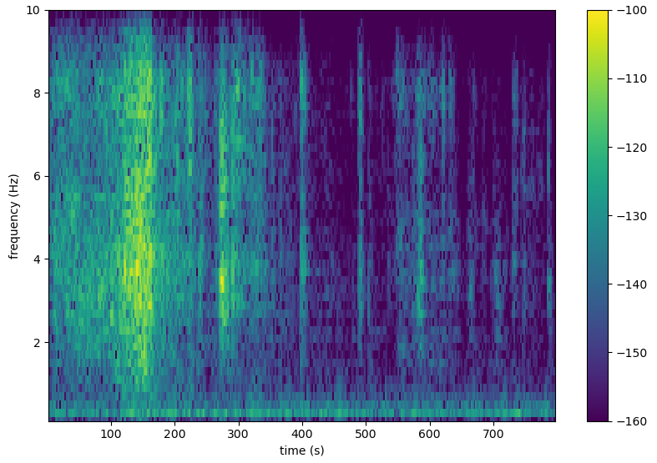
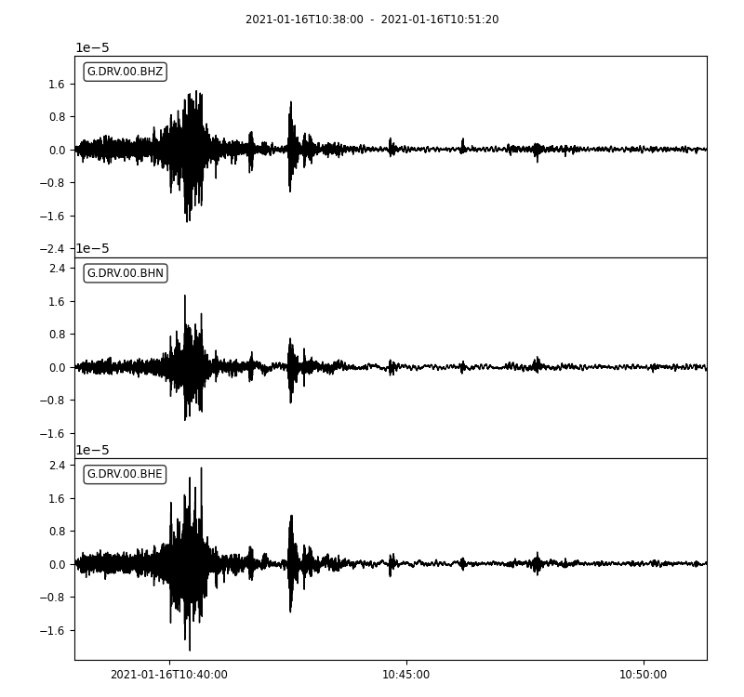
3. First results

Slide 25
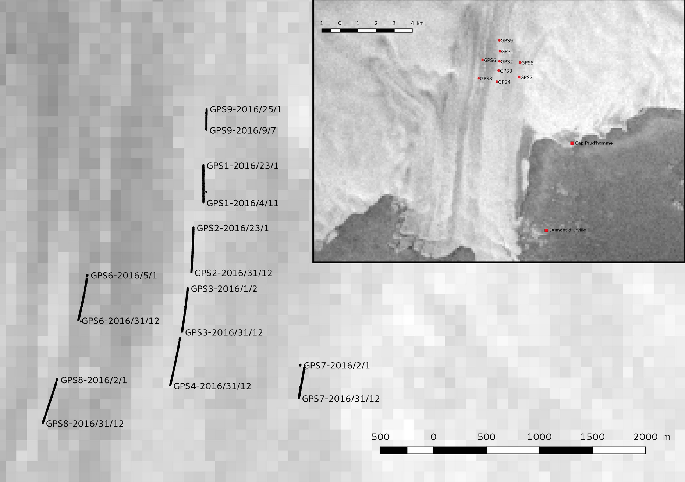

Slide 26
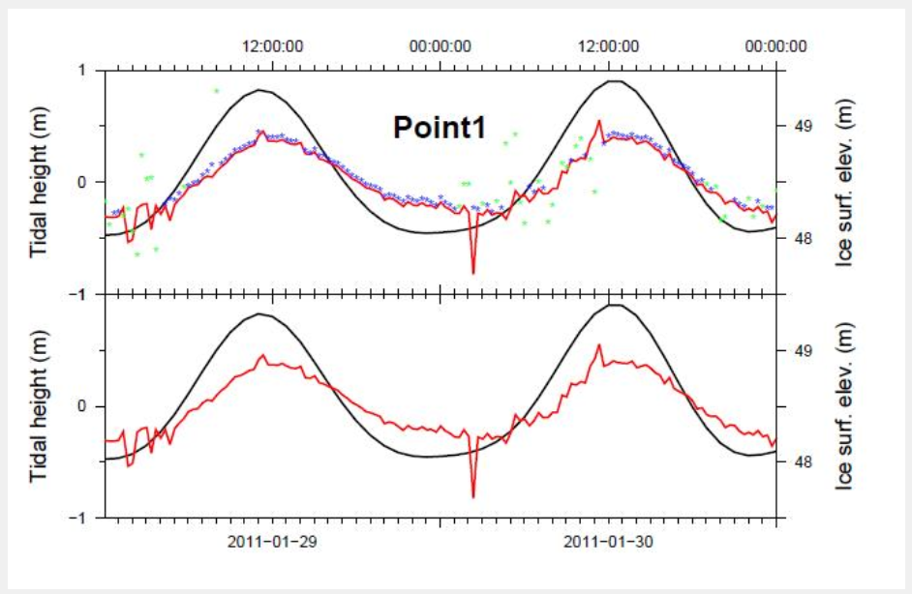
Le Meur et al. (2014)

Slide 27
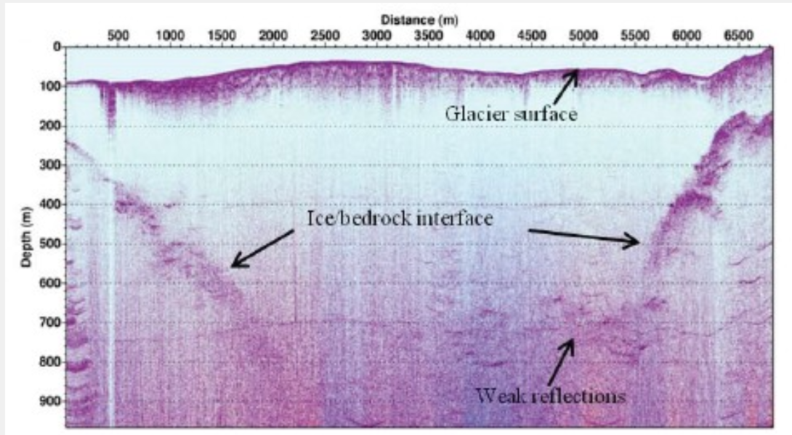
Le Meur et al. (2014)

