Slide 1
Migration de la sismicité au Piton de la Fournaise
Olivier Lengliné
Institut Terre & Environnement de Strasbourg
EOST, CNRS & Université de Strasbourg
Zacharie Duputel - OVPF/IPGP
Valérie Ferrazzini - OVPF/IPGP

Slide 2
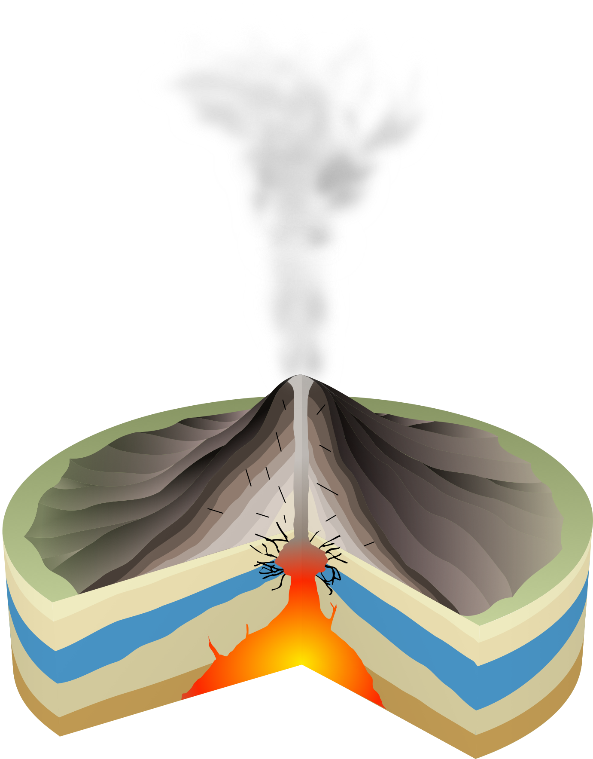
Variety of seismo-volcanic signals
Diversity of volcanic sources
Volcano Tectonic earthquakes:
Brittle failures in the edifice
Link with magma transport ?
Low-Frequency / Very low-frequency events:
Resonating fluid-filled conduit ?
Moving fluid ?
Caldera collapse ?
Hybrid earthquakes:
Brittle failures + conduit resonance ?
Brittle failures + path effect ?
Volcanic tremor:
Long-lived resonating magma-filled conduit,
Flow-induced oscillations,
Bubble dynamics …
Zoback et al., 2013
Notes:
As a seismologist, one of the striking thing about volcanoes is the variety of signals that are recorded.
This variety is illustrated here on the right with examples of seismic signals that are typically observed on volcanoes.
- We have volcano-tectonic earthquakes that are similar to tectonic earthquakes but triggered by volcanic processes
- Low-frequency or VLF earthquakes that can be associated with different types of processes
- Hybrid earthquakes
- Volcanic tremor
This variety can be largely attributed to the diversity of volcanic sources. Volcanoes are associated with a variety of processes leading to many different signals. We have diverse processes on volcanoes, leading to many different signals. This diverse source processes is generally still poorly understood.

Slide 3
Variety of seismo-volcanic signals
Diversity of volcanic sources
Volcano Tectonic earthquakes:
Brittle failures in the edifice
Link with magma transport ?
Low-Frequency / Very low-frequency events:
Resonating fluid-filled conduit ?
Moving fluid ?
Caldera collapse ?
Hybrid earthquakes:
Brittle failures + conduit resonance ?
Brittle failures + path effect ?
Volcanic tremor:
Long-lived resonating magma-filled conduit,
Flow-induced oscillations,
Bubble dynamics …
Zoback et al., 2013
Notes:
Here, I will only discuss the two first type of sources that are VT earthquakes and VLF earthquakes in the context of Piton de la Fournaise.

Slide 4
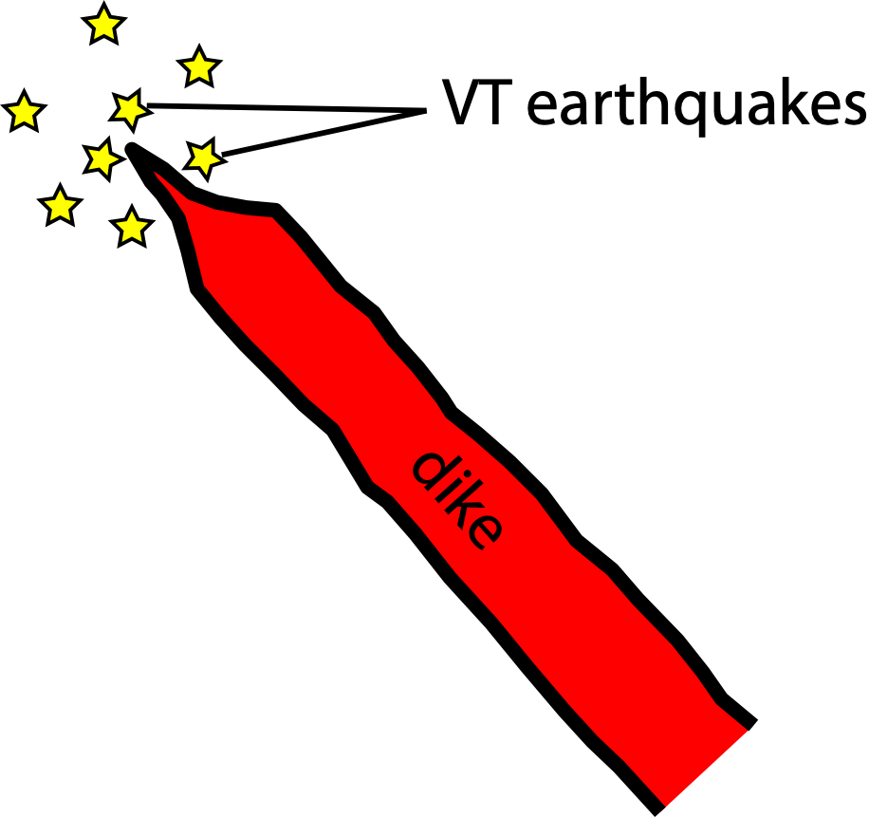
Link between detected VT earthquakes
and magma transport ?
VT events related to stress perturbations caused by intruding magma bodies
Direct marker of the magma pathway ? (e.g., Grandin et al., 2011)
Activation of existing weak structures ? (Rubin and Gillard, 1998) ?
Distributed damage within the edifice ? (Carrier et al., 2015)
Dike inflation, shear joints / Tension zones ? (Hill, 1977 / Ukara & Tsukahara)
Notes:
As I mentioned just before, VT events are usually interpreted as brittle failures in the edifice that are triggered by stress perturbations caused by magma transport
However, the link between the stress source and the occurence of earthquakes is still elusive.
Some studies consider VT earthquakes as direct markers…

Slide 5
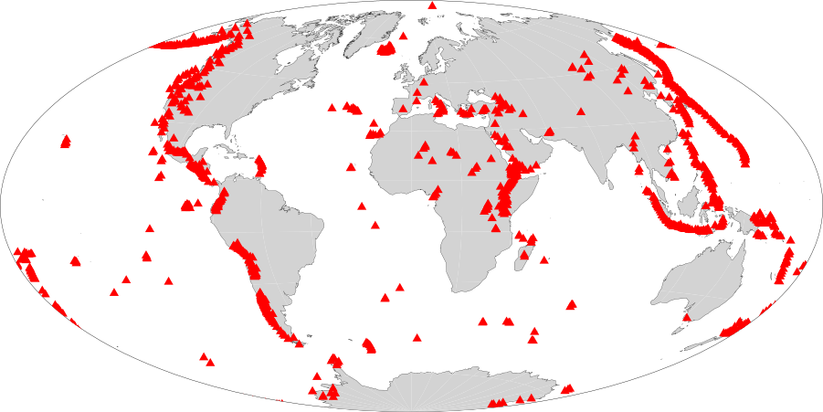
Piton de la Fournaise: an excellent field laboratory
Eruptions between 1972 and 2000
A well monitored active volcano:
- Active volcano (>3 eruption/yr since 2014)
- dense network of Seismic+GPS stations
Importance of monitoring:
- Flank eruptions close to inhabited areas
- Popular tourist attraction (~500 000 visitors/yr)
Notes:
Why Piton de la Fournaise volcano:

Slide 6
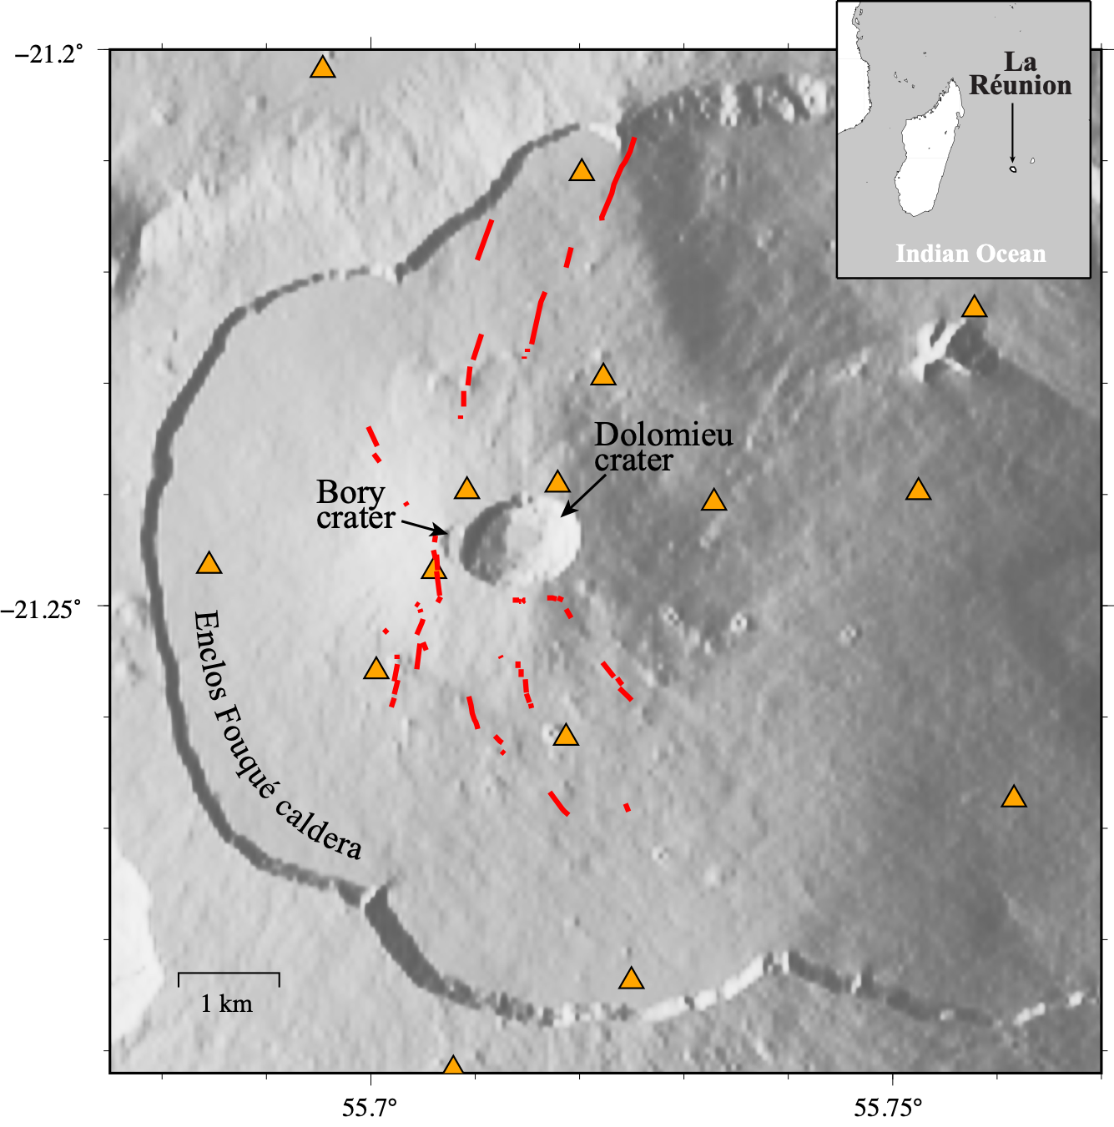
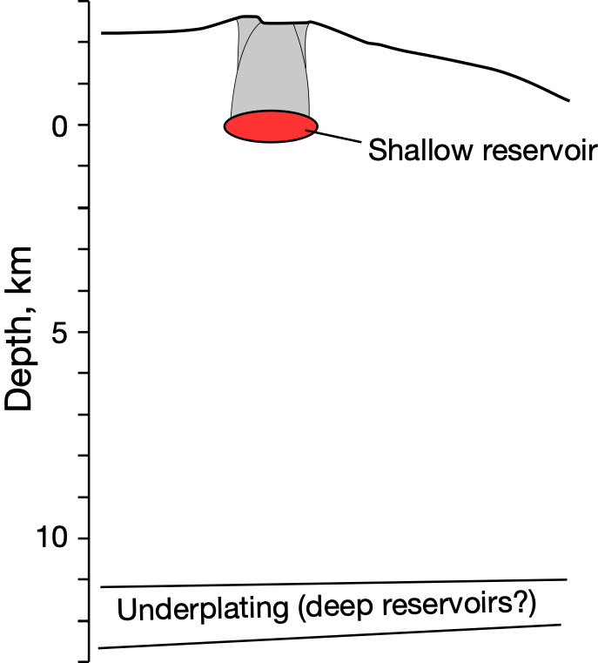
Piton de la Fournaise: Recent volcanic activity
Major caldera collapse in 2007
Inactive between 2010 and 2014
Since 2015: > 3 eruptions/yr
Before 2010 : ~2.5 eruptions/yr
Eruptions between 2014 and 2018
Properties of shallow magma migration?
Deep magma
transfer ?
Red lines = eruptive fissures.
Notes:
Recent activity of the volcano is a major collapse in 2007 followed by a quiescent phase from 2010 to 2014. Followed by a very active phase since 2014 with more that 3 eruptions/yr.
Is this activity explained by a recharge of the shallow reservoir by a deep magma transfer?
Can we use seismicity to actually constrain shallow migration of magma from the reservoir to the surface?

Slide 7
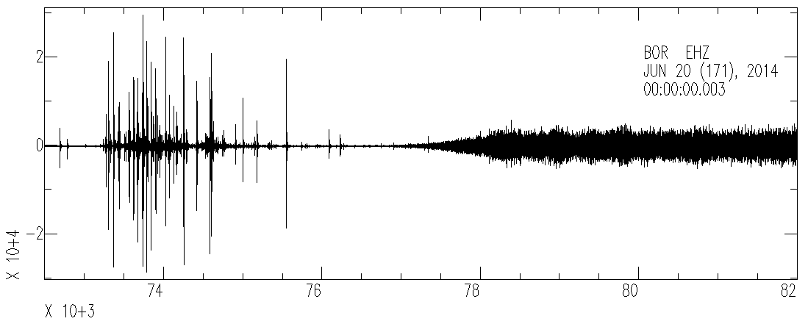
Piton de la Fournaise: Example of seismogram
15 min
VT earthquakes
Volcanic tremor
Time, sec
Notes:
Here is what a typical seismogram looks like at the onset of an eruption in June 2014
Spikes are VT earthquakes… we have a rather intense seismic crisis with large seismicity rate followed by a relatively quiet period and the apparition of tremor marking the beginning of the volcanic activity.
This intense seismic crisis is rather challenging to detect earthquakes because
They overlap on top of each other
They have a rather small magnitude
They can be hidden under the tremor.

Slide 8
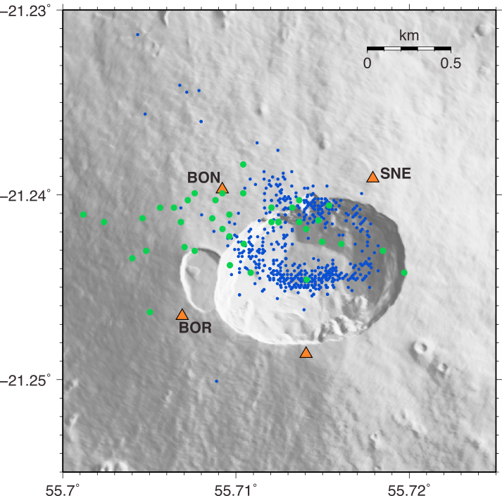
VT seismicity - Template Matching
Analysis of OVPF seismicity
Template events updated continuously
Analysis of continuous broadband data
Using multiple stations in the 5-30Hz frequency band
Template catalog (~1000 events)
Green dots: “deep” events (below sea level)
Blue dots: “shallow” events (above sea level)
Notes:
To improve the existing Catalog and get the most complete catalog, we use an approach of template matching that is usually quite standard.
I will not go into the details, but we use events in the observatory catalog as templates to detect similar earthquakes in the continuous data using multiple stations. The templates are shown here in Green and Blue.
From this catalog of about 1000 templates, we get

Slide 9
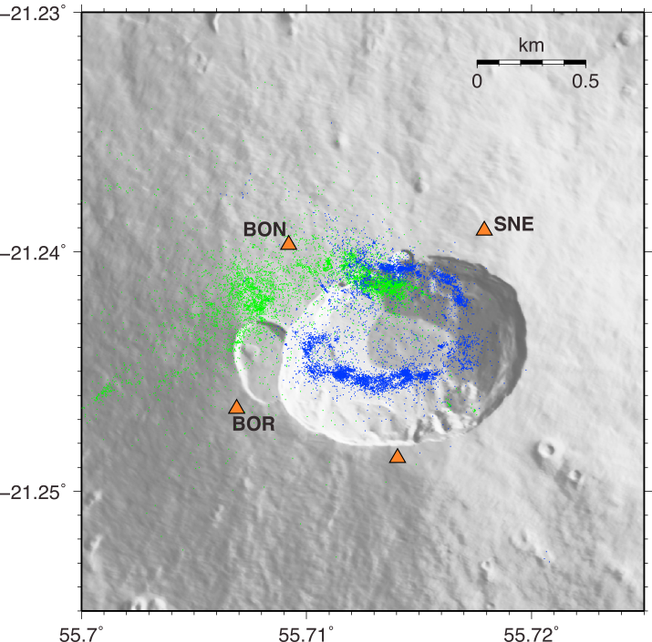
VT seismicity - Template Matching
24300 detections between 2014 and 2018
8050 deep events (below sea level)
16250 shallow events (above sea level)
Detected events (>24300 events)
Green dots: “deep” events (below sea level)
Blue dots: “shallow” events (above sea level)
Notes:
About 24 000 detections for both deep and shallow earthquakes
Among these detections we have, 8050 deep events
16250 shallow events
These events are then relocated by measuring P and S-time delays

Slide 10
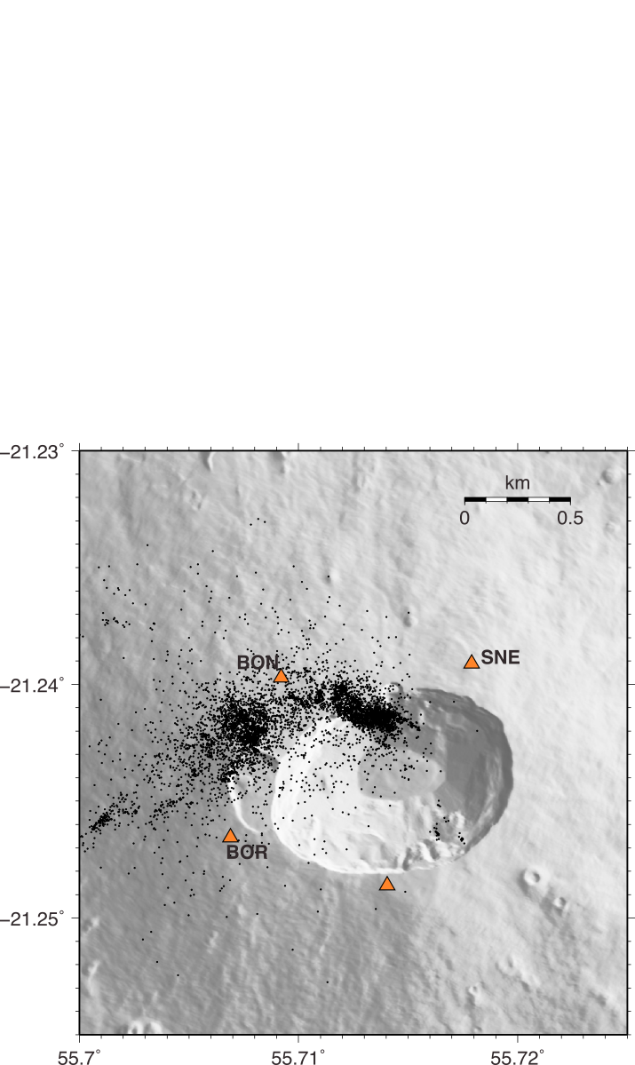
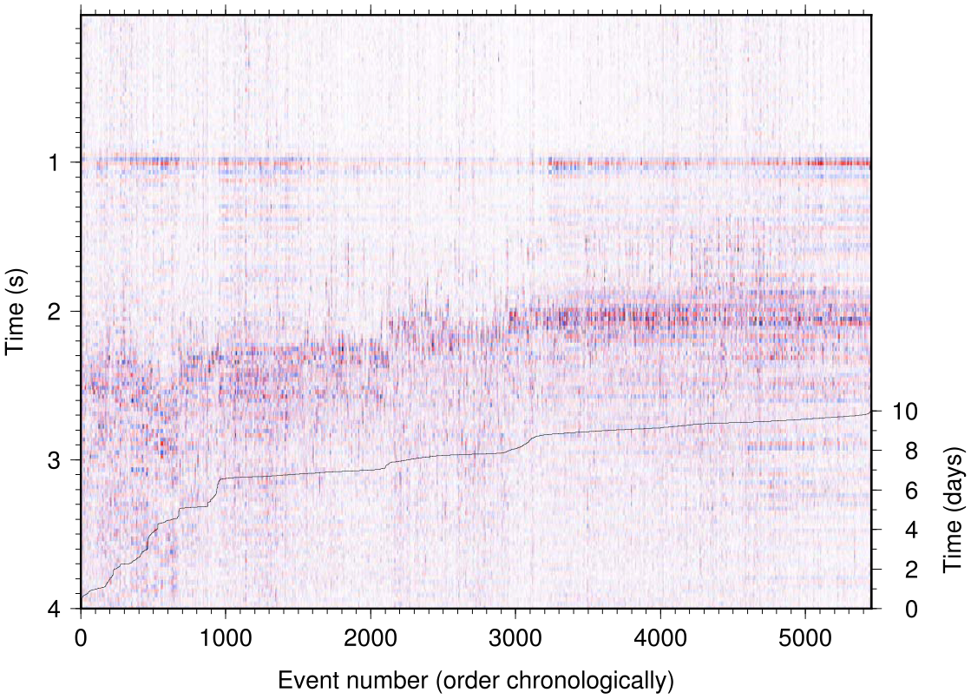
Deep VT Earthquakes - Detections
Detections of deep events
8050 detected events from 73 templates (x100)
S-wave arrival drifting from 1.5s to 1.0s after P-wave
Assuming that P/S-waves travel along the same path
CSS
Vertical records at CSS for detected events between 16 and 25 April 2015
Deep earthquakes (8050 events)
P-wave
S-wave
Event number (ordered chronologically from 16 to 25 April 2015)
Notes:
Let’s focus first on deep earthquakes. Most of these events actually occur before an eruption in 2015.
This figure shows waveforms aligned on P-wave recorded on CSS.
We clearly see that the delay between the S and P wave is reduced as a function of time
If we make a quick back of the envelope calculation with a Vp of 6km and a Vp/Vs ratio of sqrt(3), this suggest that the events moved closet to CSS by about 4km.

Slide 11
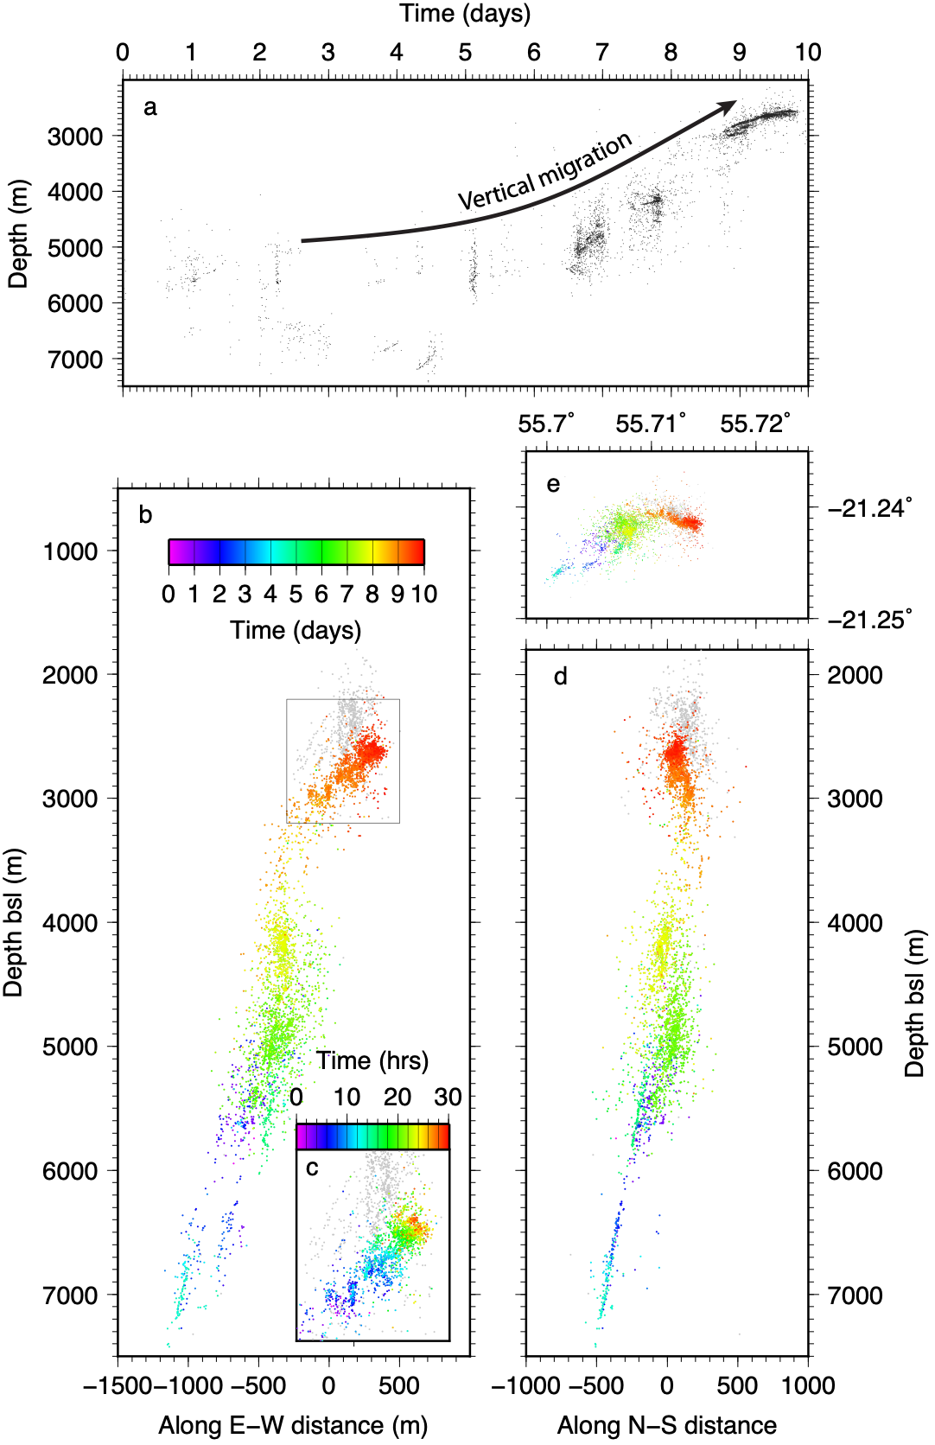
Deep VT Earthquakes - Double-difference relocation
Deep earthquakes (8050 events)
Lengliné et al. (2016)
Notes:
If we do things properly and relocate events by double-difference, this is what we get… And we see a clear vertical migration from 7km toward the free surface.
Colors indicate time over 10 days in April 2015. We can event zoom on a cluster here and see the migration over the course of a few hours.

Slide 12
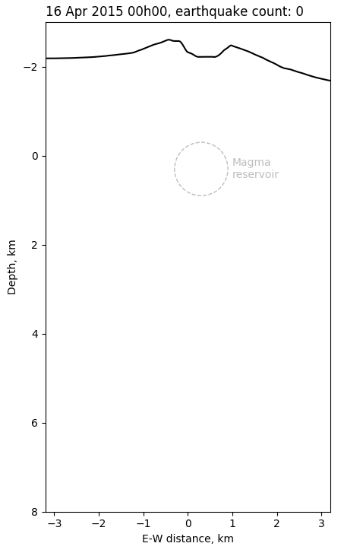
Deep VT Earthquakes - Magmatic recharge (1)
Deep magma transfer evidenced by a large number of upward migrating earthquakes moving toward the shallow reservoir
Deep earthquakes (8050 events)
Lengliné et al. (2016)
Notes:
Such seismicity migration can be interpreted as a deep magmatic recharge of the shallow reservoir that was followed within 20 days by an eruption.

Slide 13
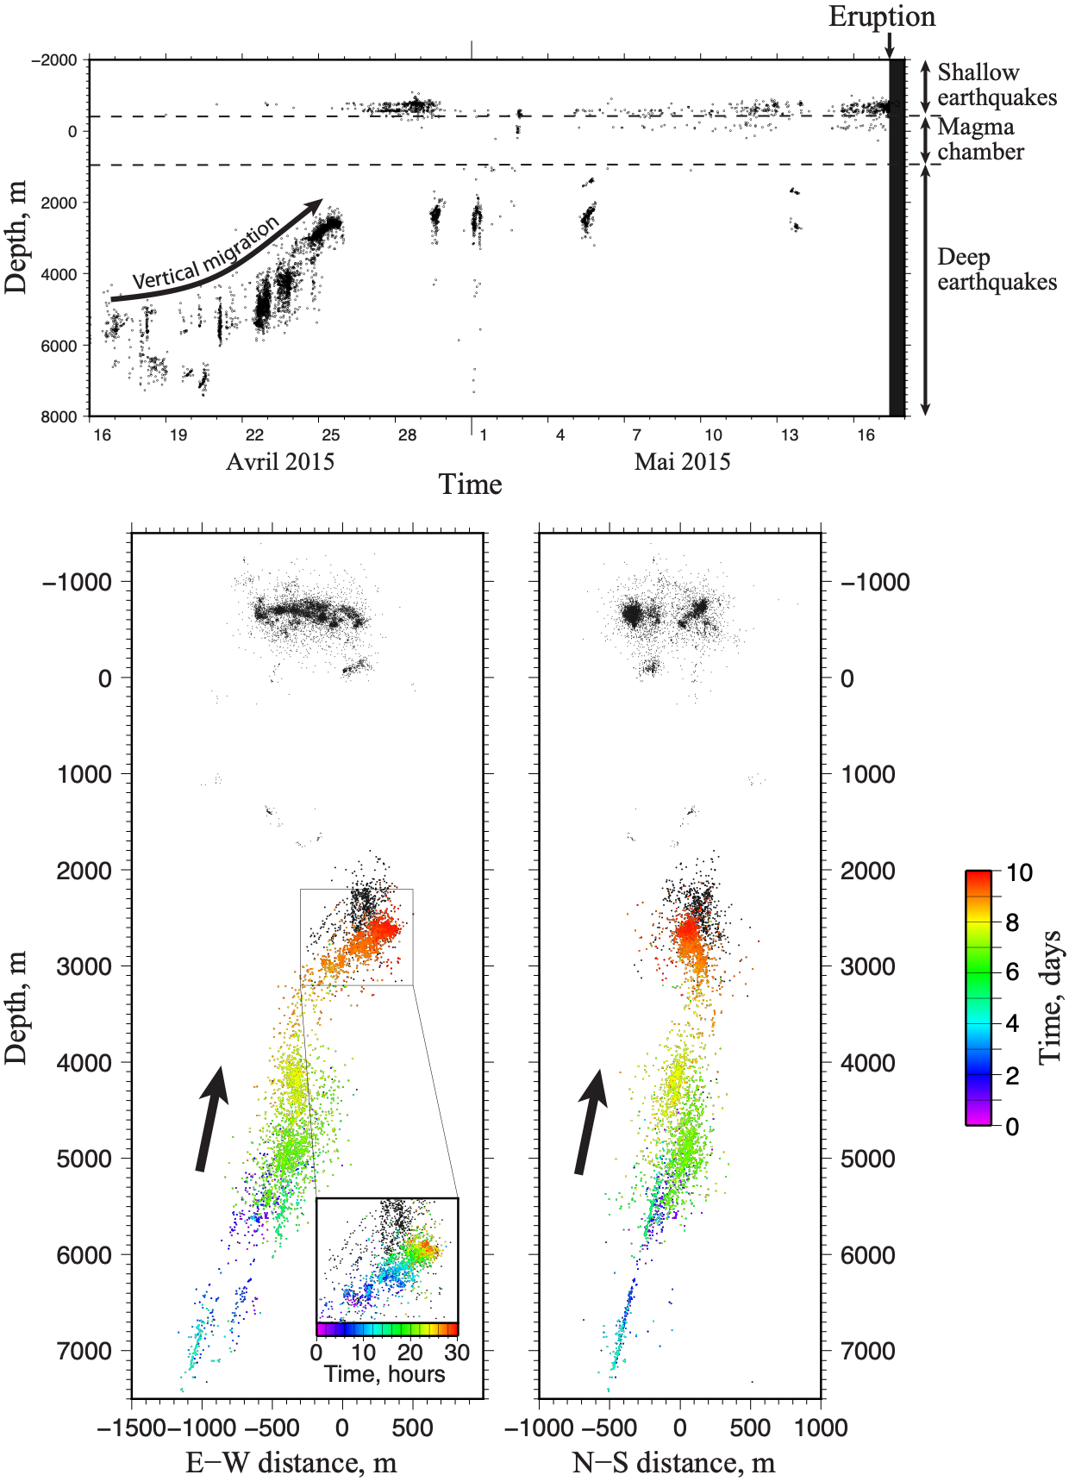
Deep VT Earthquakes - Magmatic recharge (2)
Migration followed by the occurence of shallow events leading to an eruption 20 days later
Creation of an hydraulic connection between lower part of the volcanic system and the shallow reservoir
Explains renewed volcanic activity from 2015
<
Deep magma
recharge
<
Notes:
We can see that immediately after the deep earthquakes have migrated to the shallow reservoir, shallow seismicity starts to pick up leading to an eruption a few days later.
This suggests an hydraulic connection between the lower part of the volcanic system and the shallow reservoir.

Slide 14
Deep VT Earthquakes - Comparison with GNSS data
Point source (Mogi) inversion
(Peltier et al., 2016)
GNSS data also reveals an upward migrating pressure source
April 13 to May 16
3000
2000
1000
N-S distance, m
Depth below summit, m
0
-1000
-2000
-4000
-2000
0
2000
4000
-4000
-2000
0
2000
4000
E-W distance, m
E-W distance, m
June 17 to July 30
3000
<
2000
1000
N-S distance, m
Depth below summit, m
Deep magma
recharge
0
-1000
<
-2000
-4000
-2000
0
2000
4000
-4000
-2000
0
2000
4000
E-W distance, m
E-W distance, m
August 2 to August 23
3000
2000
1000
N-S distance, m
Depth below summit, m
0
-1000
-2000
-4000
-2000
0
2000
4000
-4000
-2000
0
2000
4000
E-W distance, m
E-W distance, m
Notes:
This deep migration of magma is also visible in GNSS data showing an upward migrating pressure source.

Slide 15
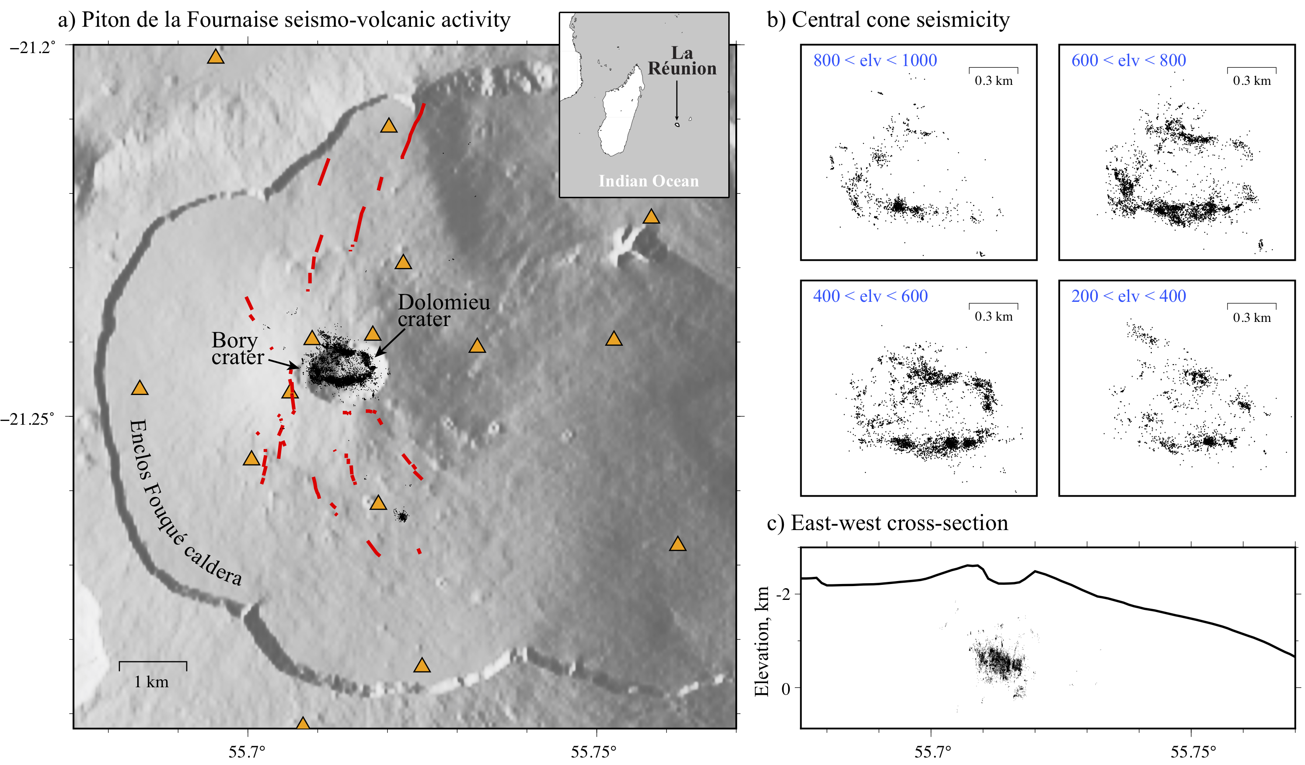
Shallow VT earthquakes between 2014 and 2018
13 pre-eruptive seismic crises, 16250 detected events
Red lines = eruptive fissures. Black dots = detected/relocated events
Duputel et al. (2019)
Notes:
Let’s focus now on shallow seismicity. We have recently analyzed pre-eruptive seismicity for 13 eruptions between 2014 and 2018. This seismicity is really concentrated under the summit caldera, along a ring-structure that is dipping slightly to the East.

Slide 16
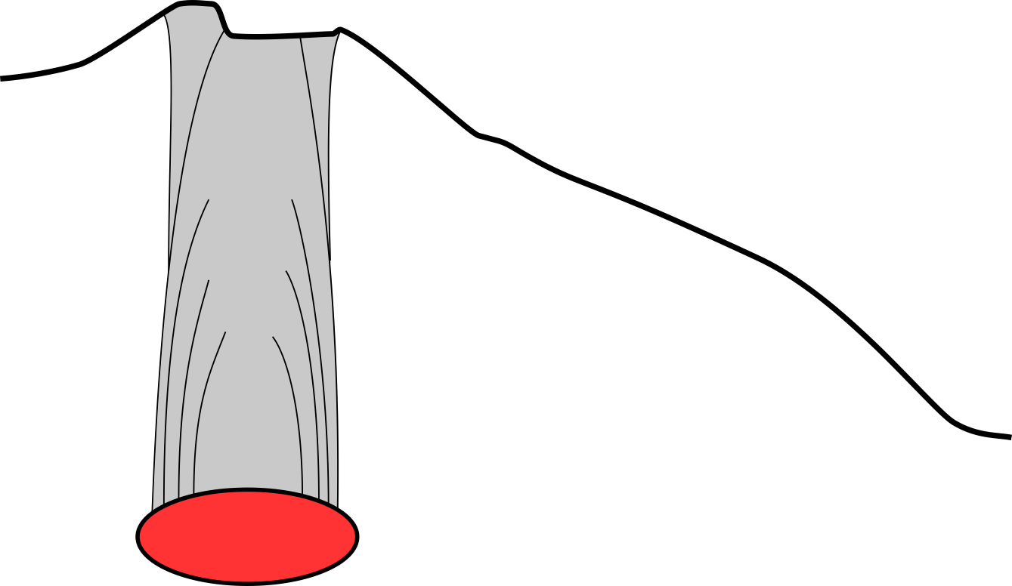
Shallow VT earthquakes between 2014 and 2018
13 pre-eruptive seismic crises, 16250 detected events
Almost all events focus on a ring structure
Ring fault system hosting repetitive collapses of the volcano summit
Secondary alignements might outline secondary faults (e.g., Bory/Dolomieu collapses)
Fractured collapse column
Earthquakes
Magma reservoir around sea level
Duputel et al. (2019)
Notes:
This kind of structure actually corresponds to a ring fault system that is observed frequency on basaltic volcanoes. This kind of ring-structure is inherited from recurrent collapses of the summit caldera. We will talk later about such Collapse that affected the summit in 2007.

Slide 17
Pre-eruptive seismicity between 2014 and 2018 (1/2)
Red = eruptive fissures. Black = pre-eruptive seismicity. Gray = 2014-2018 catalog.
Duputel et al. (2019)
Notes:
Let’s now look what is the distribution of seismicity before each eruption. In each case, the black dots are pre-eruptive earthquakes 24hours before the eruption and the red lines are eruptive fissures … that is where the magma comes out during eruption. Each subfigure is for given eruption between 2014 and 2018… We can see that there is a good correlation between the location of earthquakes and the azimuth of the eruptive fissures relative to the summit.

Slide 18
Pre-eruptive seismicity between 2014 and 2018 (2/2)
Red = eruptive fissures. Black = pre-eruptive seismicity. Gray = 2014-2018 catalog.
Duputel et al. (2019)
Notes:
When earthquakes are located to the north, the eruption is located to the north of the summit, when the earthquakes are to the south, the eruptions occurs south of the summit caldera.

Slide 19
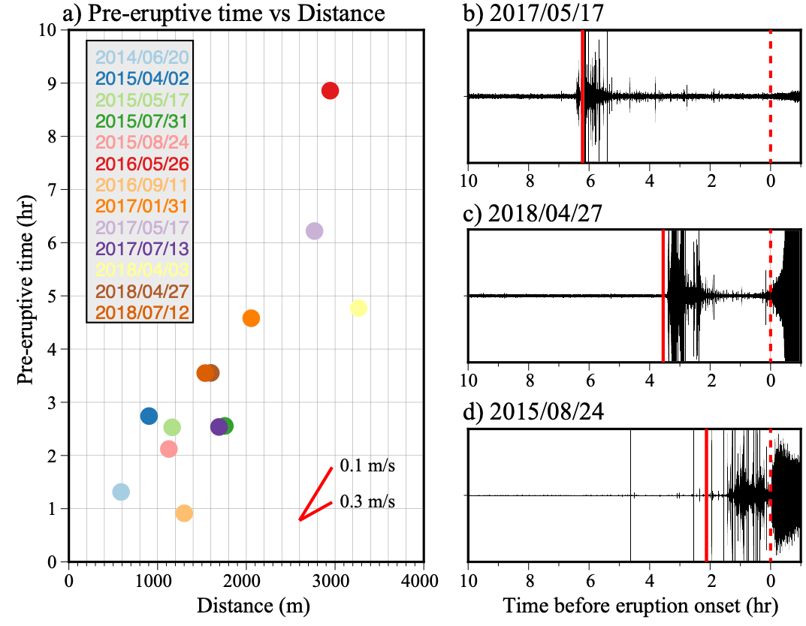
Pre-eruptive seismicity between 2014 and 2018
Correlation between earthquake locations and the azimuth of eruption sites Delay between the seismic crisis and the eruption onset correlates with the distance of the eruption site to the magma chamber (v ~ 0.1 m/s)
Duputel et al. (2019)
Notes:
To investigate how this pre-eruptive seismicity is connected to the magma transport, we also measured the delay between the beginning of the seismic crisis (when the seismicity rates increases strongly (>150eq/hour)) and the onset of the eruption. We see that there is a good correlation between the duration of the seismic crisis and the distance between the eruptive site and the summit, corresponding to a migration velocity of the order of 0.1 m/s.
At a given time after the onset of the seismic crisis, we can then predict in what direction the magma is propagating and what is the minimum distance between the dike and the central cone.

Slide 20
Seismicity before the eruption on 2018/04/27
Pre-eruptive migration of seismicity (v ~ 0.1-0.3 m/s)
East-west cross-section
Duputel et al. (2019)
Notes:
Another interesting aspect is that for each eruption we can clearly track how seismicity migrates along the structure, with a migration speed similar to what I showed just before.
This suggest
first a vertical migration of seismicity along the ring-structure below the summit
In some cases, we often detect small earthquakes between between the summit and the eruption site suggesting a lateral migration just before eruption.
Une autre chose intéressante: pour chaque éruption on voit également clairement une migration de la sismicité.
Migration d’abord vers l’ouest qui correspond également a une migration verticale liée au fait que la structure soit penchée vers l’EST.
Dans certains cas, on détecte des évènements entre cet essaim central et le dike, suggérant une migration latérale

Slide 21
Shallow magma transport at Piton de la Fournaise
Blade-like dike intrusions propagating vertically from the roof of the magma reservoir triggering earthquakes on nearby faults.
Dikes then propagate laterally in a direction mostly controlled by their location relative to the summit (due to stress field caused by topography) and the existence of preferential paths.
This injection process is consistent with geodetic observations showing two phases of dike propagation: a vertical migration followed by a lateral propagation (e.g., Peltier et al., 2005)
2. Lateral dike propagation
1. Vertical injection
Notes:
This suggests that shallow magma transport is done in two steps:
A first vertical migration along the ring-fault structure
A lateral propagation from the summit to the free surface
This two-step process is also consistent with geodetic observations showing a similar behavior

Slide 22
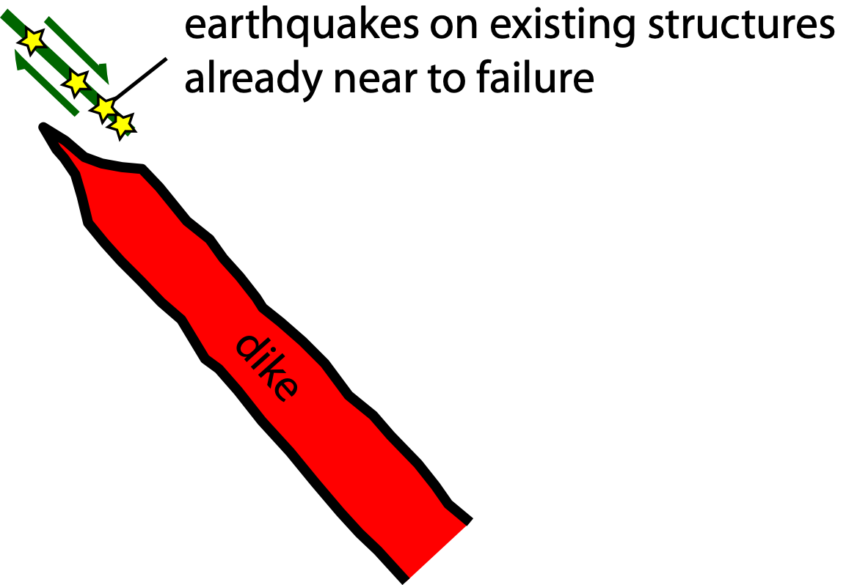
Conclusion
Quasi real-time implementation at OVPF
Dike-induced VT seismicity
Automatic analysis of the last 24h
Implemented since 2016
Marker of magma pathway ?
Dynamics ?
Thanks to all the OVPF staff for data acquisition and maintenance
Notes:
Before conclusion
Something I didn’t have time to mention is the occurrence of VLP precursors that have been observed several hours before the first collapse
These events show a duration that is quite longer than the main collapse potentially reflecting a different source mechanism or the fact that most of the piston remained locked during the early stage of the sequence
However these events are interesting as they suggest that the collapse initiated at depth before the occurrence of repeating collapse activity visible at the surface

Slide 23
Thank you for your attention

Slide 24
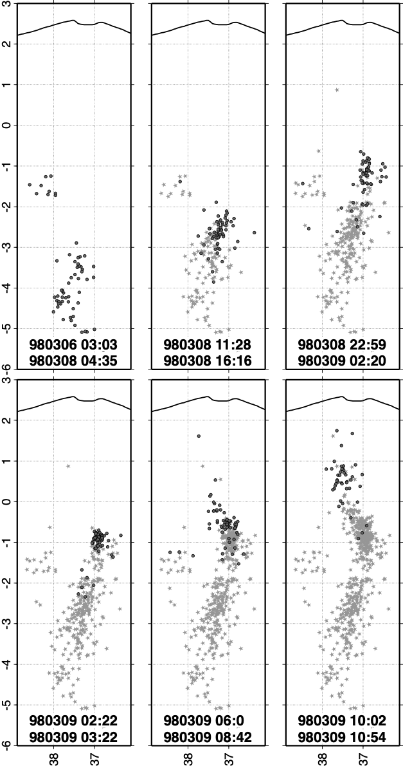
Deep VT Earthquakes - 1998 pre-eruptive migration
March 1998 seismicity migration
Similar deep seismicity migration observed in 1998
The 1998 migration also occurred after a period of quiescence (5 years)
<
Deep magma
recharge
<
Battaglia et al. (2005)
Notes:
Ce type de migration profonde est relativement peu fréquente mais a déjà été observé une fois en 1998. Cette migration a également fait suite à une phase d’inactivité du volcan et a été suivie par une reprise de l’activité volcanique jusqu’en 2010.

Slide 25
Relocated earthquakes
Secondary alignements might outline secondary faults (e.g., Bory/Dolomieu collapses)
Notes:
On voit des alignements secondaires qui pourraient correspondent a des failles secondaires peut être hérités d’effondrements différentiels entre le cratère Dolomieu et le Bory

Slide 26
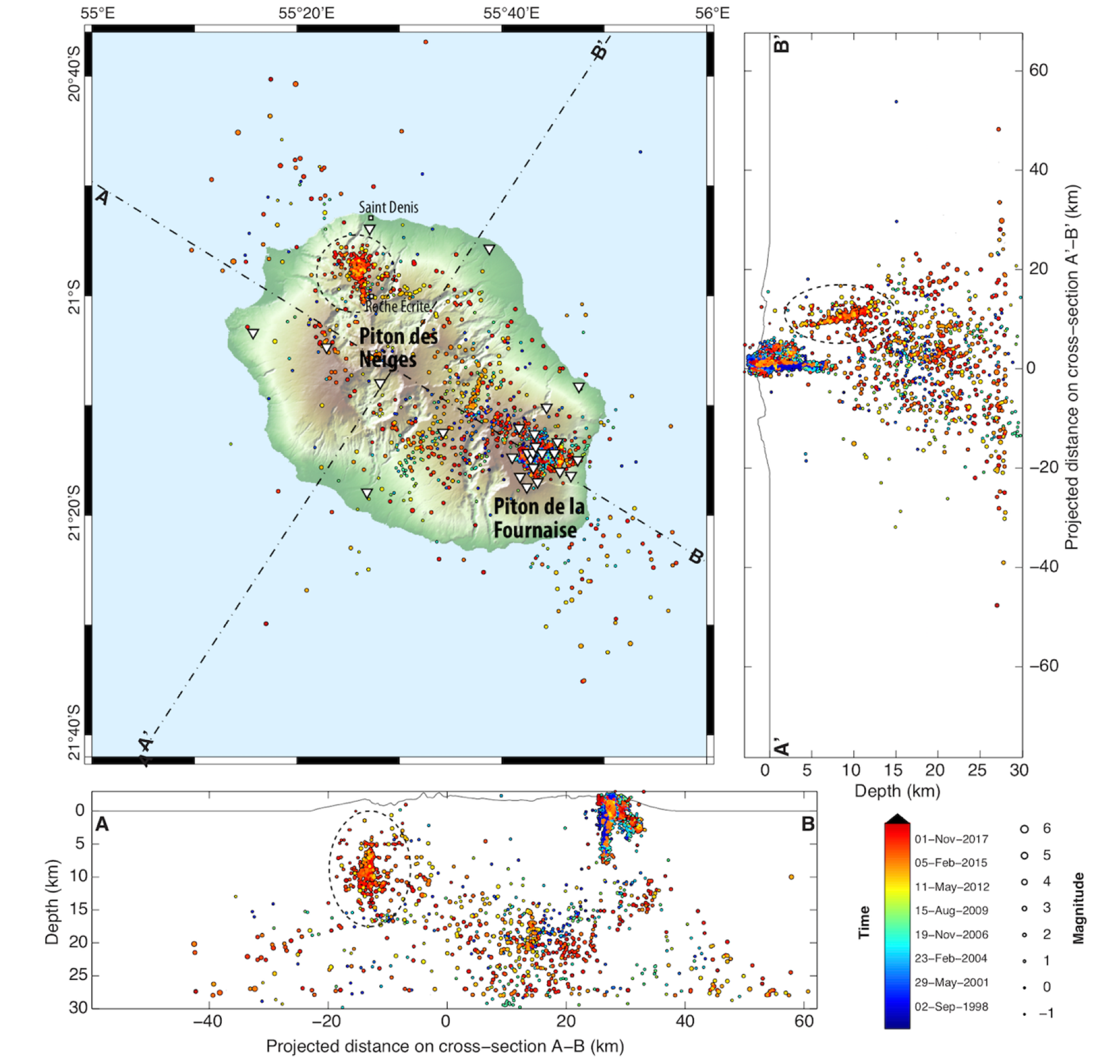
La Réunion Island - VT Seismicity
Notes:
Before conclusion
Something I didn’t have time to mention is the occurrence of VLP precursors that have been observed several hours before the first collapse
These events show a duration that is quite longer than the main collapse potentially reflecting a different source mechanism or the fact that most of the piston remained locked during the early stage of the sequence
However these events are interesting as they suggest that the collapse initiated at depth before the occurrence of repeating collapse activity visible at the surface

Slide 27
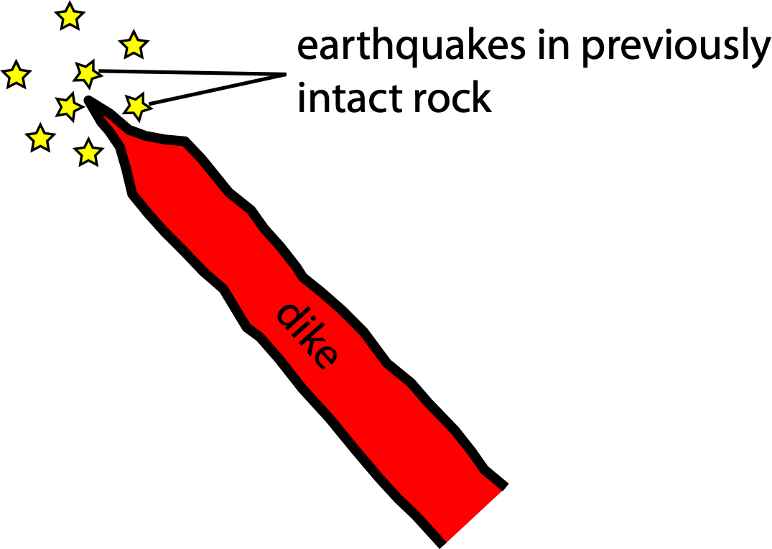
Link between detected VT earthquakes and magma transport?
Notes:
Pour en revenir à la question du lien entre séismes VT et le transport magmatique. Encore une fois il n’y a pas vraiment de question sur le fait que les séismes sont déclenchés par la perturbation de contrainte associée au transport magmatique. En revanche, nos observations suggèrent que la plupart des séismes ne correspondent pas réellement a la rupture de roches précédemment intact. On voit que 90% de la sismicité se concentre sur la même structure.

Slide 28
Most dike-induced seismicity triggered on existing structures already near to failure
Rubin and Gillard (1998)
Notes:
On est vraissemblablement beaucoup plus dans une situation telle que schématisée ici. C’est à dire des séismes déclenchés à l’extrémité du dike mais sur des structures faibles et proches de la rupture.
Cohérent avec les études théoriques qui montrent que les séismes détectables pour des intrusions basaltiques vont majoritairement correspondre à ce type de schéma. Les fractures en tête de dike étant associée à de très faibles magnitudes.

Slide 29
Template matching & Double-difference relocation
Time-Window | Duration = 5.12sec Start = 1sec before the P-wave
Detection threshold | Correlation threshold for detection = 0.45 Correlation threshold for relocation = 0.7
Relocation | Delay measured in 1.28sec windows around P&S Cauchy prior with σ=0.1sec around picked times
Event numbers | 16246 shallow event detection 15598 shallow event relocations 8011 deep event detections 7857 deep event relocations
Notes:
Additional slide: Some relevant parameters
Dimension and density of the collapsing piston
Size of the reservoir
Elastic parameters to estimate Downward displacement from MT/Force
Some equations/values to estimate lava outflow rate

