Slide 1
MachineLearning and Distributed Acoustic Sensing: A case study
18 November 2021

Slide 2
General principle of Distributed FO Sensing

Slide 3
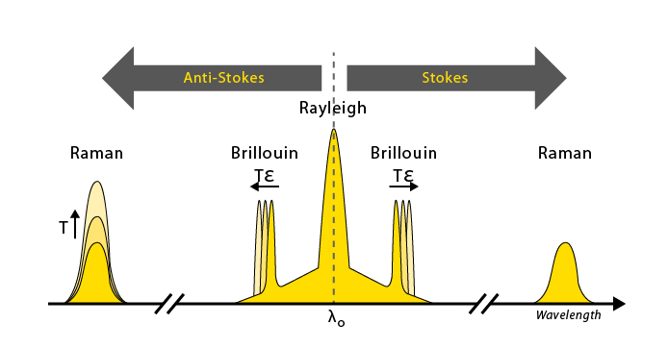
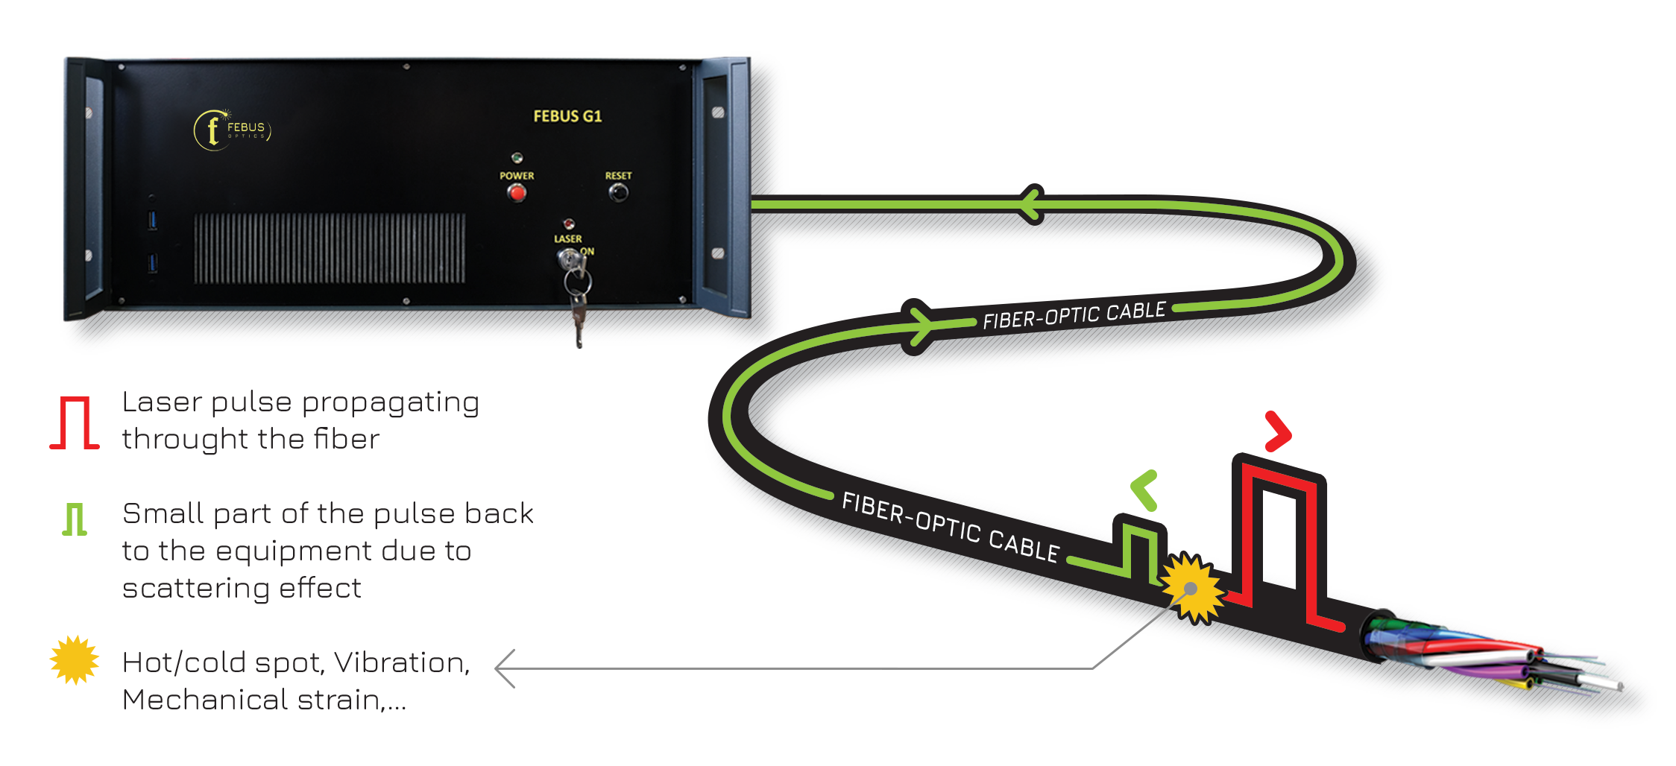
General principle of fiber optic distributed sensing
DTS DSS DAS
DTS: Distributed Temperature Sensing
DSS: Distributed Strain Sensing
DAS: Distributed Acoustic Sensing
A pulse of light is sent through the fiber
Back-scattering effect occurs continuously everywhere along the fiber
The backscattering light contains information from where it was generated
Operation is repeated to increase S/N (DTS, DTSS) or access the dynamic (DAS)

Slide 4
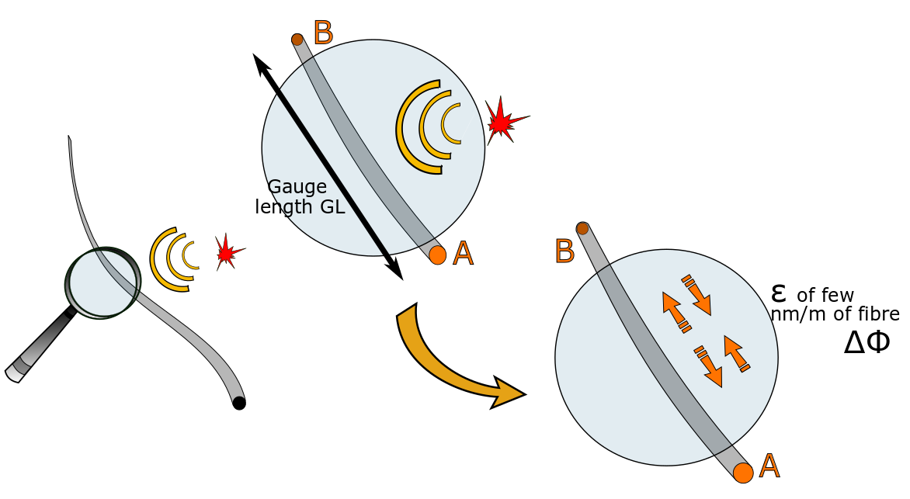
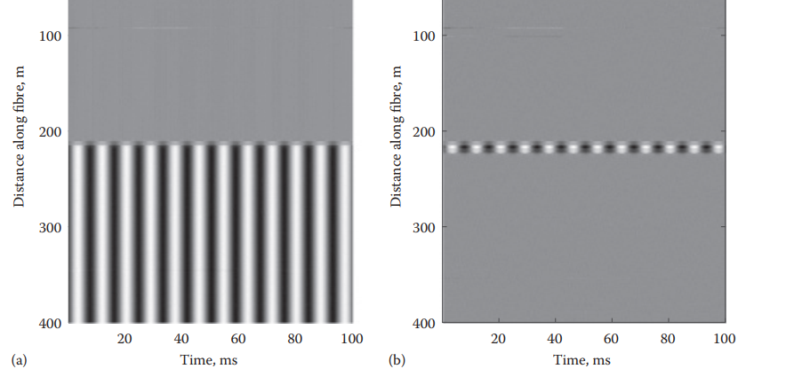
From optic to acoustic
df-OTDR - Phase-based DAS and Gauge length
Information of longitudinal strain applied on the optical fiber is contained on the phase of the optical pulse travelling to it
Scattering has a fixed phase relation to the incident light
$$ε= \frac{λ .Δφ}{4πnGLξ}$$
$$φ_{B}$$
$$Δφ=φ_{B}−φ_{A}$$
Without differenciation
With differenciation
$$∝$$
Pulse propagating
$$φ_{A}$$
-> Need direct access to the phase of the pulse
-> Need to differentiate the phase of the light through the gauge length

Slide 5
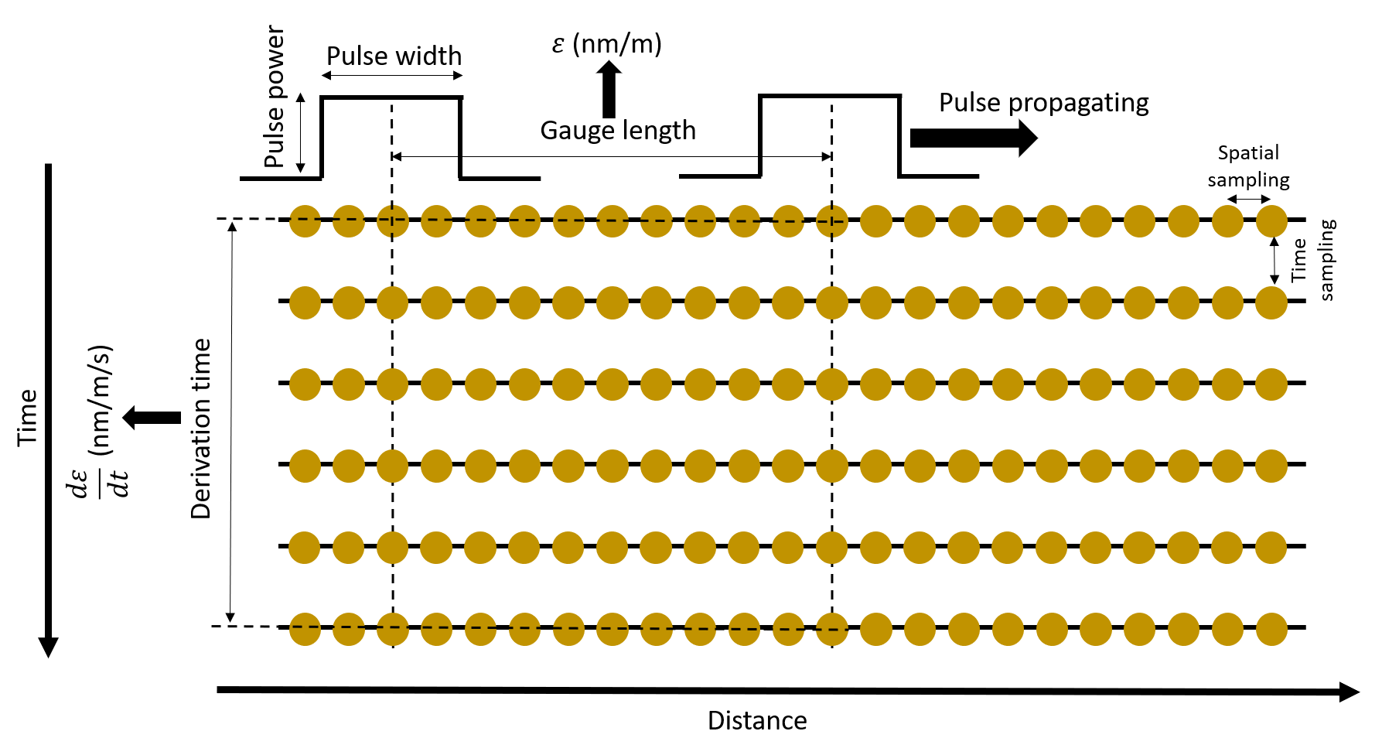
δφ-OTDR - Phase-based DAS
Acquisition parameters
$$ε= \frac{λ .Δφ}{4πnGLξ}$$
A.H. Hartog, An Introduction to Distributed Optical Fibre Sensors, CRC Press, 2017
Parameters to adjust :
Fiber distance
Optical power
Pulse width
Pulse rate frequency
Spatial sampling resolution
Gauge length
Derivation time (if strain-rate)

Slide 6
Context

Slide 7
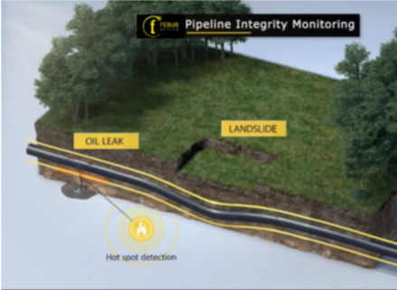
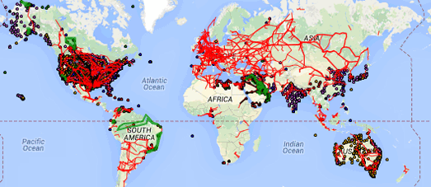
Pipeline Monitoring
Risk identification:
Leaks,
Natural hazards,
Anthropogenic hazards,
Intrusion

Slide 8
Pipeline Monitoring
Challenges:
Use of DAS for risk identification.
Handle the large amounts of data generated by DAS acquisitions.
Release an accurate alert if necessary.
Solution:
Use of Machine Learning techniques for event classification.

Slide 9
The algorithm

Slide 10
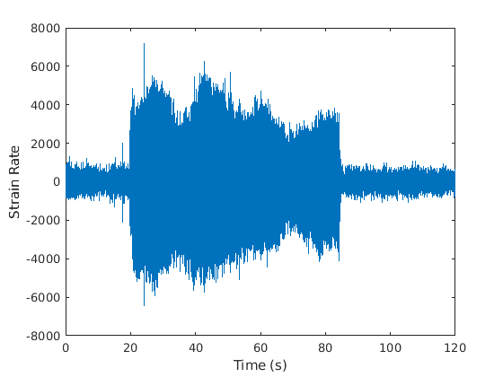
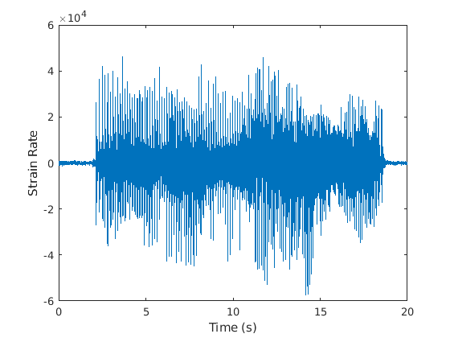
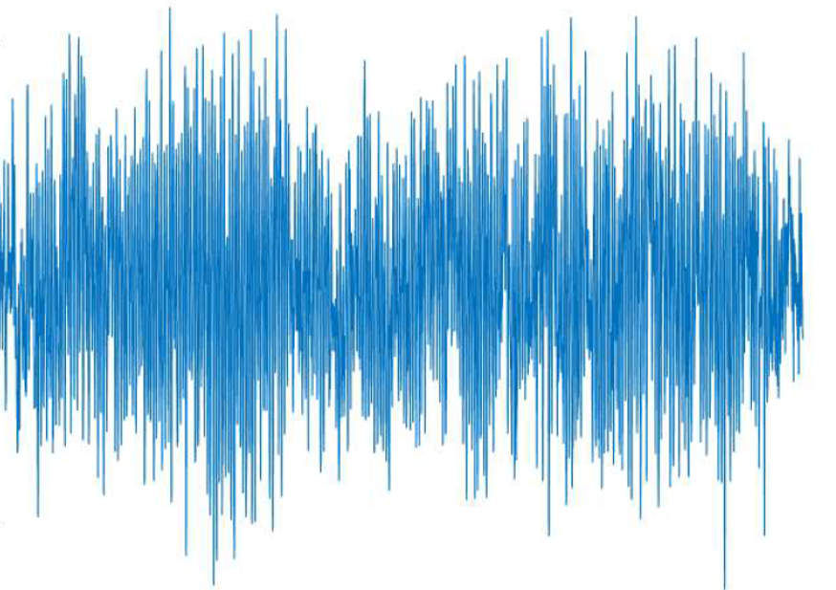
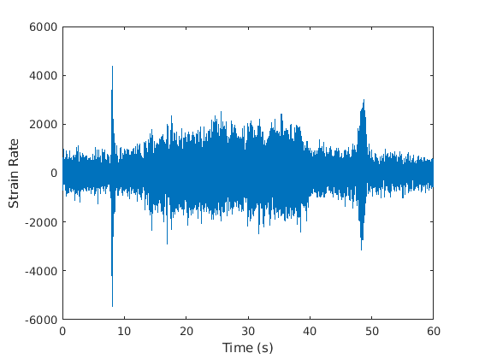
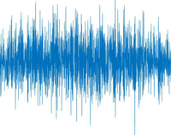
The Random Forest algorithm
A supervised Machine Learning algorithm developed by Breiman in 2001
Proved its interest in seismology for classification of environmental sources, tectonic events or nuclear explosions
Use of a large number of decision trees constituing a forest.
Random Forest algorithm
Tree n
Tree 2
…
Training set:
Class determination
Discriminating attributes:
Duration
skewness
f_{max}
Kurtosis
Spectral properties
50+ features
Tree 1
4
1
5
Decision = Classification
2
1
6
3
7

Slide 11
The Processing chain
Signal event
Database
(Sub-Samples)
Training chain
Machine Learning
with Random
Forest algorithm
Alert release if
Identified danger
Signal event
Database
Signals
Classification
Database
4
Class 1
1
5
2
Class 2
6
3
…
7

Slide 12
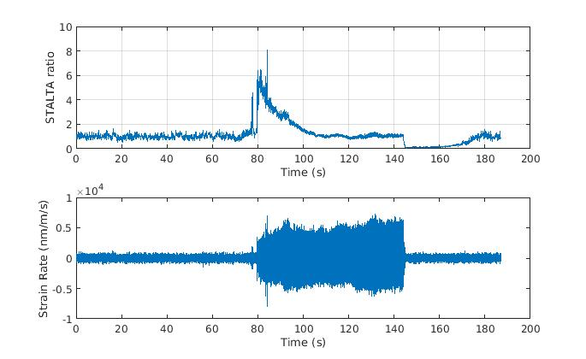
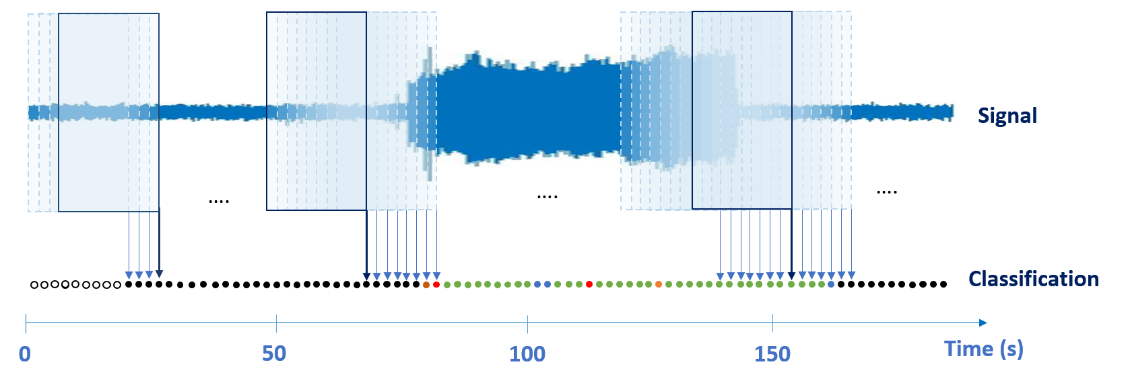
Implementation of the algorithm for real time monitoring
For now, the used approach was a succession of signal detection and classification.
Our approach is based on an analysis and classification in flow with a fixed time window.
Addition of a new class: the ambient noise.
STA/LTA detection approach
Flow approach
LTA
STA

Slide 13
The event catalogues

Slide 14
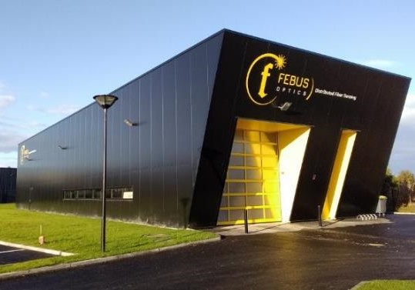
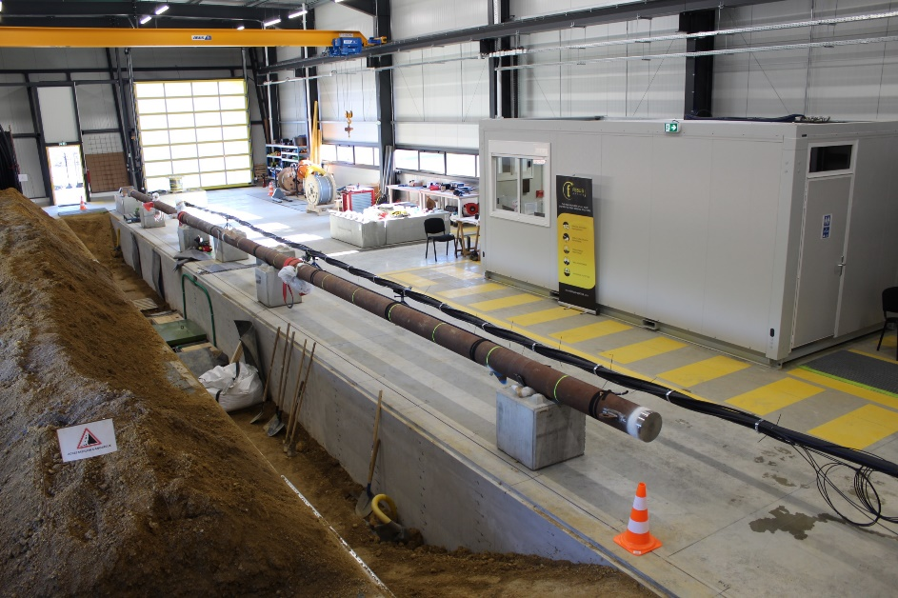
The event catalogues
FEBUS Optics’s test Center
Located in Pau, South-West of France.
State-of-the-art test center to simulate site conditions.
Designed to qualify Distributed Fibre Sensing in various conditions.
Numerous applications can be tested:
Pipeline leak detection of both gas and liquid with pressure up to 50 bars: 3 different sizes, positions and orientations of leaks
Third party intrusion
Ground movement/landslides
PIDS
Cable/umbilical monitoring
And more on demand

Slide 15
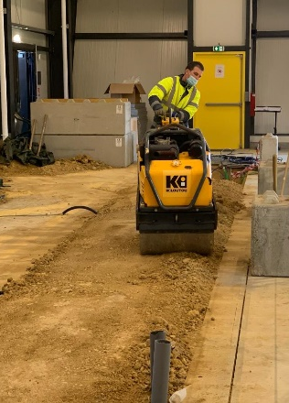
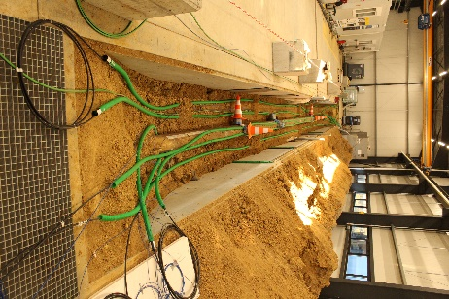
The event catalogues
Various fibre-optic cables: Single-Mode, Multi-Mode fibres in tight or loose tube, directly buried in the ground or inside conduits and at various distances from a buried pipe.
Different events: falling objects, compactor, foot steps, vehicles.
Events recorded with FEBUS A1-R DAS system.
Class | Number of windows
Ambient noise | 388625
Falling objects | 55425
Compactor | 179600
Vehicle | 117680
Pedestrian | 73325

Slide 16
Results of classification

Slide 17
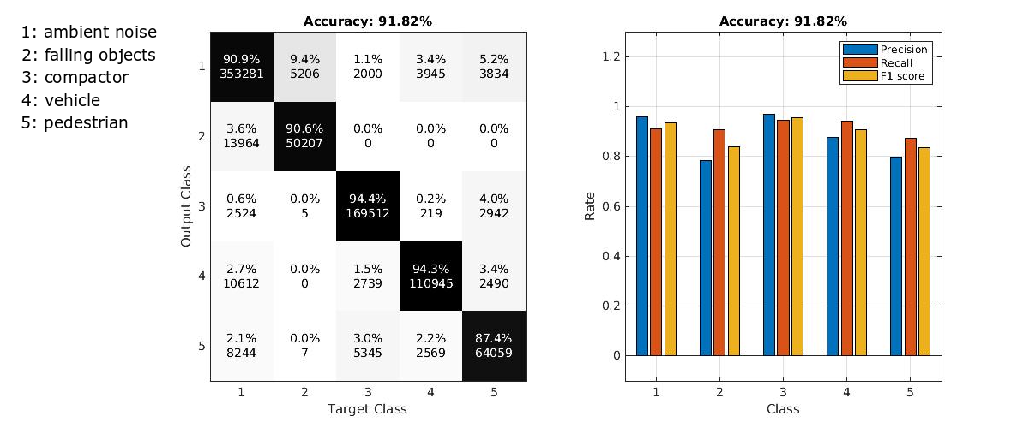
Results of classification
Class | Number of windows
Ambient noise | 388625
Falling objects | 55425
Compactor | 179600
Vehicle | 117680
Pedestrian | 73325

Slide 18
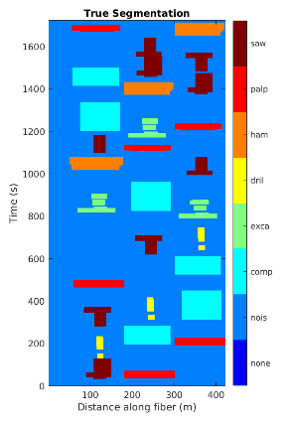
Results of classification
Real time classification

Slide 19
Conclusions

Slide 20
Conclusions
We demonstrated in this work the ability of the Random Forests algorithm, a supervised Machine Learning algorithm, for the classification of event recorded with DAS system.
The training dataset, well labelled and equilibrated, appears of a large importance to obtain the best quality of event identification.
Other tests are planned to be conducted in order to grow the training dataset with a large variety of sources such as leaks or landslides. This will enable to experience, test the limits, and improve the efficiency of our classification algorithm.

Slide 22
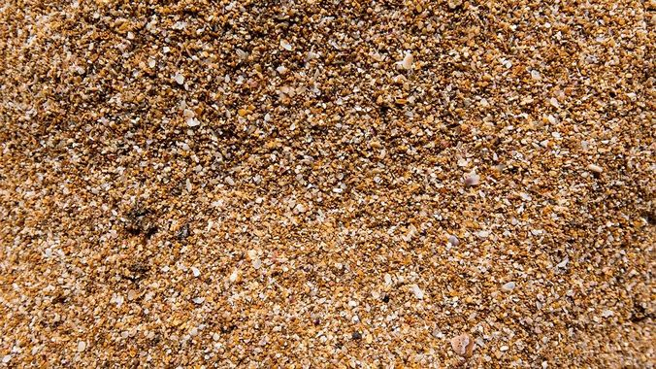
Scattering mechanisms
glass scattering structures
Waves
moving
with wind
Individual
Grains of sand
moving
with wind
‘Frozen’
waves
Static glass inhomogeneities
Inter-molecular vibrations
Propagating wave
ν_{vib} in the GHz frequency range
frequency depends on temperature and strain
Intra-molecular bond vibrations
ν_{vib} in the THz frequency range
amplitude of vibrations depends on T
Rayleigh scattering
Brillouin scattering
Raman scattering

Slide 23
Scattering mechanisms
Summary table
 | Temperature | Strain (static or slow) | Acoustic | Optical measurement
Raman |  |  |  | Intensity ratio
Brillouin |  |  |  | Frequency shift
Rayleigh |  |  |  | Phase shift
( )
( )

