Slide 1
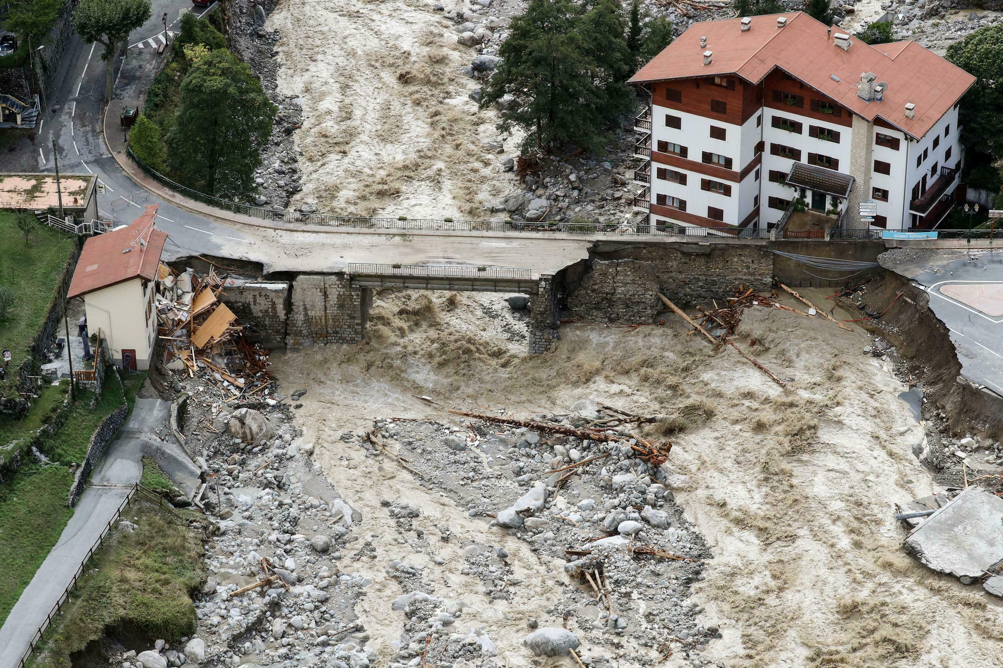
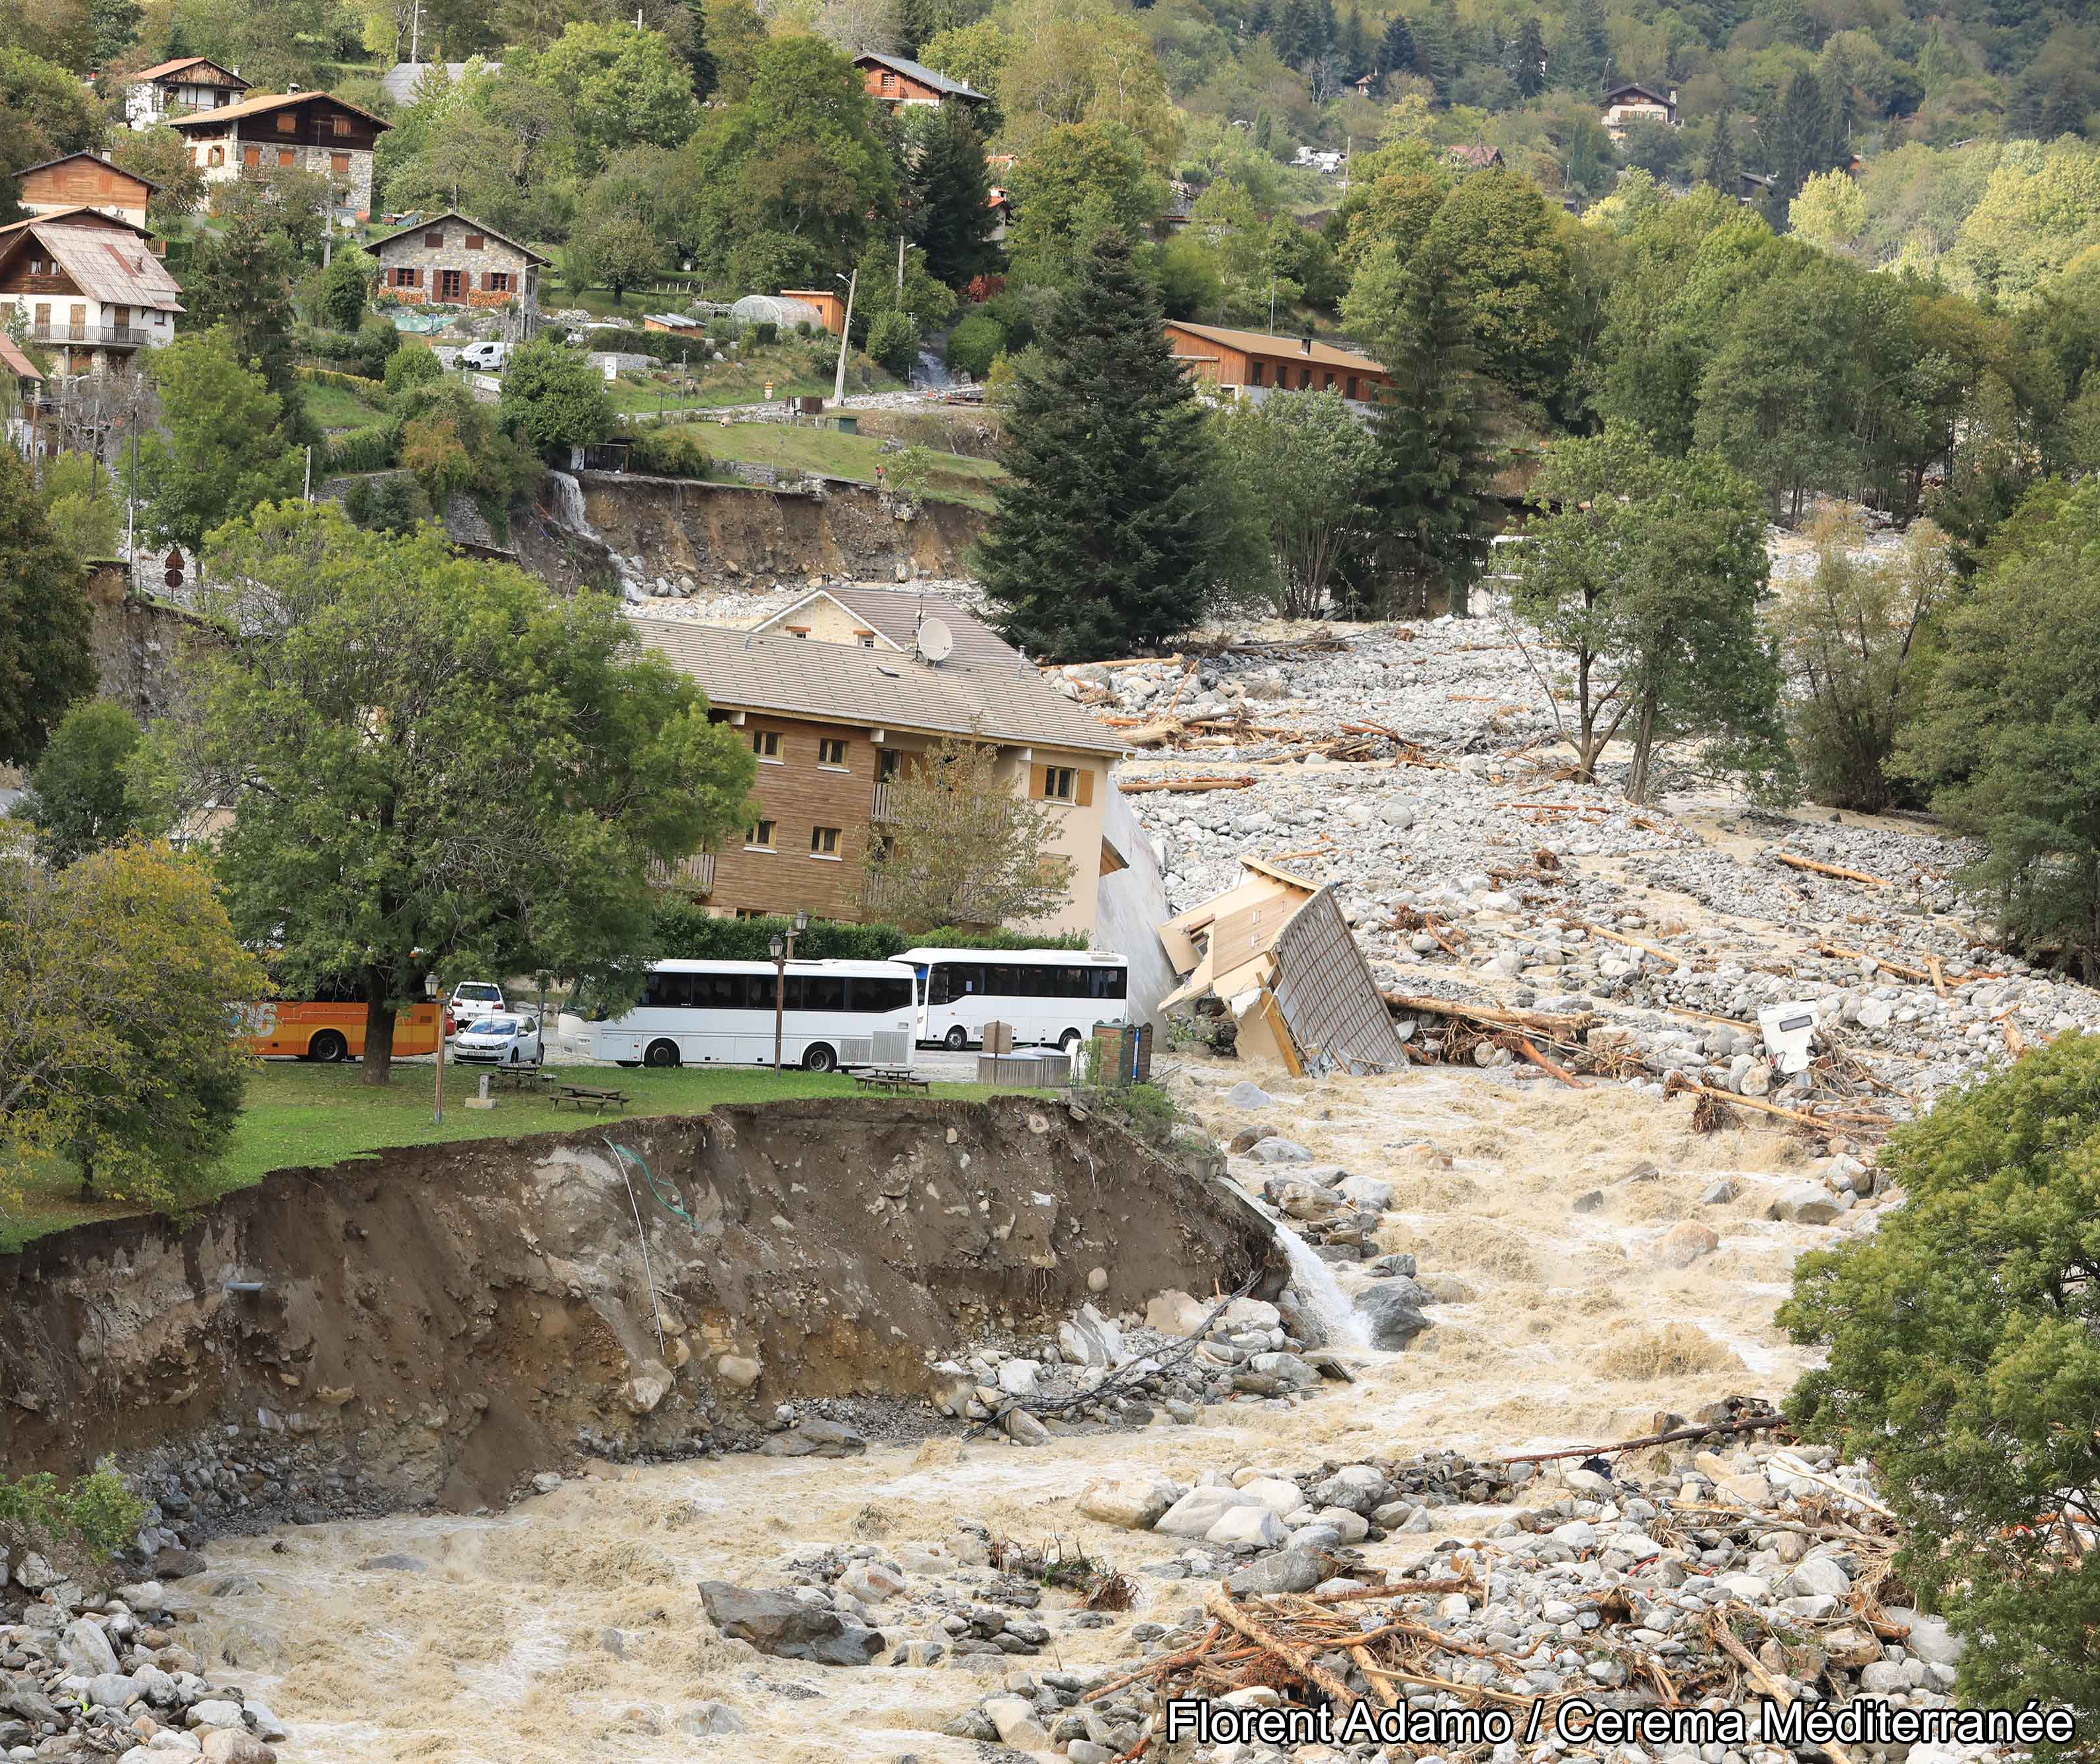









Seismological analysis of flood dynamics and hydrologically-triggered earthquake swarms associated with storm Alex
Małgorzata Chmiel, M. Godano, M. Piantini, M. Bakker, F. Gimbert, J.-P. Ampuero, P. Brigode, A. Sladen, D. Rivet, D. Ambrois, M. Chapuis
Rencontres scientifiques et techniques RESIF, 17/11/2021
Notes:
The torrential rains triggered hazardous flash floods and landslides of an intensity and spatial extent that have never been observed yet in this area, causing several casualties as well as large infrastructure and economic damage [Figure 1A,B1, 60 Brigode et al. (2021b)].
On October 2, 2020, the Maritime Alps in southern France were struck by the devastating storm Alex that caused locally >600 mm of rain in less than 24 h
Analyse sismologique de la dynamique des crues et des essaims de séismes déclenchés par l'hydrologie associés à la tempête Alex
Les pluies torrentielles ont déclenché des crues soudaines et des glissements de terrain dangereux d'une intensité et d'une étendue spatiale qui n'ont encore jamais été observées dans cette zone, causant plusieurs victimes ainsi que d'importantes infrastructures et des dommages économiques [Figure 1A,B1, 60 Brigode et al. (2021b)].
Le 2 octobre 2020, les Alpes Maritimes du sud de la France ont été frappées par la tempête dévastatrice Alex qui a provoqué localement >600 mm de pluie en moins de 24 h

Slide 2
Notes:
The torrential rains triggered hazardous flash floods and landslides of an intensity and spatial extent that have never been observed yet in this area, causing several casualties as well as large infrastructure and economic damage [Figure 1A,B1, 60 Brigode et al. (2021b)].
On October 2, 2020, the Maritime Alps in southern France were struck by the devastating storm Alex that caused locally >600 mm of rain in less than 24 h
Analyse sismologique de la dynamique des crues et des essaims de séismes déclenchés par l'hydrologie associés à la tempête Alex
Les pluies torrentielles ont déclenché des crues soudaines et des glissements de terrain dangereux d'une intensité et d'une étendue spatiale qui n'ont encore jamais été observées dans cette zone, causant plusieurs victimes ainsi que d'importantes infrastructures et des dommages économiques [Figure 1A,B1, 60 Brigode et al. (2021b)].
Le 2 octobre 2020, les Alpes Maritimes du sud de la France ont été frappées par la tempête dévastatrice Alex qui a provoqué localement >600 mm de pluie en moins de 24 h

Slide 3
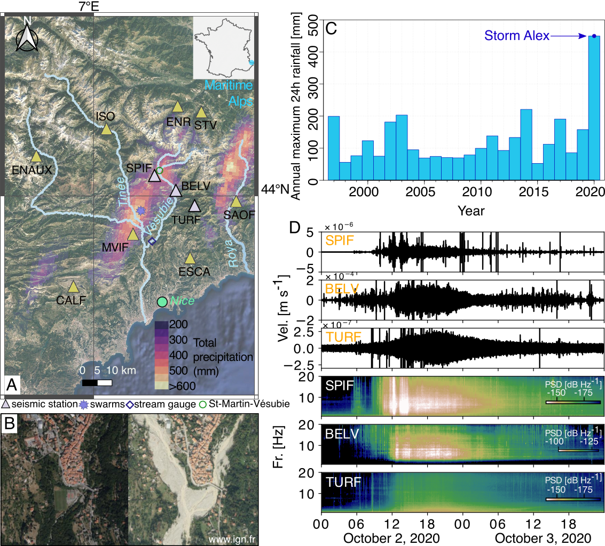
Storm Alex: a very destructive “Mediterranean episode”
On October 2, 2020, the southern Alps were struck by a heavy precipitation event caused by Storm Alex
Notes:
Heavy rainfalls occur regularly in autumn in the Mediterranean region, but the measured maximum daily rainfall caused by storm Alex was the highest since 1997 (Figure 1C). The rainfall started at 06:00 2 UTC on October 2, 2020. The Mediterranean episode lasted for less than 24 hours and generated cumulative daily rainfall that locally exceeded typical yearly average (>600 mm/day, Figure 1A), according to a rainfall estimation obtained with the ANTILOPE model (Laurantin, 2008).
To date, the spatial and temporal evolution of the flood remain poorly understood. This is partially due to a limited number of observations caused by the instrument destruction during the flood
. The extreme rainfall and flooding destroyed regional rain and stream gauges, hindering our understanding of the spatial and temporal dynamics of rainfall-runoff processes during the episode.
Both turbulent flow and sediment transport during floods generate ground motion in different frequency bands that can be used to track the flood dynamics.
Moderate-magnitude floods and controlled small-magnitude flow events. To date, extensive seismic investigations of large-magnitude flood events are rare and mostly associated with glacier lake outburst floods or cascade of hazards (Detection and potential early warning of catastrophic flow events with regional seismic networks)
fatal rockslide to mass flow to flood cascade
De fortes précipitations se produisent régulièrement en automne dans la région méditerranéenne, mais les précipitations quotidiennes maximales mesurées causées par la tempête Alex étaient les plus élevées depuis 1997 (Figure 1C). Les précipitations ont commencé à 06h00 2 UTC le 2 octobre 2020. L'épisode méditerranéen a duré moins de 24 heures et a généré des précipitations quotidiennes cumulées qui ont localement dépassé la moyenne annuelle typique (>600 mm/jour, Figure 1A), selon une pluviométrie estimation obtenue avec le modèle ANTILOPE (Laurantin, 2008).
A ce jour, l'évolution spatiale et temporelle de la crue reste mal connue. Ceci est en partie dû à un nombre limité d'observations causées par la destruction de l'instrument lors de la crue
. Les précipitations extrêmes et les inondations ont détruit les pluviomètres régionaux et les pluviomètres, empêchant notre compréhension de la dynamique spatiale et temporelle des processus pluie-débit au cours de l'épisode.
L'écoulement turbulent et le transport de sédiments pendant les crues génèrent des mouvements du sol dans différentes bandes de fréquences qui peuvent être utilisées pour suivre la dynamique des crues.
Crues de magnitude modérée et événements de débit contrôlé de faible magnitude. À ce jour, les études sismiques approfondies des événements de crue de grande magnitude sont rares et principalement associées à des crues de lac glaciaire ou à une cascade d'aléas (détection et alerte précoce potentielle d'événements de flux catastrophiques avec des réseaux sismiques régionaux)
éboulement fatal au débit de masse à la cascade d'inondation
Pluviomütresm jauge de flux

Slide 4
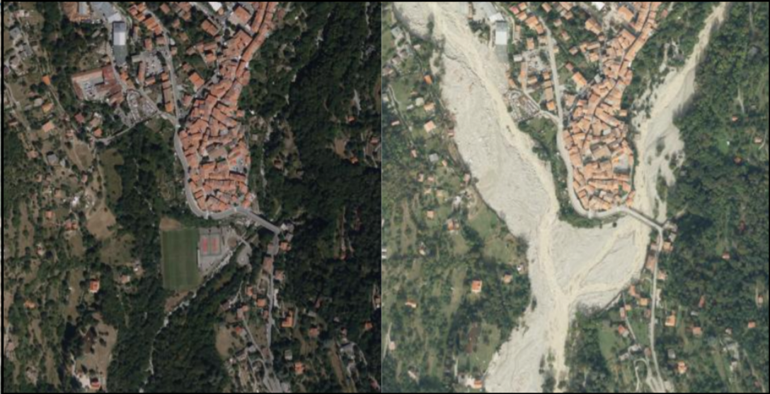
Storm Alex: a very destructive “Mediterranean episode”
On October 2, 2020, the southern Alps were struck by a heavy precipitation event caused by Storm Alex
Saint-Martin Vésubie
before
after
Limited hydrological observations
But! Both turbulent flow and sediment transport during floods generate ground motion
(Schmandt et al., 2013; Gimbert et al., 2014; Burtin et al., 2016; Cook et al., 2018).
www.ign.fr
Notes:
Heavy rainfalls occur regularly in autumn in the Mediterranean region, but the measured maximum daily rainfall caused by storm Alex was the highest since 1997 (Figure 1C). The rainfall started at 06:00 2 UTC on October 2, 2020. The Mediterranean episode lasted for less than 24 hours and generated cumulative daily rainfall that locally exceeded typical yearly average (>600 mm/day, Figure 1A), according to a rainfall estimation obtained with the ANTILOPE model (Laurantin, 2008).
To date, the spatial and temporal evolution of the flood remain poorly understood. This is partially due to a limited number of observations caused by the instrument destruction during the flood
. The extreme rainfall and flooding destroyed regional rain and stream gauges, hindering our understanding of the spatial and temporal dynamics of rainfall-runoff processes during the episode.
Both turbulent flow and sediment transport during floods generate ground motion in different frequency bands that can be used to track the flood dynamics.
Moderate-magnitude floods and controlled small-magnitude flow events. To date, extensive seismic investigations of large-magnitude flood events are rare and mostly associated with glacier lake outburst floods or cascade of hazards (Detection and potential early warning of catastrophic flow events with regional seismic networks)
fatal rockslide to mass flow to flood cascade
De fortes précipitations se produisent régulièrement en automne dans la région méditerranéenne, mais les précipitations quotidiennes maximales mesurées causées par la tempête Alex étaient les plus élevées depuis 1997 (Figure 1C). Les précipitations ont commencé à 06h00 2 UTC le 2 octobre 2020. L'épisode méditerranéen a duré moins de 24 heures et a généré des précipitations quotidiennes cumulées qui ont localement dépassé la moyenne annuelle typique (>600 mm/jour, Figure 1A), selon une pluviométrie estimation obtenue avec le modèle ANTILOPE (Laurantin, 2008).
A ce jour, l'évolution spatiale et temporelle de la crue reste mal connue. Ceci est en partie dû à un nombre limité d'observations causées par la destruction de l'instrument lors de la crue
. Les précipitations extrêmes et les inondations ont détruit les pluviomètres régionaux et les pluviomètres, empêchant notre compréhension de la dynamique spatiale et temporelle des processus pluie-débit au cours de l'épisode.
L'écoulement turbulent et le transport de sédiments pendant les crues génèrent des mouvements du sol dans différentes bandes de fréquences qui peuvent être utilisées pour suivre la dynamique des crues.
Crues de magnitude modérée et événements de débit contrôlé de faible magnitude. À ce jour, les études sismiques approfondies des événements de crue de grande magnitude sont rares et principalement associées à des crues de lac glaciaire ou à une cascade d'aléas (détection et alerte précoce potentielle d'événements de flux catastrophiques avec des réseaux sismiques régionaux)
éboulement fatal au débit de masse à la cascade d'inondation
Pluviomütresm jauge de flux

Slide 5
Seismic data
Storm Alex
Vel [m s⁻¹]
1570 m
Acc. [m s⁻²]
630 m
Vel [m s⁻¹]
5970 m
1570 m
Fr. (Hz)
630 m
after
5970 m
5
Notes:
All three seismic stations (SPIF, BELV, and TURF) show elevated noise levels during the 24 h period starting at 07:00 UTC October 2 2020 that overlap with the duration of storm Alex
TURF station, the seismic power is increased by about 10 times relative to the pre-flood conditions, mostly at frequencies lower than 5 Hz.
permanent French RESIF Network
Les trois stations sismiques (SPIF, BELV et TURF) affichent des niveaux de bruit élevés pendant la période de 24 heures commençant à 07h00 UTC le 2 octobre 2020 qui chevauchent la durée de la tempête Alex
Station TURF, la puissance sismique est augmentée d'environ 10 fois par rapport aux conditions pré-inondation, principalement à des fréquences inférieures à 5 Hz.
Réseau permanent français RESIF
Au-dessus de

Slide 6
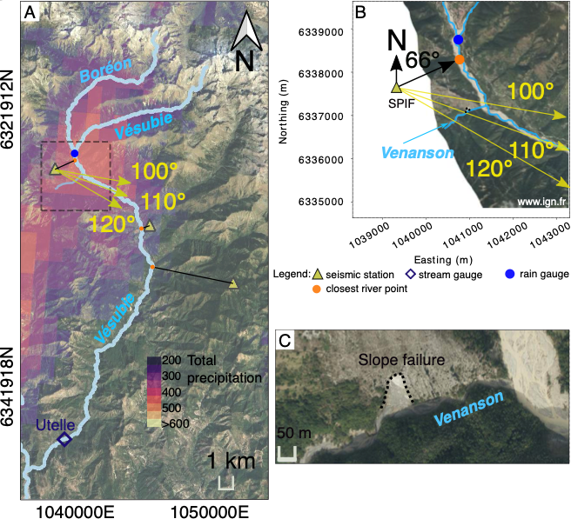
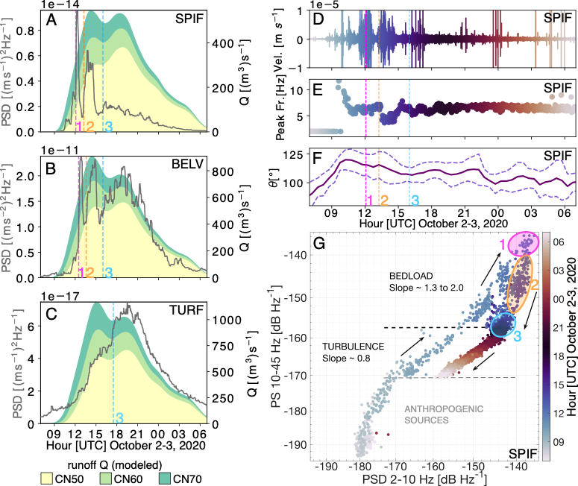
Seismological observations of the flash flood
The seismic power averaged in 1-20 Hz stations show a rapid increase from 10:00 UTC (SPIF & BELV)
3 seismic power local maxima (SPIF & BELV)
The first two seismic power maxima have pronounced high-amplitude peaks
The timing of the main seismic power maximum at TURF station and the third seismic power maximum of BELV station is well correlated with the second maximum of the simulated runoff (Q, Kinematic Local Excess Model, Borga et al., 2007)
SPIF
SPIF
BELV
BELV
TURF
TURF
(mm)
6
Notes:
We analyze seismic power (PSD), peak frequency, and dominant noise directions of seismic signals.
The first two seismic power maxima have pronounced high-amplitude peaks
We modelise the river discharge using rain gauge data
a simple KLEM rainfall-runoff model (Kinematic Local Excess Model)
modèle pluie-debit numéro de courbe (CN=curve number)
PSD values for the near-river stations SPIF, BELV contains two distinct high-amplitude maxima which propagate at ~5.8 m/s and ~4.8 m/s.
The timing of the main PSD peak at TURF station and the third PSD peak of BELV station is well correlated with a peak of simulated river discharge
Tsai et al. (2012) model for hazardous flow monitoring from Lai et al. (2018), the seismc power is strongly sensitive to particle sediment size and flow speed, while the peak frequency mostly depends on the distance from the seismic source to the receiver.
Also, previous observations reported no significant shift in peak frequency with varying water runoff (Schmandt et al., 2013; 155 Burtin et al., 2016). Therefore, the observed drop in the peak frequency (down to 4 Hz) that temporally correlates with the occurrence of the second seismic power maximum at the SPIF station (Figure 2A, E) can potentially be generated by an additional, more distant river segment or by a slope failure
The peak frequency corresponds to the frequency that has a maximum seismic power 105 value in the analyzed time-window
We observe a distinct difference in peak frequency and horizontal backazimuth ($θ$) at SPIF station before and during the flood
Finally, from maximum 1 to 3 there is a shift from short lived peaks to a much more spread distribution of power through time. This could be potentially related to different dynamics of the first two maxima (associated with two fast propagating flood waves causing a sudden raise in seismic power) and a progressive increase in the seismic power associated 200 with a progressive increase in the maximum flow.

Slide 7
Seismological observations of the flash flood
The relative contributions of low- (2-10 Hz) and high- (10-45 Hz) frequency seismic power
SPIF
SPIF
BELV
BELV
TURF
TURF
PSD
(mm)
varying relationship between low frequency and high frequency seismic power
7
Notes:
The relative contributions of low- (2-10 Hz) and high- (10-45 Hz) frequency seismic power are shown in Figure 2G. Different time periods characterized by a varying relationship between low frequency and high frequency seismic power can be identified: between 08:30 and 10:00 UTC the seismic power increases with the same velocity in the two-frequency range (slope ∼1), between 10:00 and 16:00 UTC the high frequency seismic power increases faster (slope >1), and finally between 16:00 UTC October 2 and 07:00 UTC October 3 the seismic power decreases. We discuss the significance of slope changes in the following section
We analyze seismic power (PSD), peak frequency, and dominant noise directions of seismic signals.
pentes adjacentes, des berges
Transport solide
écoulement turbulent
varying relationship between low frequency and high frequency seismic
Transport solide
Since river flow turbulence is expected to preferentially generate ground motion at low frequencies compared to bedload transport (e.g., Burtin et al., 2011; Schmandt et al., 2013; Gimbert et al., 2014), the relationships between seismic power at low versus high frequencies can tell us whether our observations may be sensitive to bedload transport (Bakker et al., 2020)
range from frictional forces at the riverbed due to turbulent river flow
gamme des forces de friction au lit de la rivière en raison de l'écoulement turbulent de la rivière
As the flood develops we observe a change in scaling between low- and high-frequency seismic power, materialized by a transitio from a 0.8 to a 1.3 scaling exponent as high frequency seismic power becomes higher than -158dB (Figure 2G). We interpret ´ this observation as an indication that high frequency seismic power above the -158dB threshold is mostly bedload induced. ´ This is consistent with expectation of enhanced bedload transport from this stage onwards due to increased bed shear stress and/or the activation of additional sediment supply sources from river bed destabilization or bank erosion (Cook et al., 2018). Interestingly, after peak seismic energy has been reached, high frequency seismic power drops drastically compared to low frequency seismic power (with a scaling exponent of about 2), consistent with an abrupt shut down of sediment transport. During the night after the flood, the low- versus high-frequency power scaling relation comes back to that observed during the early rising phase, consistent with higher frequencies over this timeframe getting back to being mostly sensitive to water flow. We also note that after the flood, the low-frequency seismic power is higher compared to before the flood (∼10dB difference, ´ see also the spectrogram of SPIF station in Figure 1), which could be due to flood-induced changes in river bed geometry and/or flow conditions (e.g. river roughness, Roth et al. (2017)) that may preferentially affect low frequency power.
rugosité de la rivière
PSD values for the near-river stations SPIF, BELV contains two distinct high-amplitude maxima which propagate at ~5.8 m/s and ~4.8 m/s.
The timing of the main PSD peak at TURF station and the third PSD peak of BELV station is well correlated with a peak of simulated river discharge
Tsai et al. (2012) model for hazardous flow monitoring from Lai et al. (2018), the seismc power is strongly sensitive to particle sediment size and flow speed, while the peak frequency mostly depends on the distance from the seismic source to the receiver.
Also, previous observations reported no significant shift in peak frequency with varying water runoff (Schmandt et al., 2013; 155 Burtin et al., 2016). Therefore, the observed drop in the peak frequency (down to 4 Hz) that temporally correlates with the occurrence of the second seismic power maximum at the SPIF station (Figure 2A, E) can potentially be generated by an additional, more distant river segment or by a slope failure
The peak frequency corresponds to the frequency that has a maximum seismic power 105 value in the analyzed time-window
We observe a distinct difference in peak frequency and horizontal backazimuth ($θ$) at SPIF station before and during the flood
a simple KLEM rainfall-runoff model (Kinematic Local Excess Model
Finally, from maximum 1 to 3 there is a shift from short lived peaks to a much more spread distribution of power through time. This could be potentially related to different dynamics of the first two maxima (associated with two fast propagating flood waves causing a sudden raise in seismic power) and a progressive increase in the seismic power associated 200 with a progressive increase in the maximum flow.

Slide 8
The Vésubie river dynamics during the flash flood
The flash flood on the Vésubie river started at about 10:00 UTC
The backazimuth of ∼110°: bending of the Vésubie river channel, a ∼2.5 km long downstream reach of the Vésubie river, or the confluence of the Venanson stream with the Vésubie river
Similar peaks in seismic power generated by flood waves were observed during glacial lake outburst floods in the Himalayas (Cook et al., 2018). These peaks may share similar characteristics to sediment pulses (Piantini et al., 2021).
From maximum 1 to 3 there is a shift from short lived peaks to a much more spread distribution of power through time.
v1=~5.8 m/s
v2=~4.8 m/s
SPIF
BELV
TURF
(mm)
8
Notes:
Gisement
Enfin, du maximum 1 à 3, il y a un passage des pics de courte durée à une distribution de puissance beaucoup plus étalée dans le temps
SPIF, BELV and TURF signals are mostly generated by the flash flood on the Vésubie river
The rapid increase in seismic power, the changes in peak frequencies, and dominant backazimuth ->
Comparison amongst the increased seismic power (100 times larger than common noise levels), runoff modeling, and runoff measurements indicates that the signals recorded by SPIF, BELV and TURF stations during storm Alex are mostly generated by the flash flood on the Vésubie river
The backazimuth of ∼110° may be associated with a bending of the Vésubie river channel, a ∼2.5 km long downstream reach of the Vésubie river that aligns with the estimated azimuth, or the confluence of the Venanson stream with the Vésubie river which lies in the estimated direction (Figure B2B). This provides evidence that the commonly made assumption that the recorded seismic signals are associated with the river segments located closest to the station (e.g., Zhang et al., 2021) may not be always valid.
local water flow depth supports the fact that local water flow depth or bed shear stress
Since river flow turbulence is expected to preferentially generate ground motion at low frequencies compared to bedload transport (e.g., Burtin et al., 2011; Schmandt et al., 2013; Gimbert et al., 2014), the relationships between seismic power at low versus high frequencies can tell us whether our observations may be sensitive to bedload transport (Bakker et al., 2020)
Similar peaks in seismic power generated by flood waves were observed during glacial lake outburst floods in the Himalayas by Cook et al. (2018) and Maurer et al. (2020). These peaks may share similar characteristics to sediment pulses reproduced experimentally by Piantini et al. (2021) 190 in a torrential river setting as investigated here
The absence of the two main maxima on the TURF station can be related to a lack of sensitivity of this station to the bedload transport due to its large distance from the river (∼6 km). Farther distance means stronger geometrical attenuation at higher frequencies versus lower frequencies, and thus lower sensitivity to bedload compared to water flow (Gimbert et al., 2014).
Finally, from maximum 1 to 3 there is a shift from short lived peaks to a much more spread distribution of power through time. This could be potentially related to different dynamics of the first two maxima (associated with two fast propagating flood waves/sediment pulses causing a sudden raise in seismic power) and a progressive increase in the seismic power associated 200 with a progressive increase in the maximum flow
In the upper part of mountain river catchments, large amounts of loose debris produced by mass wasting processes can accumulate at the base of slopes and cliffs. Sudden destabilizations of these deposits are thought to trigger energetic sediment pulses that may travel in downstream rivers with little exchange with the local bed. The dynamics of these exogenous sediment pulses remain poorly known because direct field observations are lacking, and the processes that control their formation and propagation have rarely been explored experimentally.

Slide 9
The Vésubie river dynamics during the flash flood
The flash flood on the Vésubie river started at about 10:00 UTC
The backazimuth of ∼110°: bending of the Vésubie river channel, a ∼2.5 km long downstream reach of the Vésubie river, or the confluence of the Venanson stream with the Vésubie river
Similar peaks in seismic power generated by flood waves were observed during glacial lake outburst floods in the Himalayas (Cook et al., 2018). These peaks may share similar characteristics to sediment pulses (Piantini et al., 2021).
From maximum 1 to 3 there is a shift from short lived peaks to a much more spread distribution of power through time.
v1=~5.8 m/s
v2=~4.8 m/s
SPIF
BELV
TURF
(mm)
Summary 1
Seismological observations constrain time- and space-dependent processes during the flood and rainfall-runoff relationship at the catchment scale
Notes:
Gisement
Enfin, du maximum 1 à 3, il y a un passage des pics de courte durée à une distribution de puissance beaucoup plus étalée dans le temps
SPIF, BELV and TURF signals are mostly generated by the flash flood on the Vésubie river
The rapid increase in seismic power, the changes in peak frequencies, and dominant backazimuth ->
Comparison amongst the increased seismic power (100 times larger than common noise levels), runoff modeling, and runoff measurements indicates that the signals recorded by SPIF, BELV and TURF stations during storm Alex are mostly generated by the flash flood on the Vésubie river
The backazimuth of ∼110° may be associated with a bending of the Vésubie river channel, a ∼2.5 km long downstream reach of the Vésubie river that aligns with the estimated azimuth, or the confluence of the Venanson stream with the Vésubie river which lies in the estimated direction (Figure B2B). This provides evidence that the commonly made assumption that the recorded seismic signals are associated with the river segments located closest to the station (e.g., Zhang et al., 2021) may not be always valid.
local water flow depth supports the fact that local water flow depth or bed shear stress
Since river flow turbulence is expected to preferentially generate ground motion at low frequencies compared to bedload transport (e.g., Burtin et al., 2011; Schmandt et al., 2013; Gimbert et al., 2014), the relationships between seismic power at low versus high frequencies can tell us whether our observations may be sensitive to bedload transport (Bakker et al., 2020)
Similar peaks in seismic power generated by flood waves were observed during glacial lake outburst floods in the Himalayas by Cook et al. (2018) and Maurer et al. (2020). These peaks may share similar characteristics to sediment pulses reproduced experimentally by Piantini et al. (2021) 190 in a torrential river setting as investigated here
The absence of the two main maxima on the TURF station can be related to a lack of sensitivity of this station to the bedload transport due to its large distance from the river (∼6 km). Farther distance means stronger geometrical attenuation at higher frequencies versus lower frequencies, and thus lower sensitivity to bedload compared to water flow (Gimbert et al., 2014).
Finally, from maximum 1 to 3 there is a shift from short lived peaks to a much more spread distribution of power through time. This could be potentially related to different dynamics of the first two maxima (associated with two fast propagating flood waves/sediment pulses causing a sudden raise in seismic power) and a progressive increase in the seismic power associated 200 with a progressive increase in the maximum flow
In the upper part of mountain river catchments, large amounts of loose debris produced by mass wasting processes can accumulate at the base of slopes and cliffs. Sudden destabilizations of these deposits are thought to trigger energetic sediment pulses that may travel in downstream rivers with little exchange with the local bed. The dynamics of these exogenous sediment pulses remain poorly known because direct field observations are lacking, and the processes that control their formation and propagation have rarely been explored experimentally.

Slide 10
Hydrologically triggered earthquake swarm?
Before template matching (22 earthquakes Seiscomp3)
3 main clusters
Template matching on MVIF (+ 91 earthquakes ML>=-0.5)
<
Notes:
A cluster of 23 earthquakes was detected and located around 4 km depth in the area where rainfall was maximum.
This area (Tinée valley) has on average 2 earthquakes of ML>= 0.4 per month and transient increases up to 11 earthquakes/month over the 7 last years.
augmentations transitoires
Karstique
front de pression interstitielle,
Une charge verticale provoquée immédiatement par le poids de l'eau de pluie accumulée près de la surface du sol. Augmentation de la pression interstitielle dans la zone hypocentrale en raison de la charge verticale ou de la migration de l'eau ou de la diffusion de la pression de la surface à la profondeur.
In October 2020, the seismic rate significantly increased up to 22 earthquakes/month (the maximum value since 2014).
The spatial coincidence between the maximum rainfall of storm Alex, in the Tinée valley, and the seismic sequence a few hours later (Figure 1A) raises the question whether the earthquakes were triggered by the heavy rainfall.
First hypothesis is a pore pressure increase at depth 205 caused by fluid migration from the surface through hydraulically connected fractures. In this case the time lag between rainfall at the surface and earthquakes at depth is dependent on the hydraulic diffusivity along the fractures

Slide 11
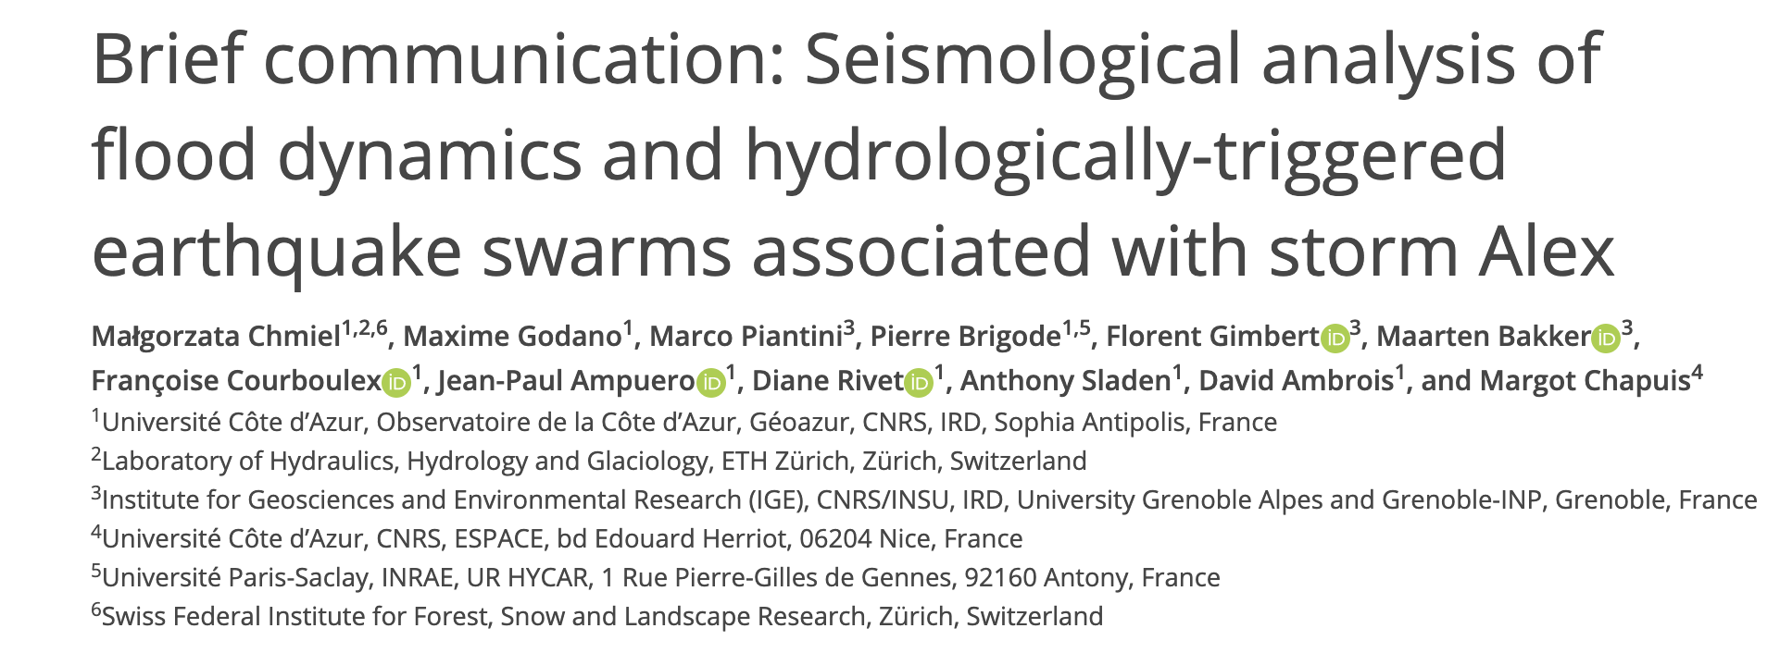
Hydrologically triggered earthquake swarm?
Before template matching (22 earthquakes Seiscomp3)
3 main clusters
Template matching on MVIF (+ 91 earthquakes ML>=-0.5)
Possible origin.
1) Pore pressure increase at depth caused by fluid migration from the surface through fractures (Saar and Manga, 2003; Kraft et al., 2006)
2) An elastic stress perturbation induced by hydrological loadings (Rigo et al., 2008)
3) Pore pressure increase in deep fluid-saturated poroelastic rock in response to overlying hydrological loading (Miller, 2008; D’Agostino et al., 2018).
<
Notes:
A cluster of 23 earthquakes was detected and located around 4 km depth in the area where rainfall was maximum.
This area (Tinée valley) has on average 2 earthquakes of ML>= 0.4 per month and transient increases up to 11 earthquakes/month over the 7 last years.
In October 2020, the seismic rate significantly increased up to 22 earthquakes/month (the maximum value since 2014).
The spatial coincidence between the maximum rainfall of storm Alex, in the Tinée valley, and the seismic sequence a few hours later (Figure 1A) raises the question whether the earthquakes were triggered by the heavy rainfall.
First hypothesis is a pore pressure increase at depth 205 caused by fluid migration from the surface through hydraulically connected fractures. In this case the time lag between rainfall at the surface and earthquakes at depth is dependent on the hydraulic diffusivity along the fractures

Slide 12
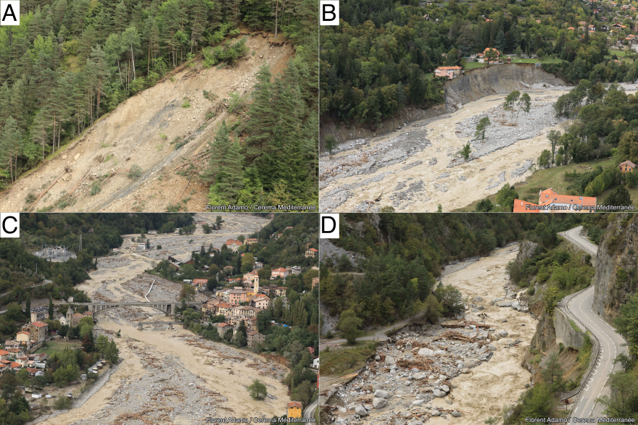
Summary
Further analysis based on the presented unique dataset to study surface and deep earth processes associated with storm Alex.
Seismometers can constrain interaction between the different Earth’s systems, time- and space-dependent processes during the flood and rainfall-runoff relationship at the catchment scale
114 earthquakes between local magnitude ML 0.5 and 2.5 were triggered by the hydrological loading and/or by the resulting in-situ pore pressure increase in the Tinée valley.
Notes:
Erosion and accumulations – no defined seismological signature
Integrate strain rate to get the particle motion
Impedence contrast in rehology
flow depth supports the fact that local water flow depth or bed shear stress can be inverted from
seismic measurements.
Advacnes in acquition and processing method allow to better monitor mass movement processes
Combining DAS measurements with Machine learnin
Dense arrays! The advantage of having multiple sensors.
DAS, w

Slide 13
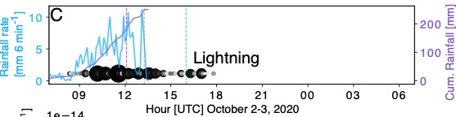
Seismological observations of the flash flood
Notes:
The inital phase of the flood (~12:00-15:00) seems to be dominated by (coarse) bedload transport and/or strong sediment supply to the river
the upper part of mountain river catchments, large amounts of loose debris produced by mass wasting processes can accumulate at the base of slopes and cliffs. Sudden destabilizations of these deposits are thought to trigger energetic sediment pulses that may travel in downstream rivers with little exchange with the local bed. The dynamics of these exogenous sediment pulses remain poorly known because direct field observations are lacking, and the processes that control their formation and propagation have rarely been explored experimentally.
The relative contributions of low- (2-10 Hz) and high- (10-45 Hz) frequency seismic power are shown in Figure 2G. Different time periods characterized by a varying relationship between low frequency and high frequency seismic power can be identified: between 08:30 and 10:00 UTC the seismic power increases with the same velocity in the two-frequency range (slope ∼1), between 10:00 and 16:00 UTC the high frequency seismic power increases faster (slope >1), and finally between 16:00 UTC October 2 and 07:00 UTC October 3 the seismic power decreases with the same velocity. We discuss the significance of slope changes in the following section
Since river flow turbulence is expected to preferentially generate ground motion at low frequencies compared to bedload transport (e.g., Burtin et al., 2011; Schmandt et al., 2013; Gimbert et al., 2014), the relationships between seismic power at low versus high frequencies can tell us whether our observations may be sensitive to bedload transport (Bakker et al., 2020). As the flood develops we observe a change in scaling between low- and high-frequency seismic power, materialized by a transition 170 from a 0.8 to a 1.3 scaling exponent as high frequency seismic power becomes higher than -158dB (Figure 2G). We interpret ´ this observation as an indication that high frequency seismic power above the -158dB threshold is mostly bedload induced. ´ This is consistent with expectation of enhanced bedload transport from this stage onwards due to increased bed shear stress and/or the activation of additional sediment supply sources from river bed destabilization or bank erosion (Cook et al., 2018). Interestingly, after peak seismic energy has been reached, high frequency seismic power drops drastically compared to low 175 frequency seismic power (with a scaling exponent of about 2), consistent with an abrupt shut down of sediment transport. During the night after the flood, the low- versus high-frequency power scaling relation comes back to that observed during the early rising phase, consistent with higher frequencies over this timeframe getting back to being mostly sensitive to water flow. We also note that after the flood, the low-frequency seismic power is higher compared to before the flood (∼10dB difference, ´ see also the spectrogram of SPIF station in Figure 1), which could be due to flood-induced changes in river bed geometry 180 and/or flow conditions (e.g. river roughness, Roth et al. (2017)) that may preferentially affect low frequency power.

