Slide 1




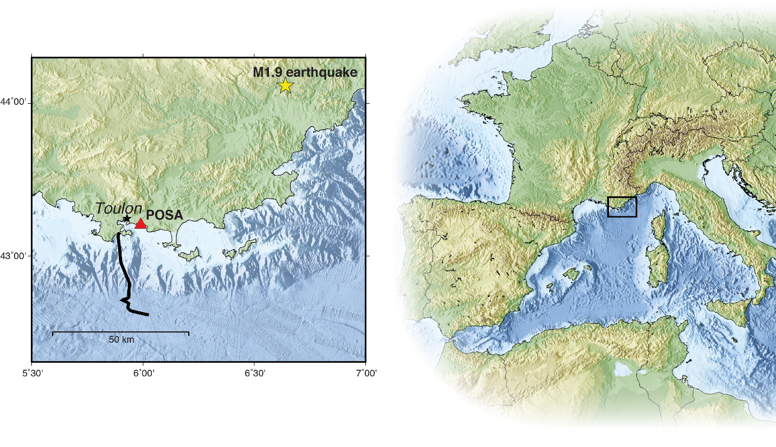
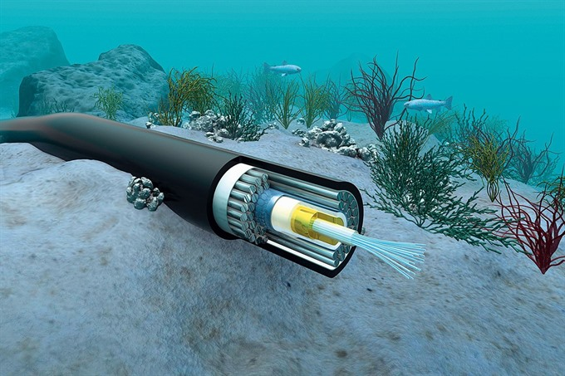
Distributed Acoustic Sensing (DAS) for marine geosciences
Geoazur DAS team:
Anthony Sladen, Diane Rivet, Jean-Paul Ampuero, Diego Mercerat,
Daniel Mata, Gauthier Guerin, Itzhak Lior

Slide 2
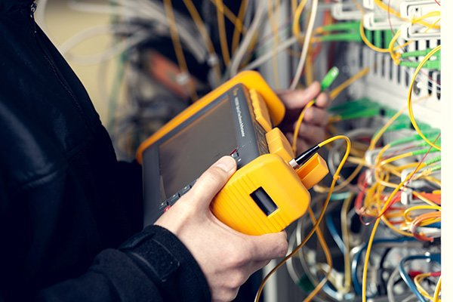
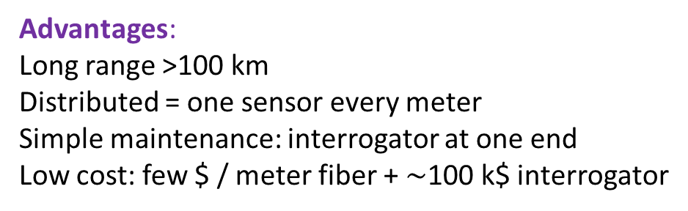
Principle and advantages of DAS
Laser source
~10 ns
2-7U
Sensing unit
100-600 Watts
Reflected light signal
(Rayleigh scattering)
Advantages:
Long range >100 km
Distributed = one sensor every meter
Simple maintenance: interrogator at one end
Low cost: few $ / meter fiber + $\sim$100 k$ interrogator
Fibre optic cable (~50 km)

Slide 3
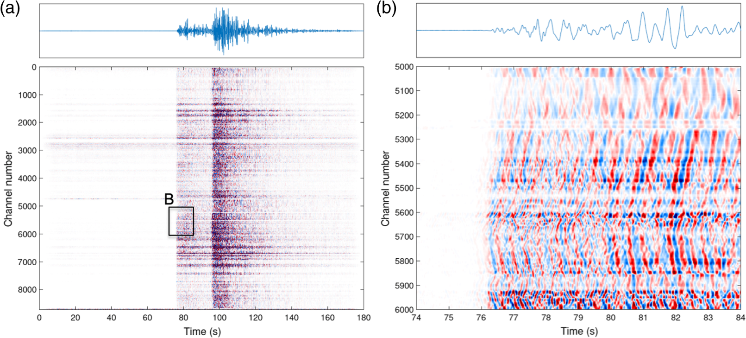
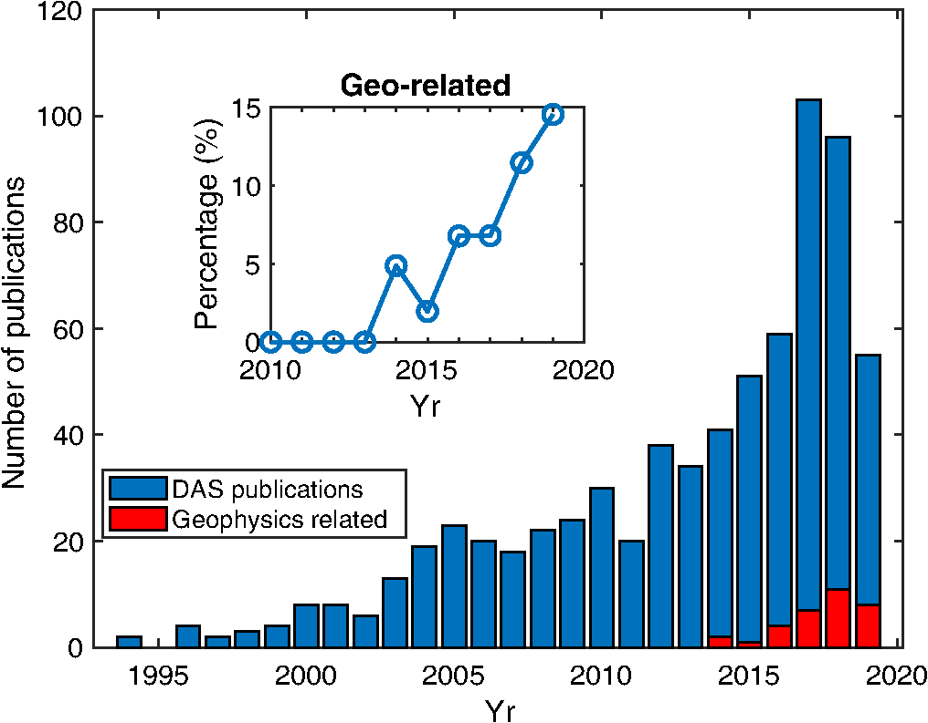
“Distributed Acoustic Sensing Turns Fiber‐Optic Cables into Sensitive Seismic Antennas”
(Zhan, SRL 2020 review paper)
DAS recording of a M4.5 earthquake 150 km away
1 m spacing between channels
Seafloor DAS Geo
Geoazur - Sladen et al (2019)
Caltech - Williams et al (2019)
Berkeley – Lindsey et al (2019)

Slide 4
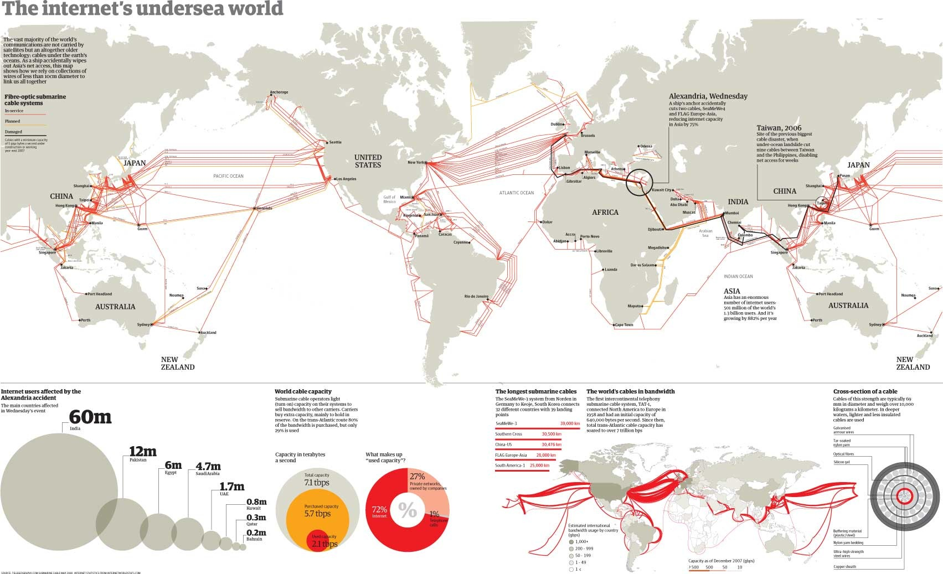
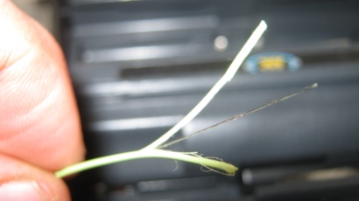
Two complementary strategies
Using existing seafloor telecom cables
Installing dedicated cables

Slide 5
DAS Geoazur team publications
A. Sladen, D. Rivet, J. P. Ampuero, L. De Barros, Y. Hello, G. Calbris, P. Lamare, Distributed sensing of earthquakes and ocean-solid Earth interactions on seafloor telecom cables, Nature Comms., 2019
I. Lior, A. Sladen, D. Rivet, J. P. Ampuero, Y. M. Hello, P. Lamare, C. Jestin, S. Tsagkli, C. Markou, On the detection capabilities of underwater DAS, J. Geophys. Res., 2020
I. Lior, A. Sladen, D. Mercerat, J.-P. Ampuero, D. Rivet and S. Sambolian, Strain to ground motion conversion of DAS data for earthquake magnitude and stress drop determination, Solid Earth, 2021
Rivet, D., de Cacqueray, B., Sladen, A., Roques, A., Calbris, G., Preliminary assessment of ship detection and trajectory evaluation using Distributed Acoustic Sensing on an optical fiber telecom cable, JASA, 2021
M. van den Ende and J. P. Ampuero, Evaluating seismic beamforming capabilities of Distributed Acoustic Sensing arrays, Solid Earth, 2021
M. van den Ende, I. Lior, J. P. Ampuero, A. Sladen, A. Ferrari, C. Richard, A self-supervised Deep Learning approach for blind denoising and waveform coherence enhancement in Distributed Acoustic Sensing data, EarthArXiv preprint, 2021
I. Lior, D. E. Mercerat, D. Rivet, A. Sladen, J. P. Ampuero, Imaging an underwater basin and its resonance modes using optical fiber Distributed Acoustic Sensing, EarthArXiv preprint, 2021

Slide 6
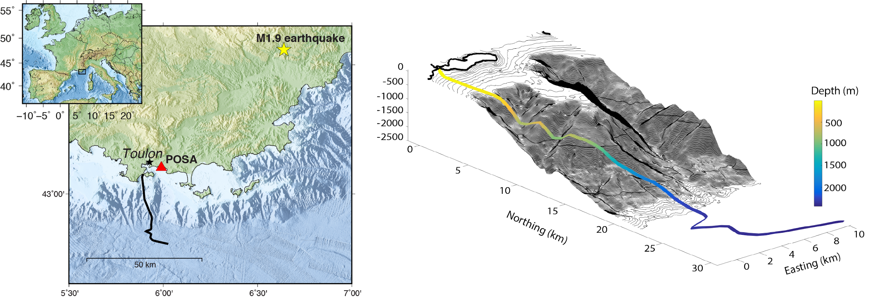
Distributed sensing of earthquakes on seafloor telecom cables
Sladen et al. (2019)
DAS interrogator
Seafloor
fiber optic cable

Slide 7
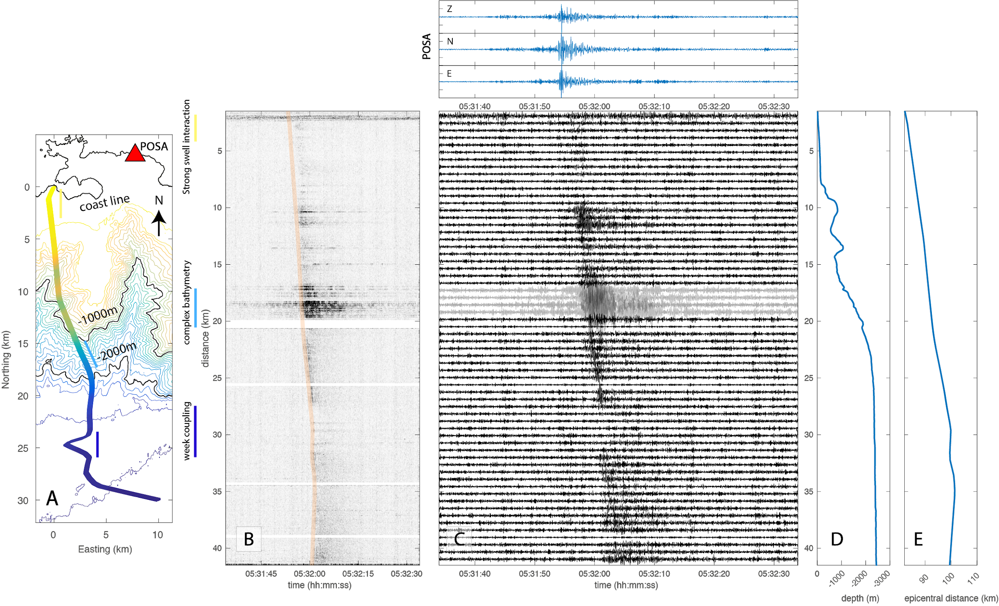
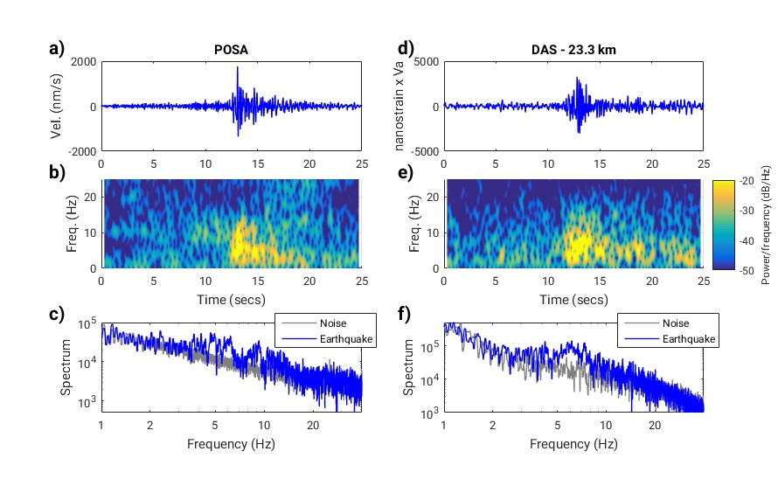
Distributed sensing of earthquakes on seafloor telecom cables
Sladen et al. (2019)
Seismic
station
Recordings of a M1.9 micro-earthquake 100 km away
Seafloor
fiber optic cable
Seismic station
Seafloor
fiber optic
cable

Slide 8
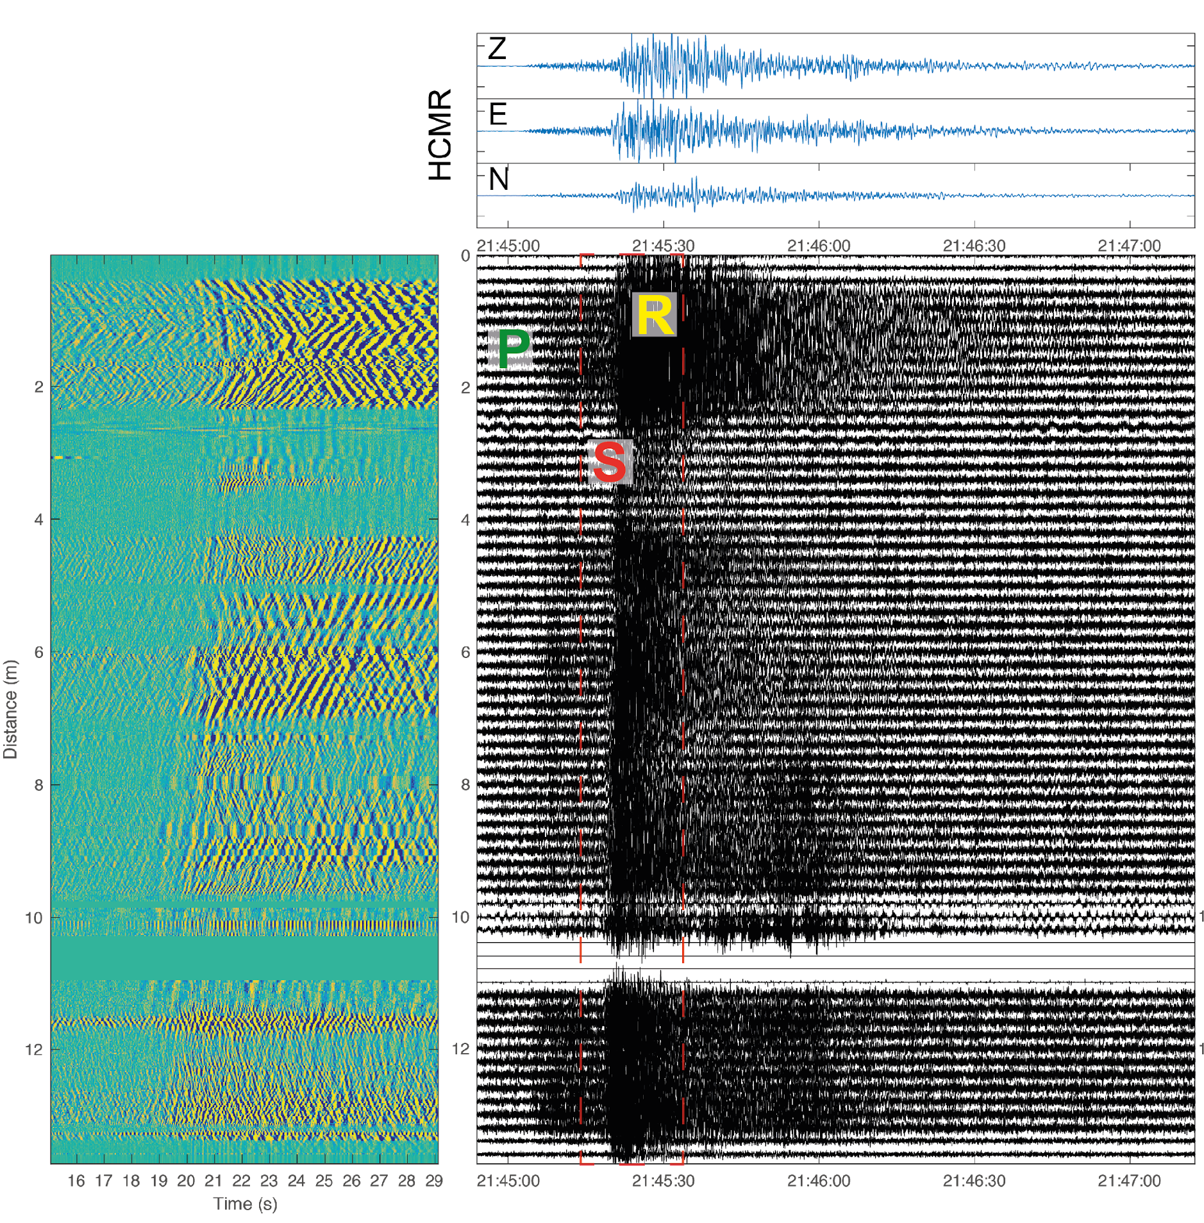

Seafloor recordings of a M3.4 earthquake in Greece
Comparison with ocean bottom seismometer. S and surface waves are visible

Slide 9
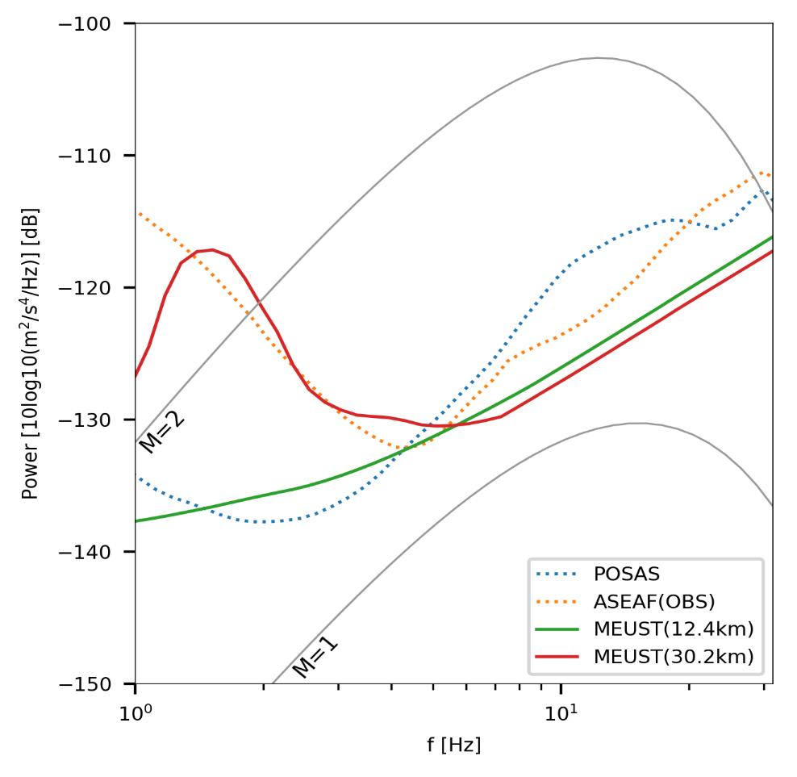
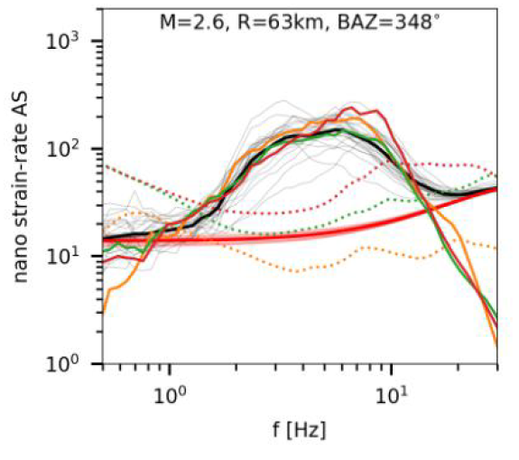

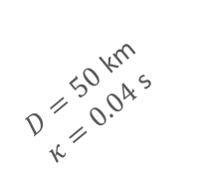
Detection Capabilities of Underwater DAS
Lior et al (2020)
$ε=v/c_{app}$ $strain=\frac{ground velocity}{apparent wave speed}$
$D=50$ km
$κ=0.04$ s
Ground acceleration (power dB)
Seismometers
DAS

Slide 10
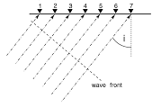
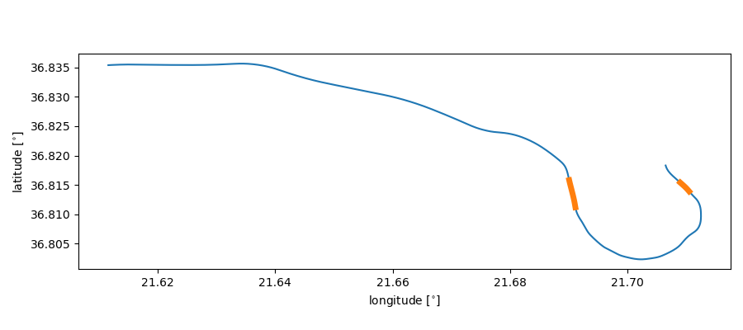
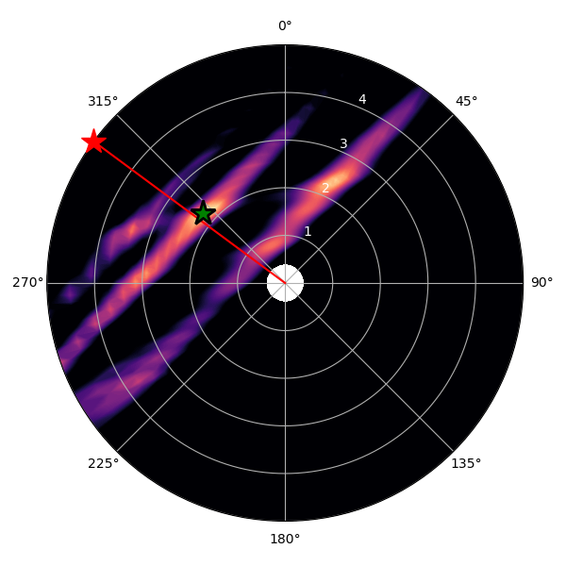
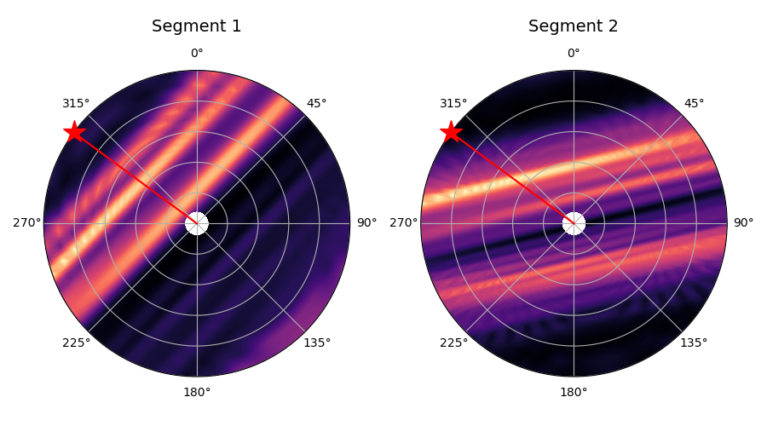
Location Capabilities of Underwater DAS
Martijn van den Ende (Geoazur)
Apparent speed
= (true speed)/sin(i)
①
②
Radial axis = slowness = 1/speed

Slide 11
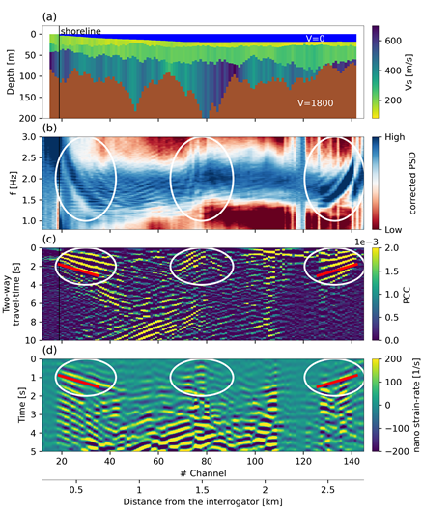
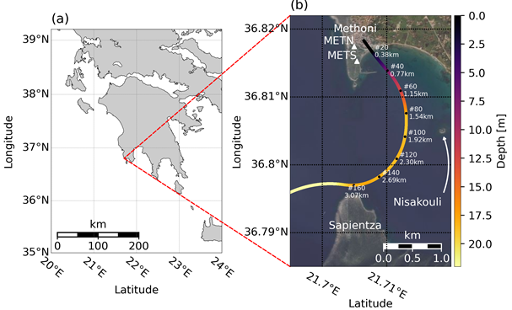
Imaging an underwater basin
and its resonance modes
Methoni Bay, Greece
Lior et al (2021)

Slide 12
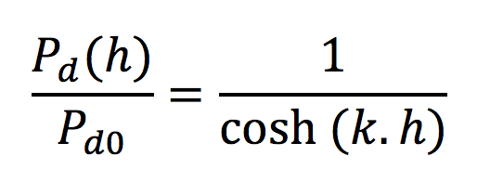
Ocean gravity waves
ω = √g.k.tanh(k.h)
Sladen et al (2019)

Slide 13
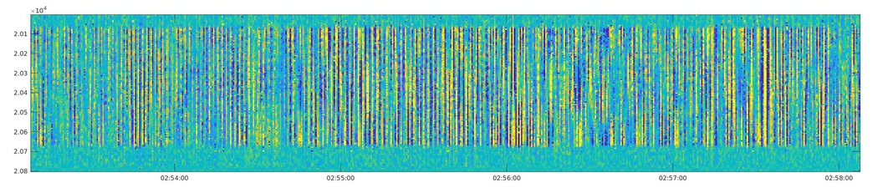
Vibration of suspended cable portions
Daniel Mata
x
time

Slide 14
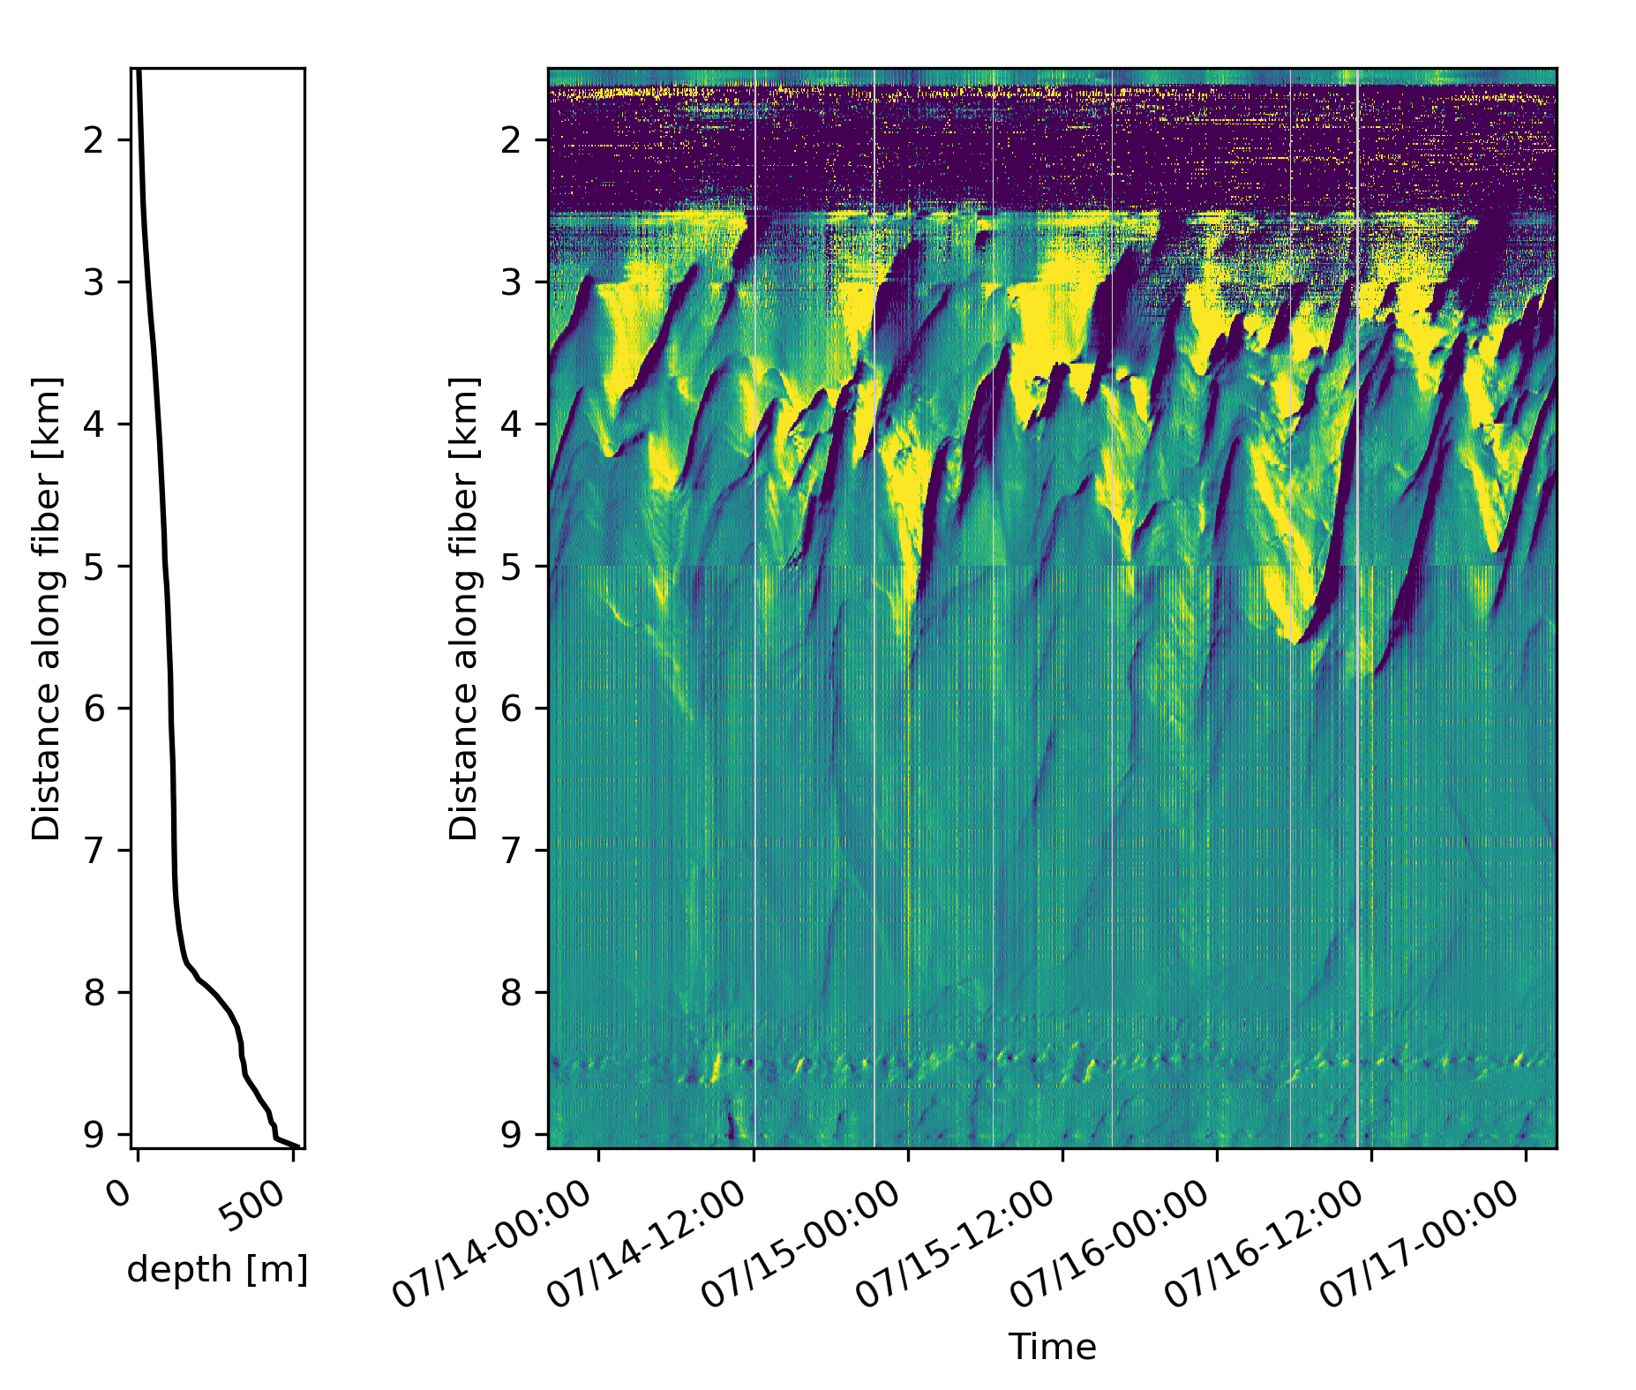
Long-period deep sea dynamics
Five-minute averages of strain rate power
Toulon cable
Temperature fronts?
Deep sea currents?
Notes:
Toulon cable

Slide 15
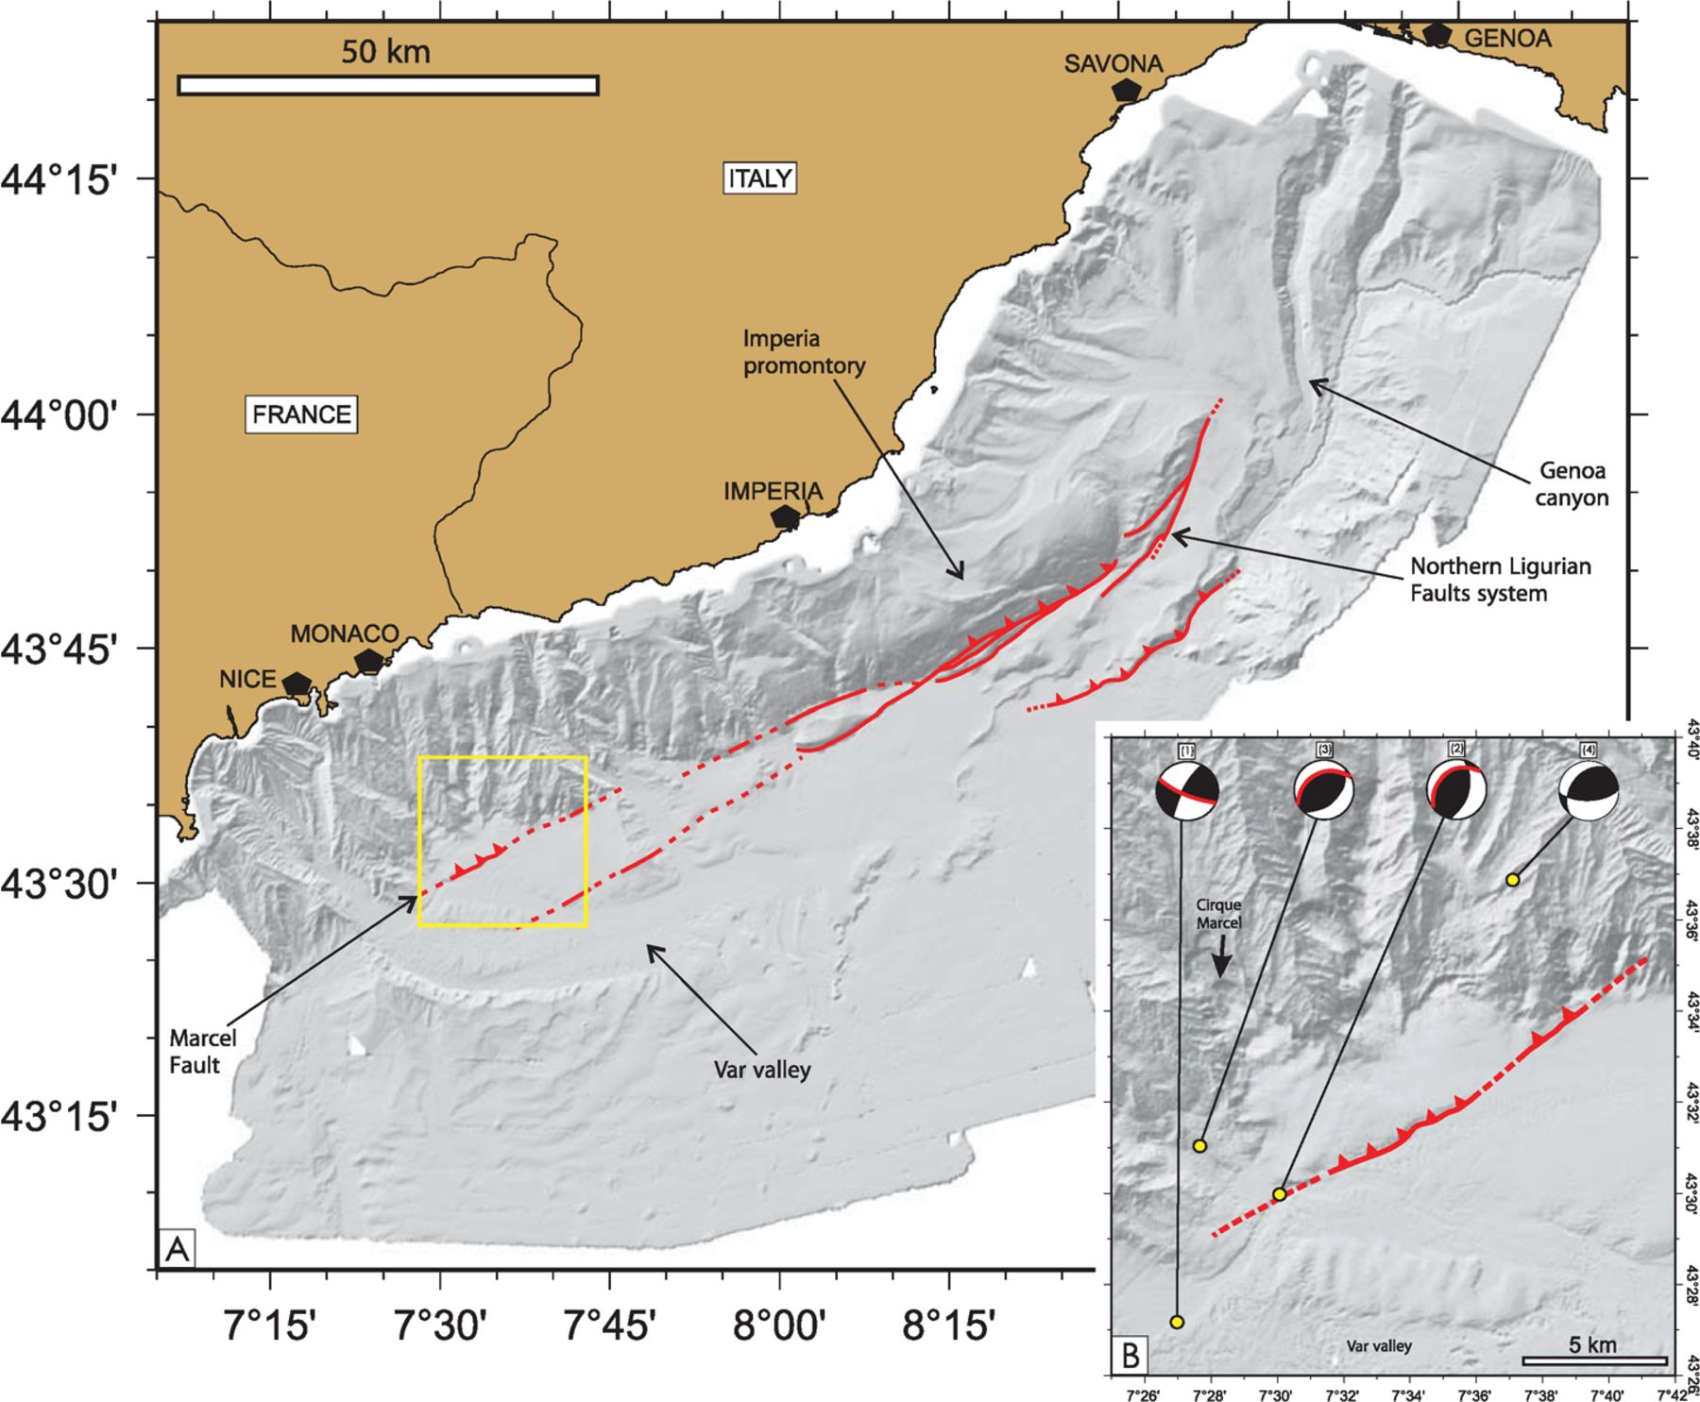
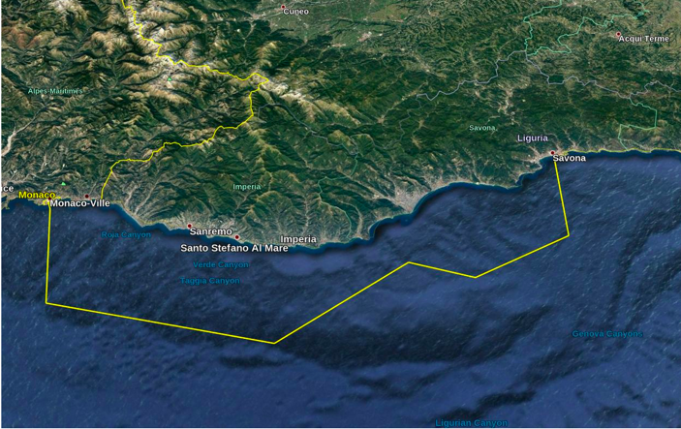
DAS-Ligure
Ligurian fault system
Star = 1887 earthquake epicenter
(Larroque et al, 2012)
Câble telecom décommissionné de Monaco à Savone.
140 km + DAS = 14 000 capteurs sismo-acoustiques
Notes:
https://doi.org/10.1111/j.1365-246X.2012.05498.x

Slide 16
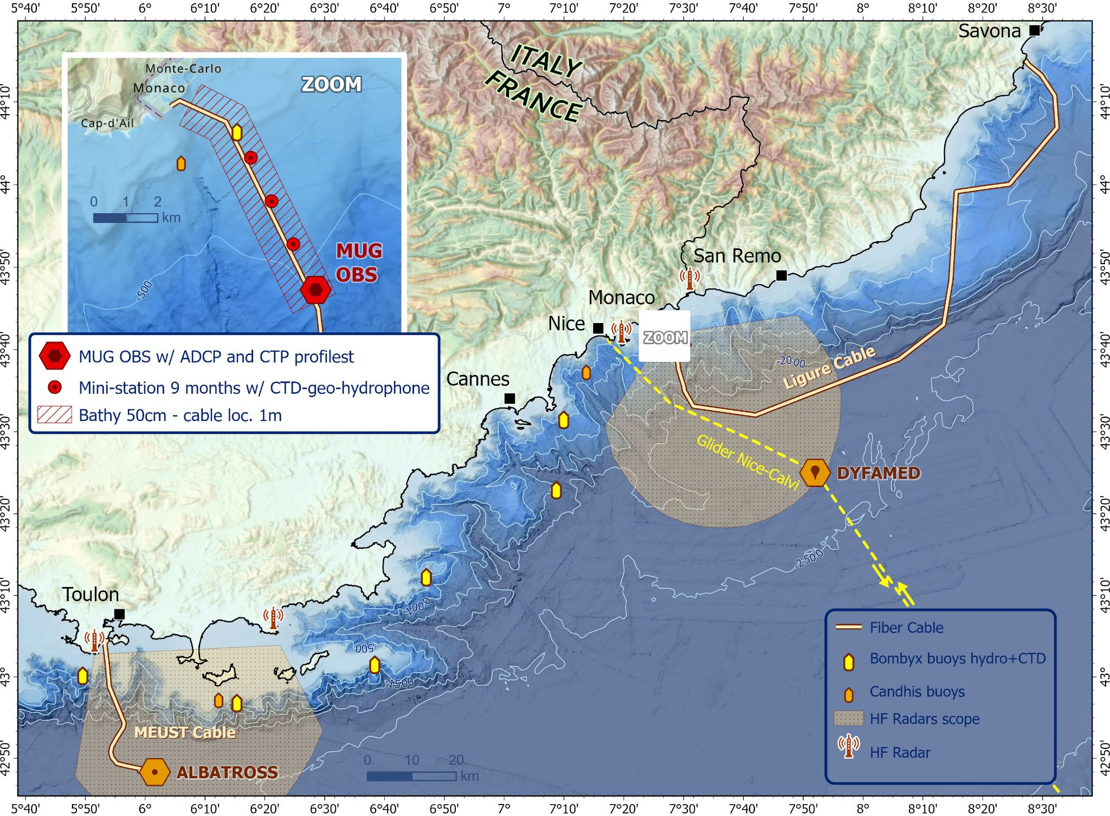
INITIATIVE FOR DISTRIBUTED FIBER OPTIC OCEAN OBSERVATORIES ​(ID-FOO)
AAP “Un océan de solutions”
Fédère communauté nationale sur l’exploitation des données DAS pour étude de l’océan
15 labos, 50 chercheurs,
Projet 2.5M€ sur 5 ans
Centré sur cable Ligure et autres (Toulon, Mayotte, experiences...)
Thèmes abordés :
  Paysage sonore
  Mammifères marins
  Hydrodynamique côtière
  Circulation océanique via microsismique et température
  Tomographie de la colonne d’eau

Slide 17
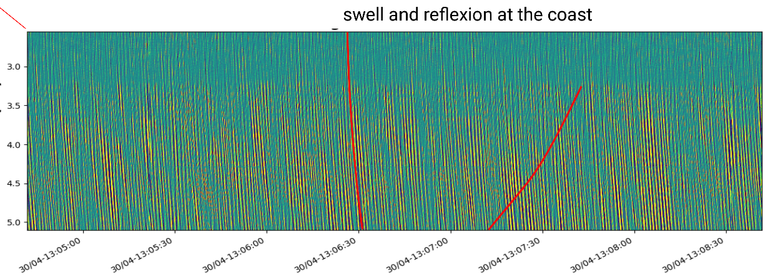
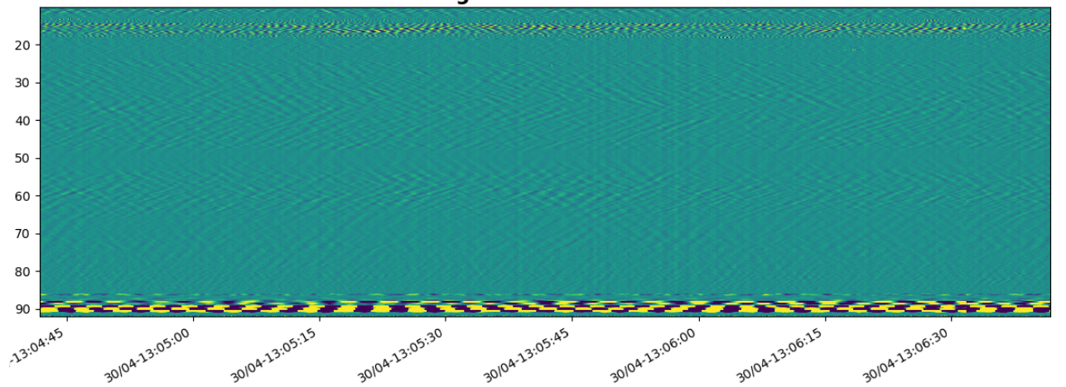
Sample of DAS data on the Ligure cable
Secondary microseism

Slide 18
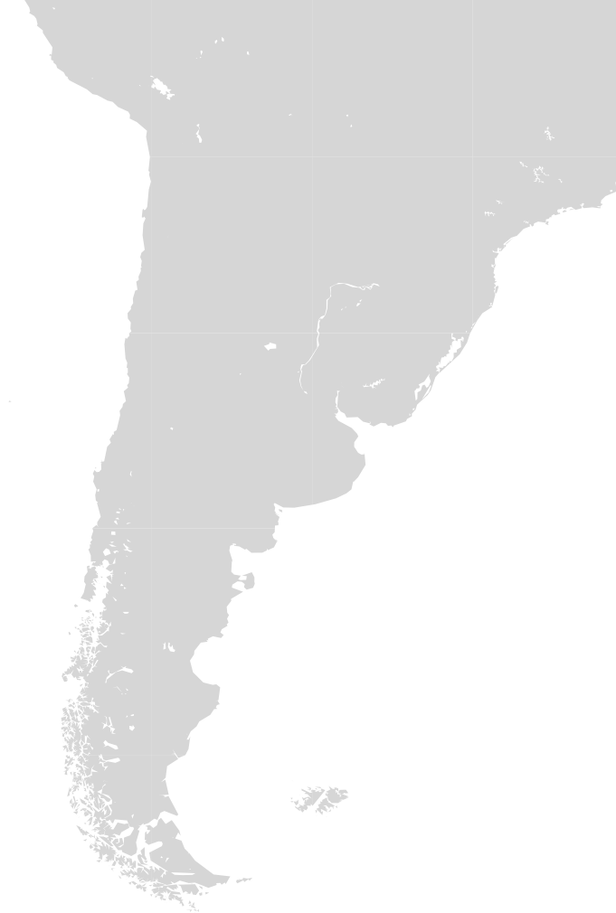
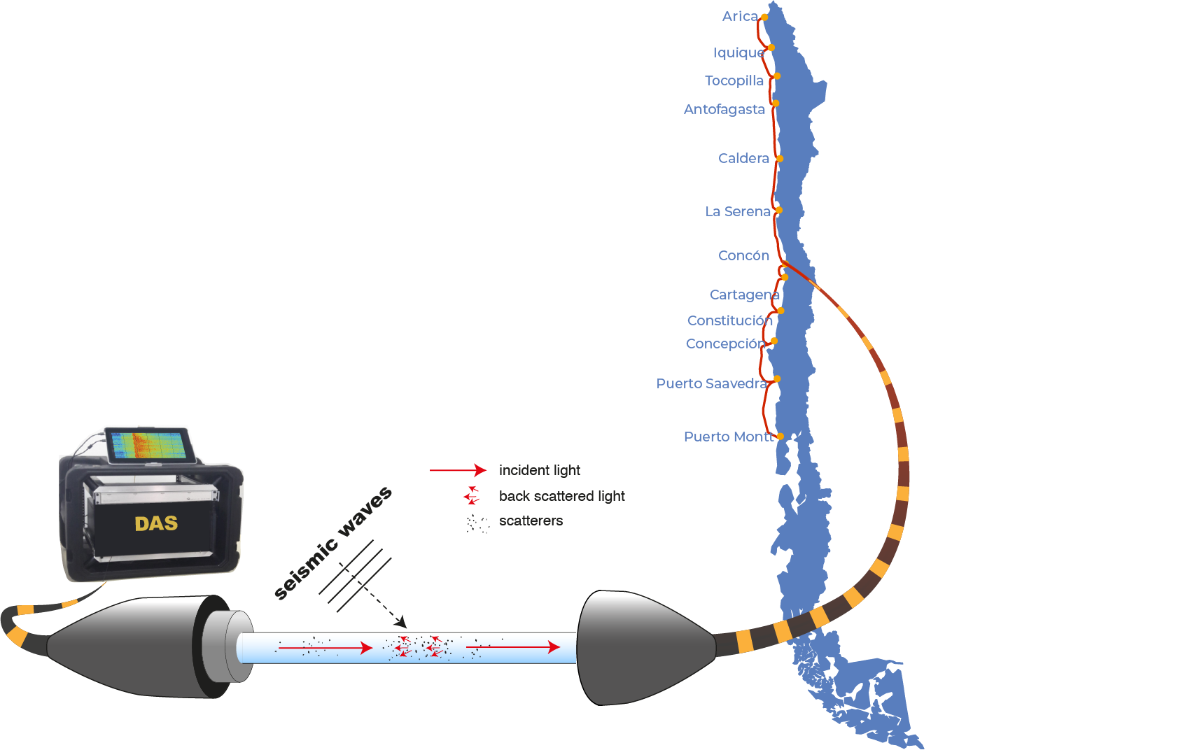
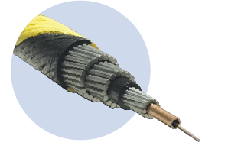
DAS-Chili
Diane Rivet ERC ABYSS proposal
22 times:
150 km long DAS arrays
37500 sensors each
4 m spacing between sensors
Notes:
La technologia DAS transforma une cable de fibra optica en milles des sensores distribuido a lo largo del cable hasta distancia de 150km. Se connecta a una extremidad del cable, sole necesita un instrumento el interrogador, qui contiene une laser y un interferometro. Durante su trayecto a travers la fibra, parte de la luz se develve asia el instrumento, se llama back scattered light, luz retro difusada.

Slide 19
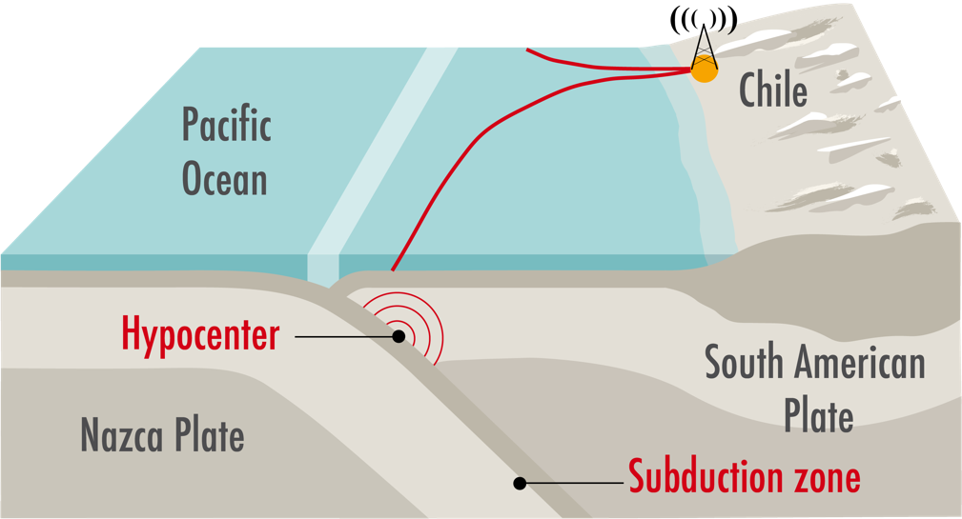
DAS-Chili
Diane Rivet ERC ABYSS proposal
Expected breakthroughs:
Probe the mechanical state of a fault prior to large earthquakes using seismic waves.
Transform the way we make
real-time early warning
for offshore earthquakes.
Dense Permanent
Remote Real-time

Slide 20

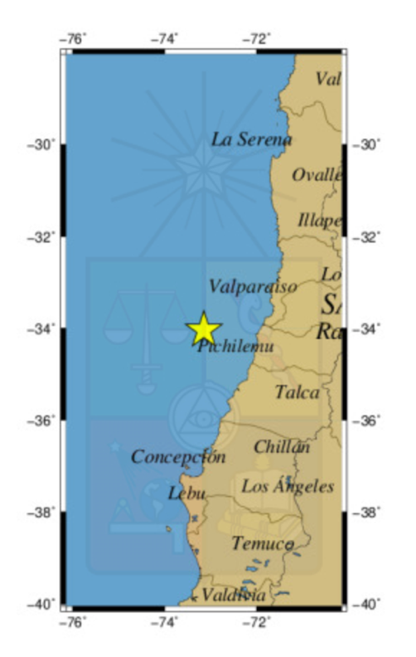
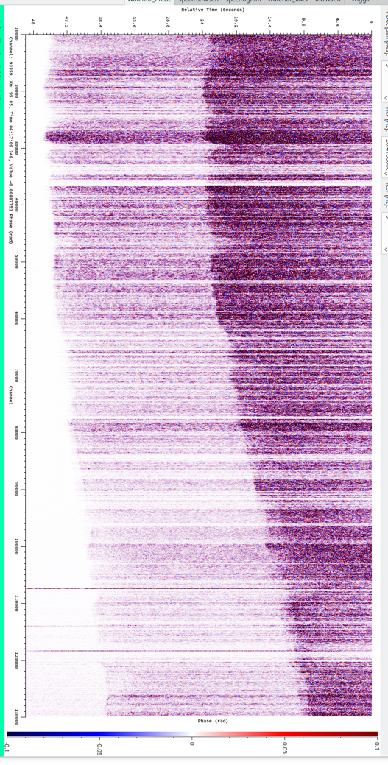
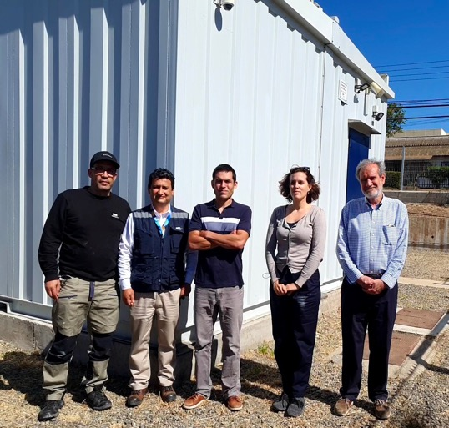
50 secondes
Pilot experiment Oct-Nov 2021
Mw 4.8
08/11/2021
06:16:30
130km

Slide 21
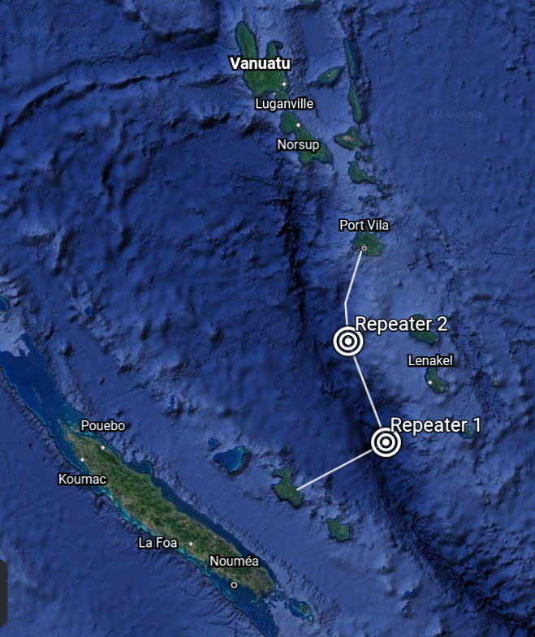
New Caledonia - Vanuatu
SMART cable initiative
Future cable Lifou to Port Vila, ~300 km
IRD funding to add DAS
Moore Foundation funding to develop geophysics applications

Slide 22
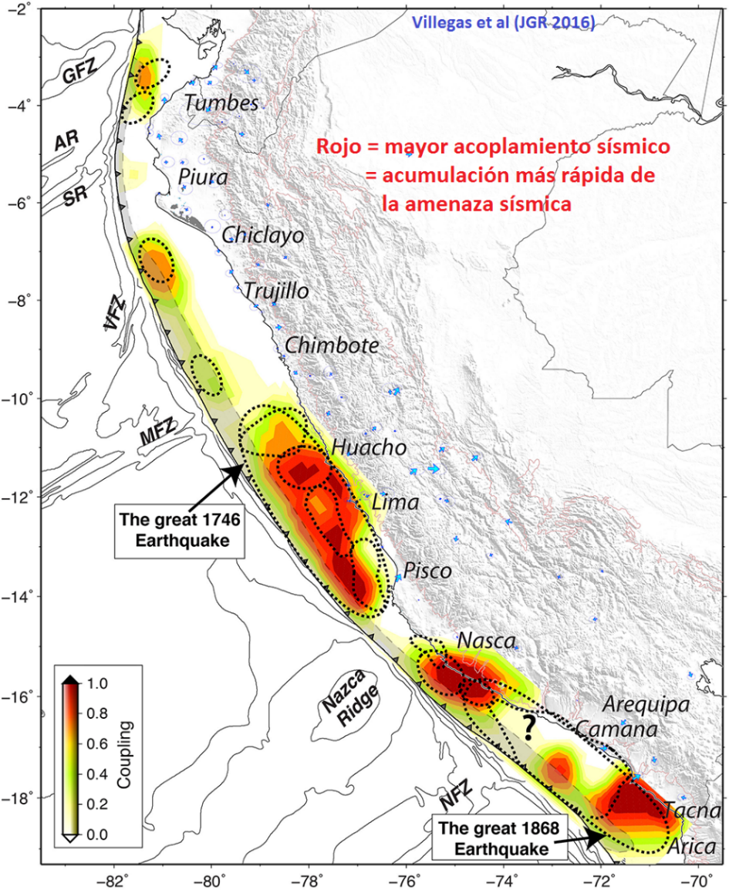
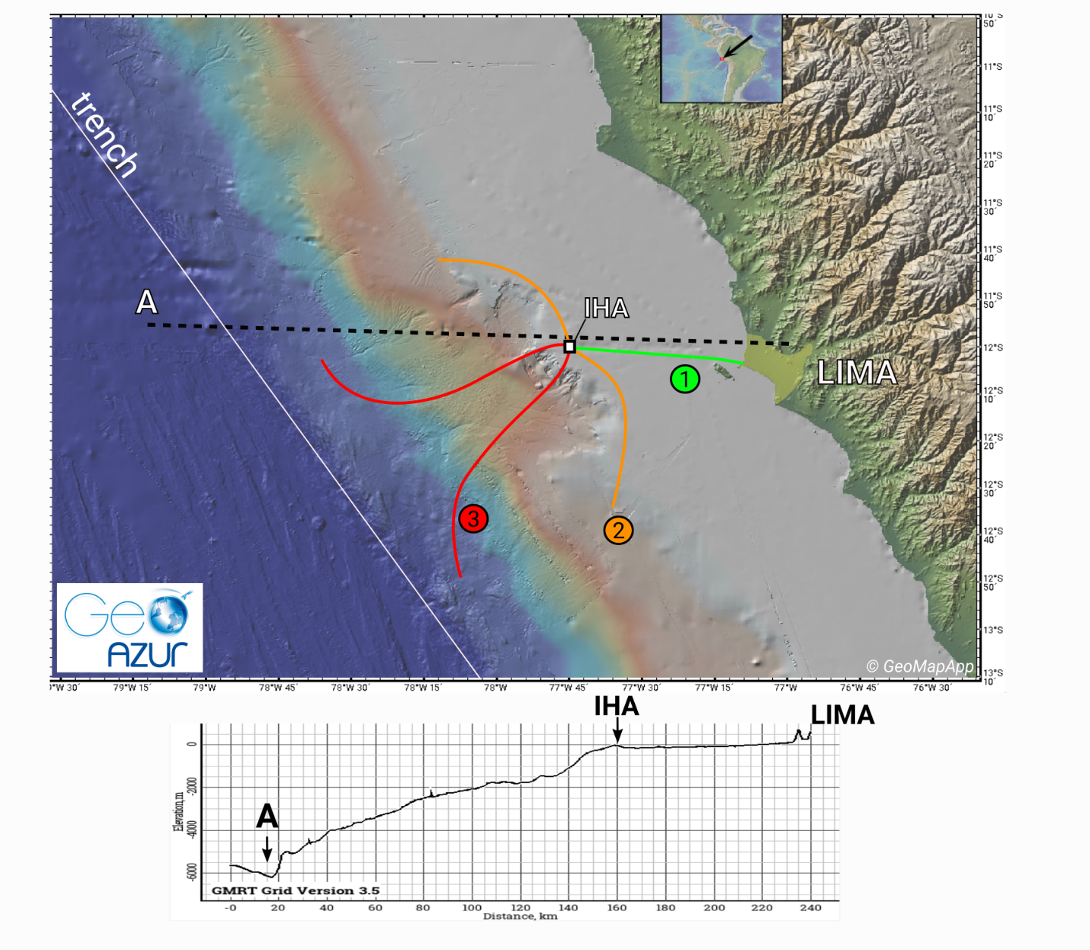
DAS-Peru – J.P. Ampuero ERC proposal

Slide 23
Marine DAS : a key moment for the French seismology community
France has pioneered marine DAS,
but more teams are now investing on it (USA, Japan, Spain, Portugal)
→ need to keep moving forward
So far, experiments have been short-duration
→ need for long-term observation
So far, data access has been restricted
→ need open data to accelerate broader use
So far, experiments have been led and analyzed by seismologists
→ need to train other communities for multi-disciplinary use

