Slide 1



Earthquake triggering by quarrying in France (Le Teil, Cruas, Nice)
J. P. Ampuero
Jérémy Billant, Chao Liang
(Geoazur SEISMES)

Slide 2
Overview
Le Teil: a quarry triggered earthquake
Potential for quarry triggering near the Cruas nuclear power plant
Quarry triggering near Nice?

Slide 3
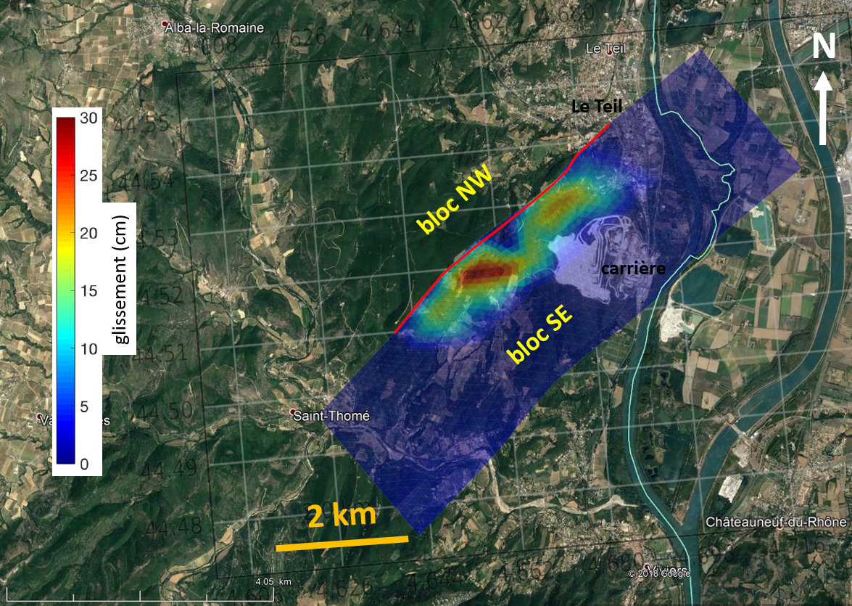
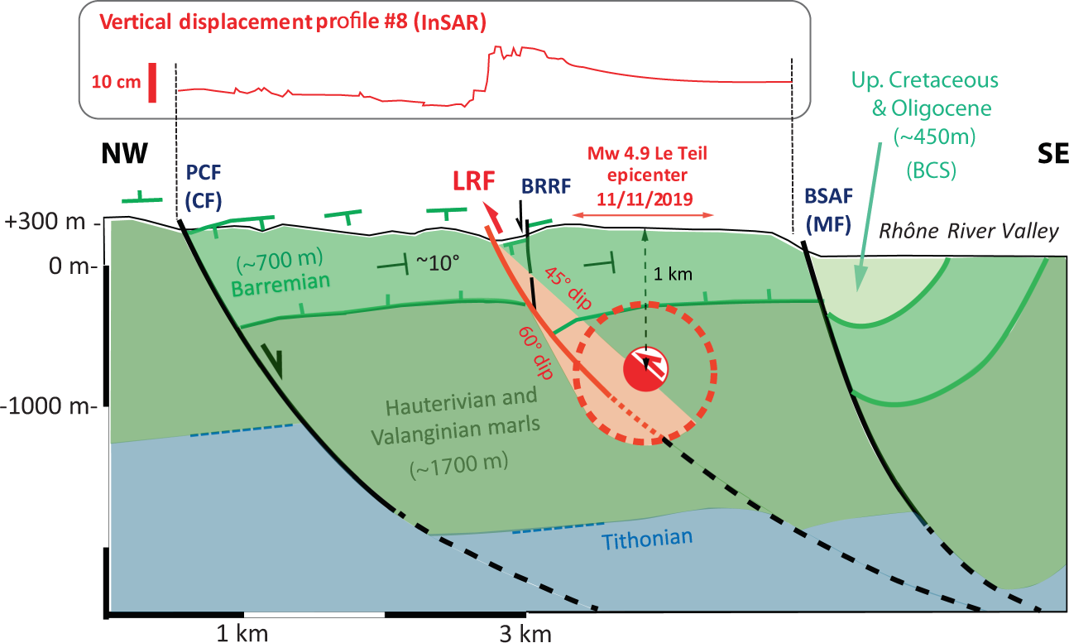
The November 11 2019 M5 earthquake in Le Teil, France
A surprisingly shallow event
Slip model inferred from InSAR (Grandin, Jolivet and Cavalié)
Quarry
Slip (cm)
Slip confined at shallow depth <2 km
Ritz et al. (2020)

Slide 4
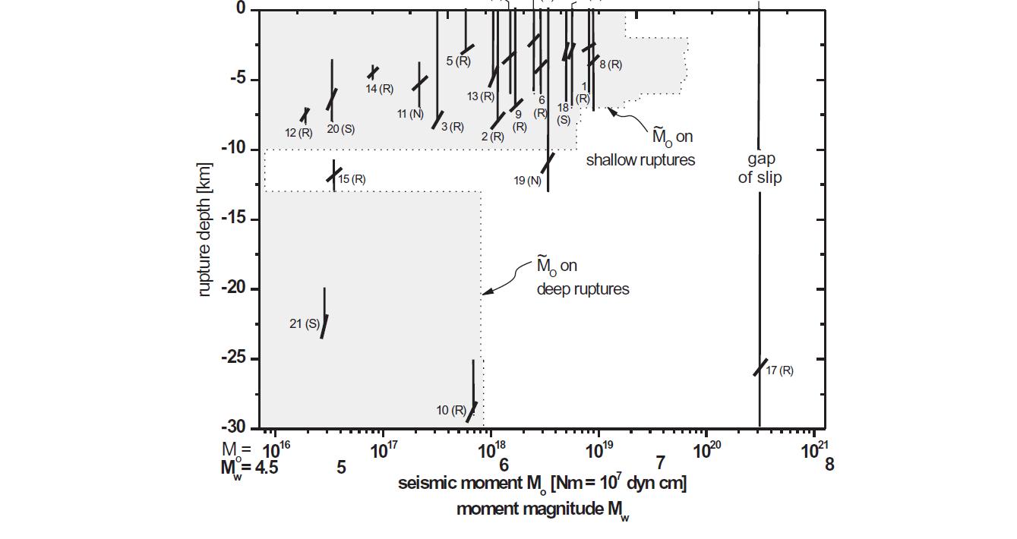
The November 11 2019 M5 earthquake in Le Teil, France
A surprisingly shallow event
Rupture depth of earthquakes
in stable continental regions
Le Teil
Klose and Sieber (2007)

Slide 5
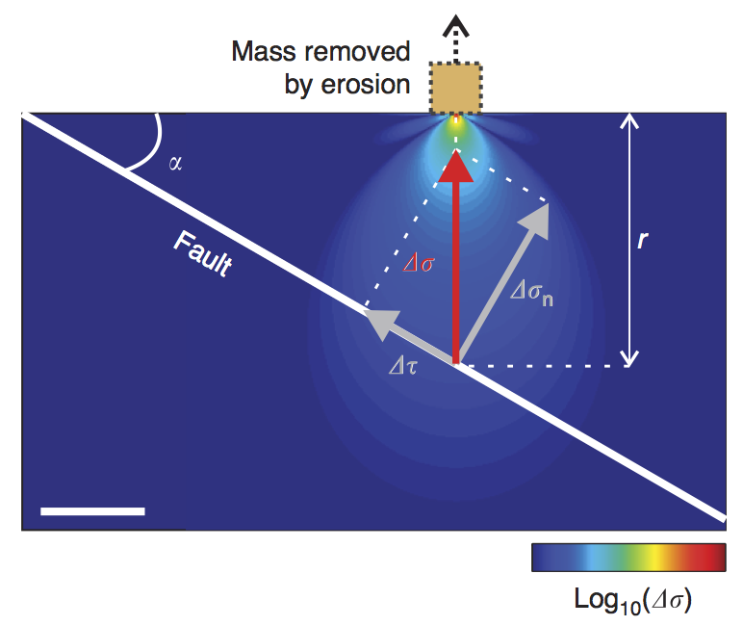
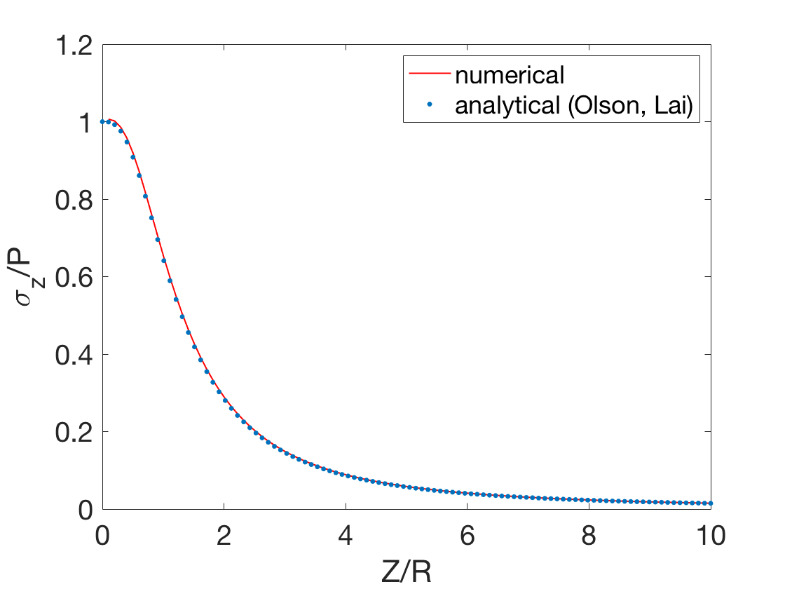
Surface mass removal promotes shallow reverse faulting
Induced stress decays quickly at depth
(analytical solution for a disk load)
P
R
Quarry
z
Steer et al. (2014)

Slide 6
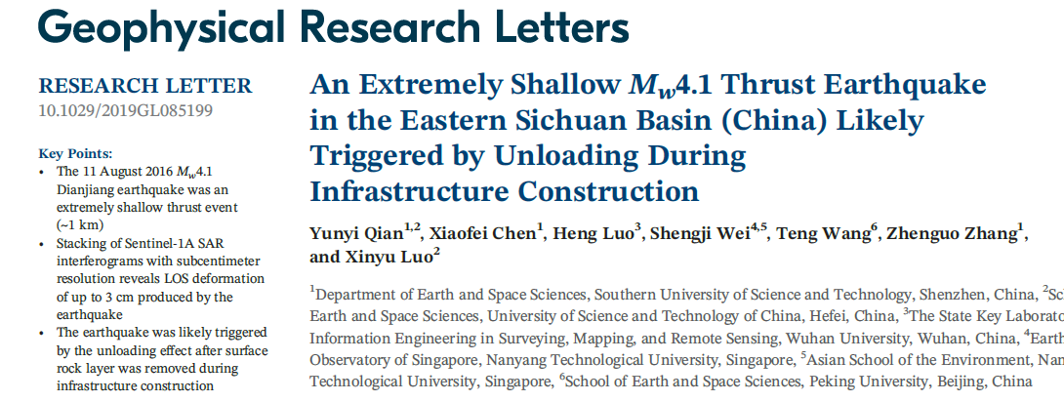
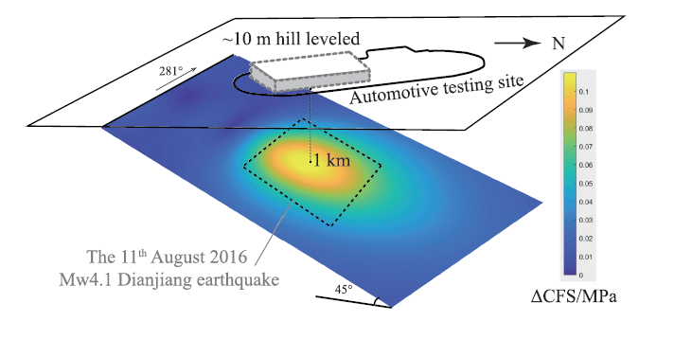
December 2019

Slide 7
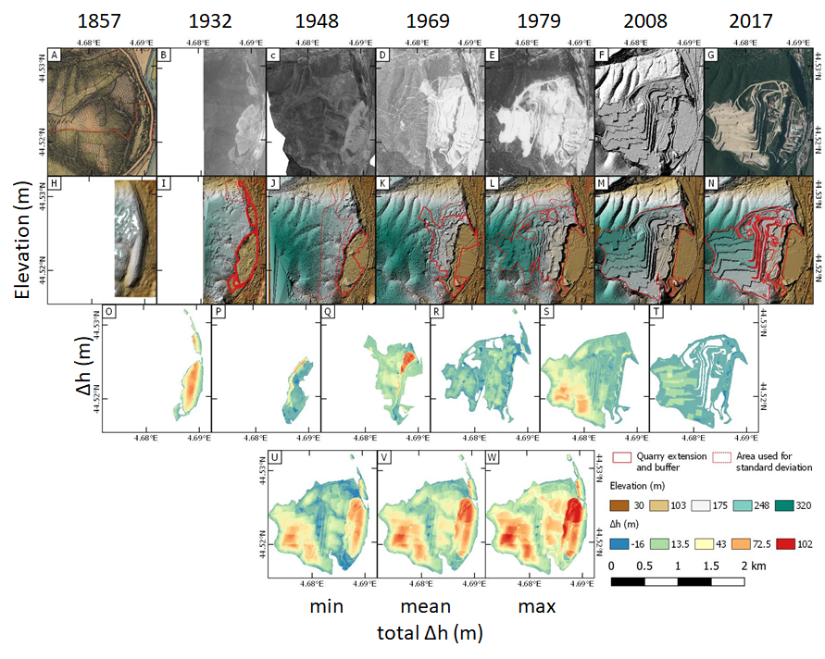
Estimate of volume extracted by Lafarge quarry
Data:
Aerial photographs and their parameters from 2017 campaign (IGN)
DEM derived from 2008 LiDAR campaign
Historical aerial photographs from 1932, 1948, 1969 and 1979 were downloaded from remonterletemps.ign.fr
1857 military map “Carte d’état major”
Inferred altitude change between each image pair

Slide 8
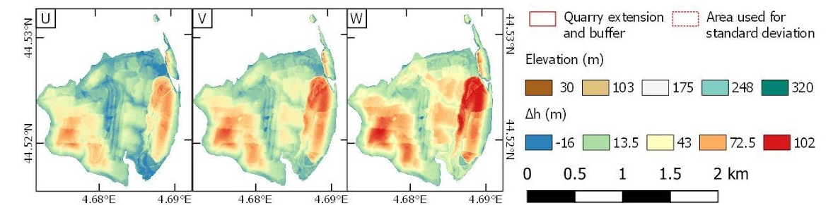
Estimate of volume extracted by Lafarge quarry
Extracted mass = 140 MT in 160 years

Slide 9
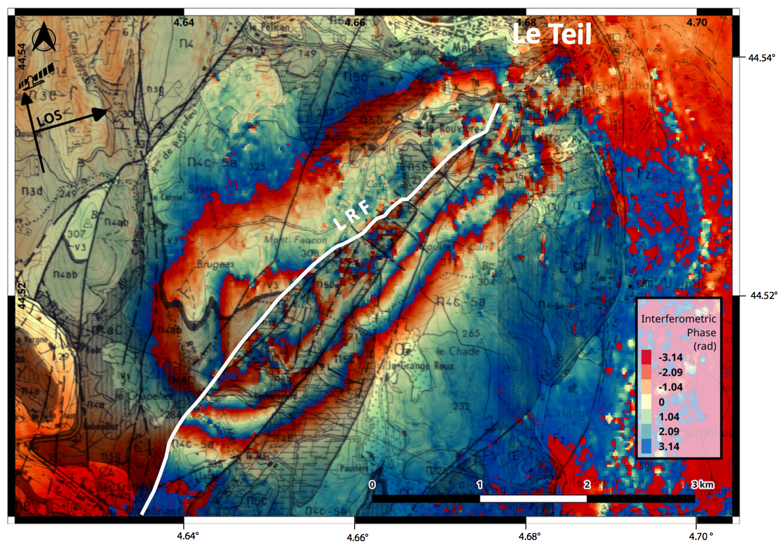
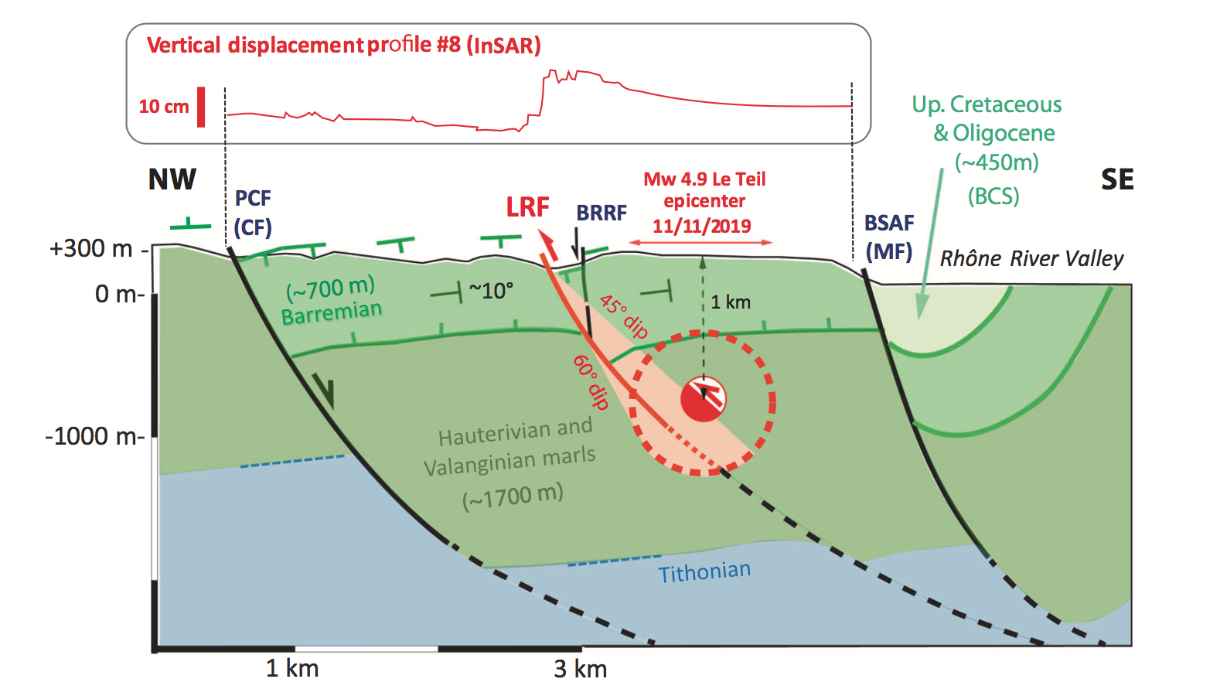
Fault and quarry geometry
Fault trace from InSAR
Geological cross-section
Ritz et al. (2020)
Notes:
+ contributions from Clément Bastie, school teacher at Le Teil

Slide 10
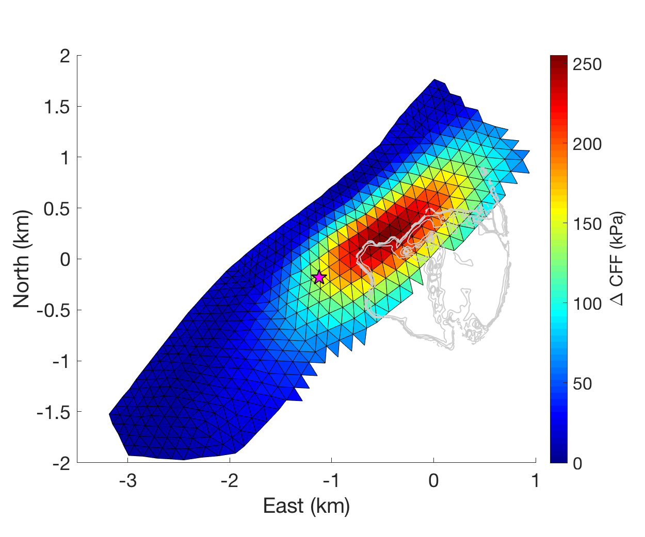
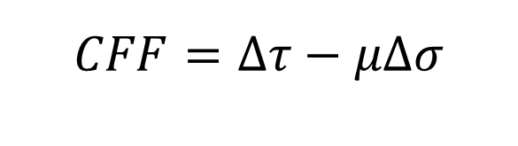
Coulomb stress changes on La Rouvière fault induced by quarry extraction
$$CFF=Δτ−μΔσ$$
Assumed friction coefficient 𝜇 = 0.5
2 km
mainshock epicenter (Bertrand Delouis)
Up to ~250 kPa Coulomb stress change

Slide 11
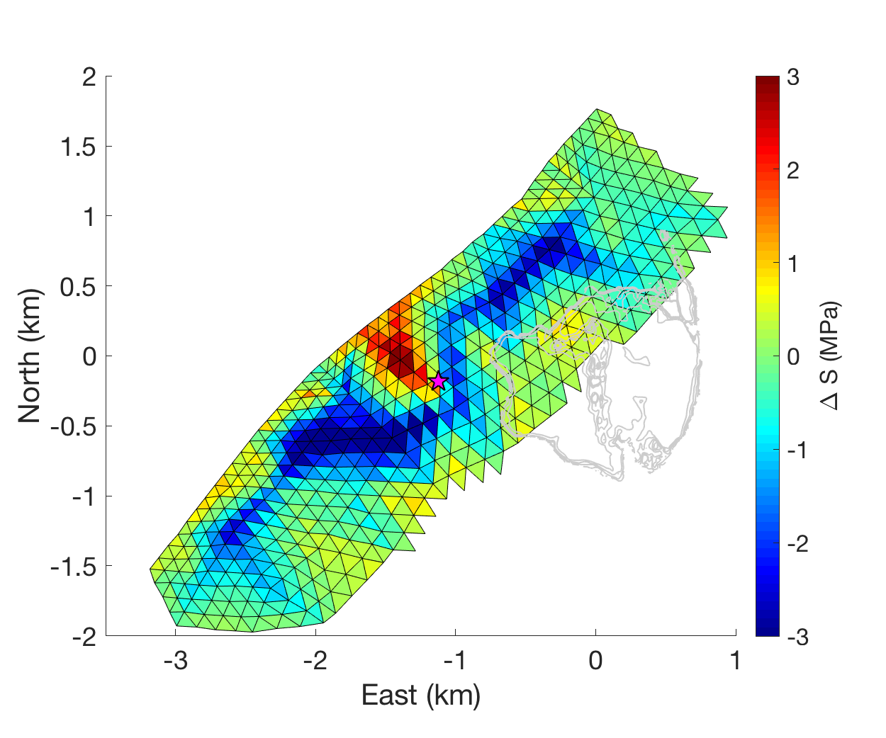
Induced stress changes compared to mainshock stress drop
CFF assuming 𝜇 = 0.5
Mainshock stress drop
2 km
2 km
mainshock epicenter from Bertrand Delouis
Up to ~250 kPa Coulomb stress change
Up to 3 MPa static stress drop

Slide 12
Overview
Le Teil: a quarry triggered earthquake
Potential for quarry triggering near the Cruas nuclear power plant
Quarry triggering near Nice?

Slide 13
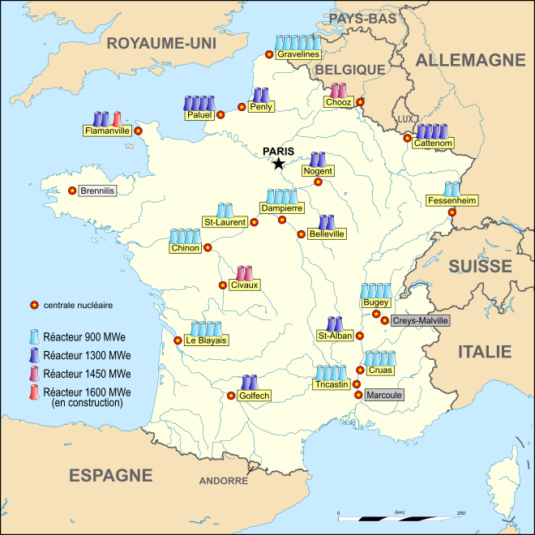
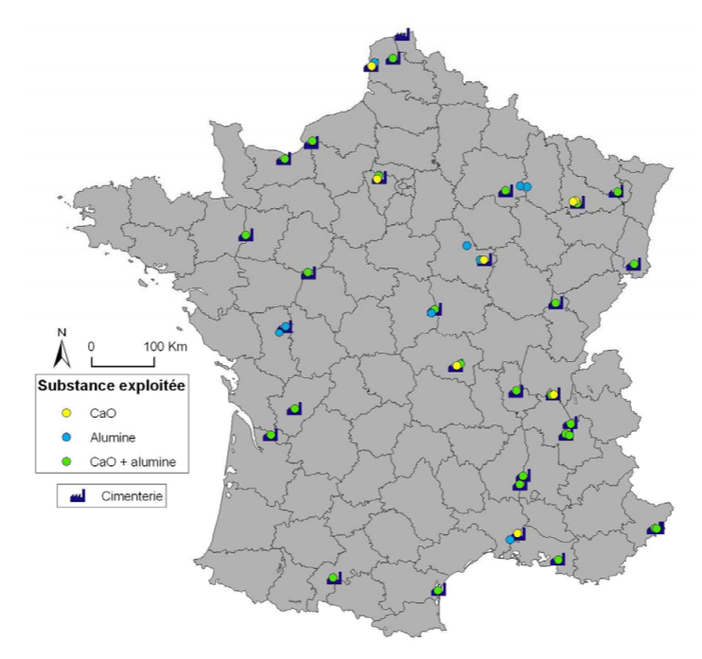
Nuclear power plants in France
Cement quarries in France
(BRGM)

Slide 14
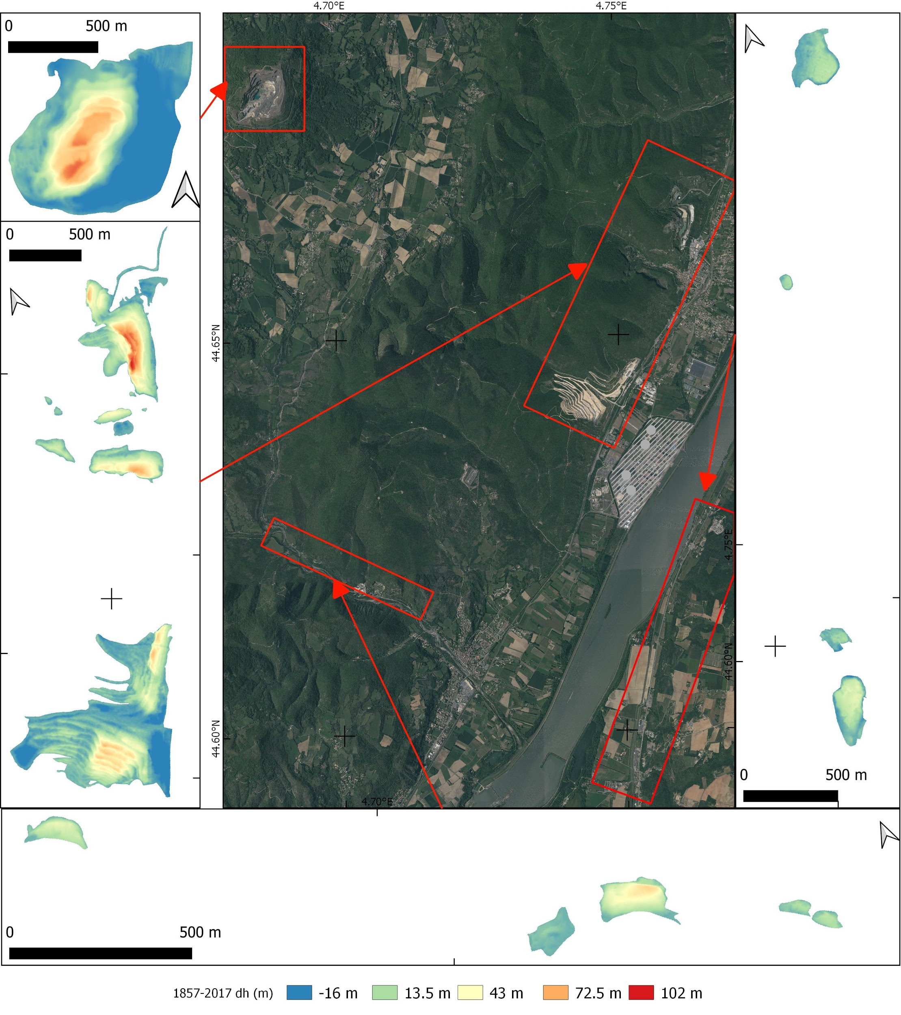
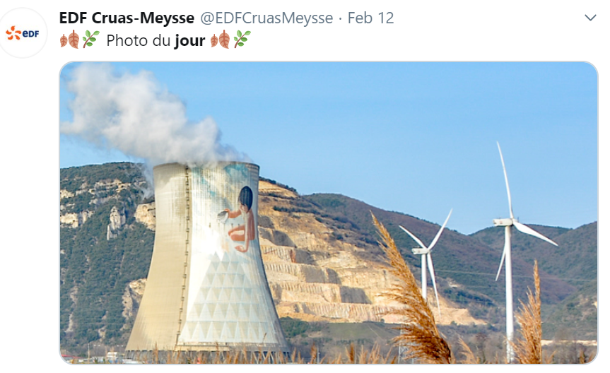
Other quarries in the region
Quarries from Le Teil to Cruas identified by visual inspection (Google Earth)
For each quarry we estimated extracted volumes since ~1850s from aerial photos, etc
Cruas

Slide 15
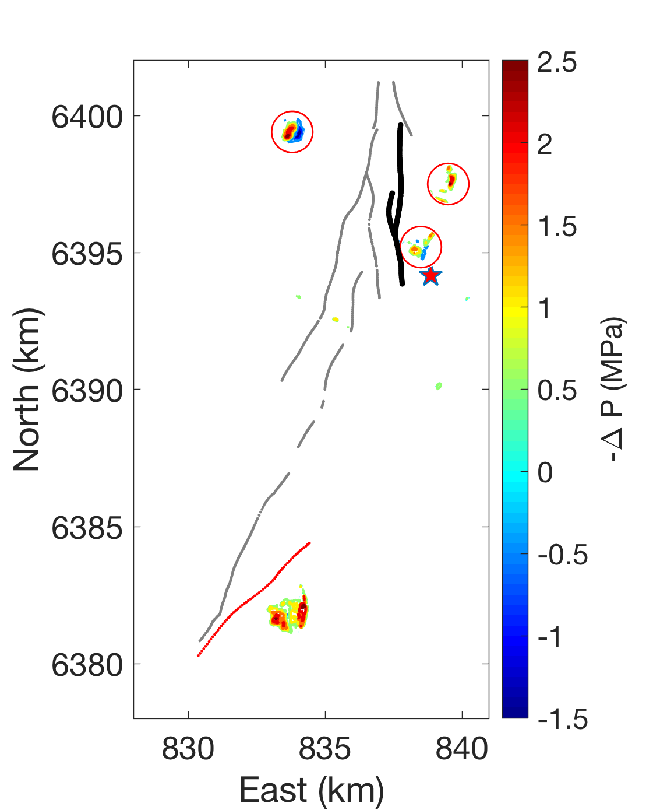
Fault geometry, quarries and surface pressure change
Surface pressure change (from average map)
9.51 Mt
24.61 Mt
Focus on the two faults nearest to Cruas power plant (from BRGM geological map).
The largest effect is induced by the nearest quarry
The effect of the smaller scattered quarries is negligible.
14.12 Mt
Cruas
Scatters: 4.14 Mt
2019 rupture
Le Teil
139.15 Mt
Notes:
Note the audience that some of the small faults are not included in the BDFA map but included in the BRGM map.

Slide 16
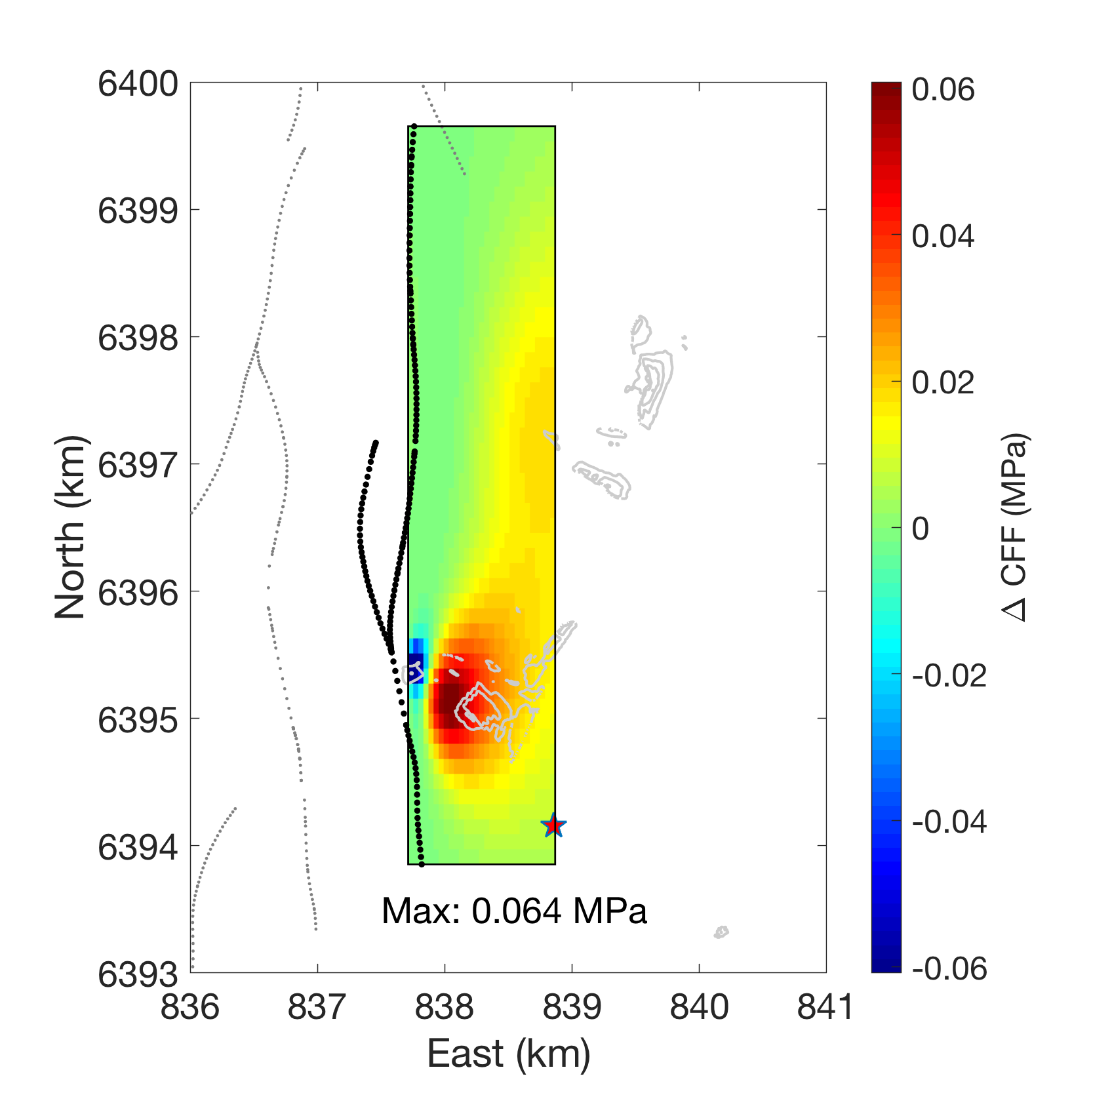

Stress induced by quarries on faults near Cruas
Approx: one NS trending fault, dip 60
Assumed $μ=0.5$
CFF max ~60 kPa
at shallow depths 300 - 500 m
Cruas

Slide 17
Overview
Le Teil: a quarry triggered earthquake
Potential for quarry triggering near the Cruas nuclear power plant
Quarry triggering near Nice?

Slide 18
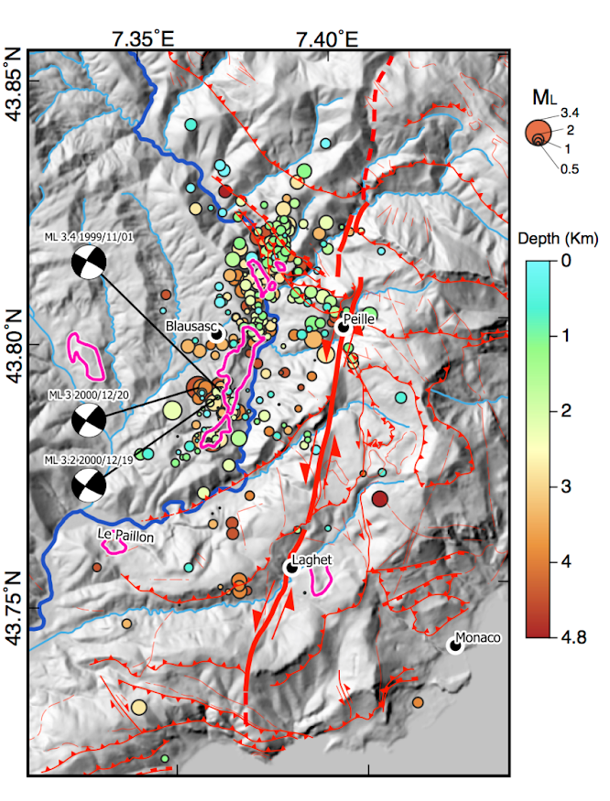
The 2000-2001 swarm near Blausasc
Courboulex et al (2003, 2007)
→ Blausasc fault, potential M5.7
Pink contours: quarries

Slide 19
Summary
The 2019 Le Teil earthquake was possibly triggered by quarrying
  Induced stress ~250 kPa, similar to stresses reported to trigger earthquakes in California and much larger than a reported triggering threshold of 10 kPa
  Hypocenter within the area of influence of quarry-induced stresses
  ~10% of coseismic stress drop: triggered, not induced
Quarrying has induced significant stresses on faults near the Cruas nuclear plant
  Induced stresses ~60 kPa, at shallow depth
Quarry triggering near Nice?
  Spatial correlation between an earthquake swarm and quarries

Slide 20
Backup slides

Slide 21
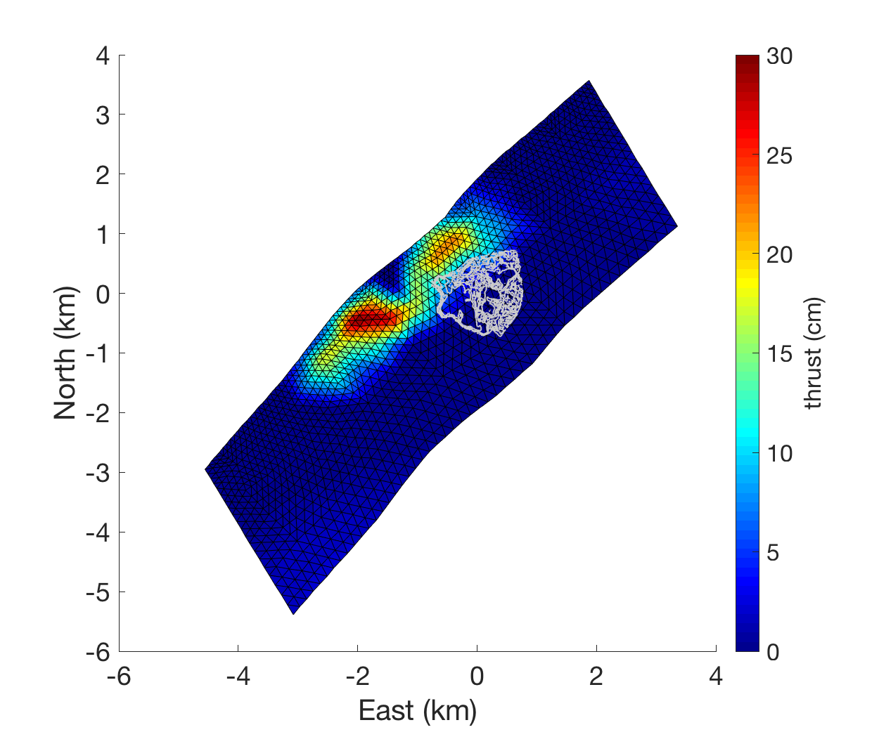
Open questions that fault drilling can address
What stops earthquake ruptures at depth and laterally?
(role of deep marl layers?)
How do earthquakes nucleate at such shallow depths?
How do fault properties control rupture features at the hypocenter, in high slip areas, at the rupture ends, in between slip asperities?
What controls the scarcity of aftershocks?
Can rupture behavior be well predicted by surface studies only?
(Coseismic slip + quarry. From Le Teil report INSU/CNRS)

Slide 22
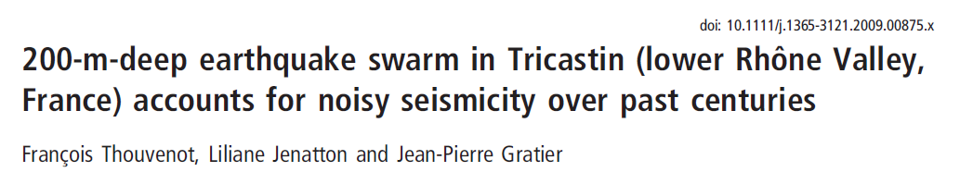
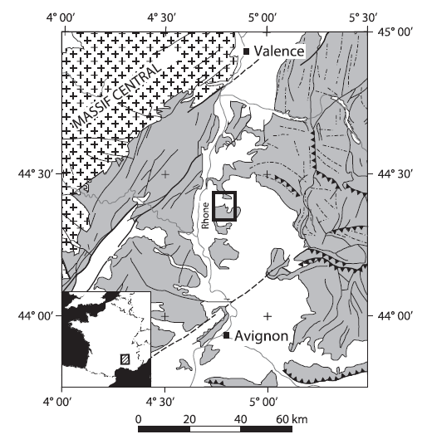
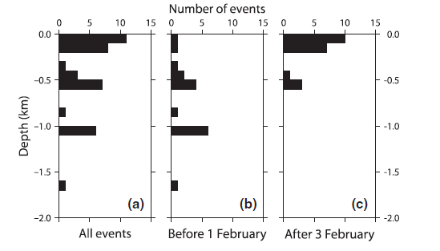
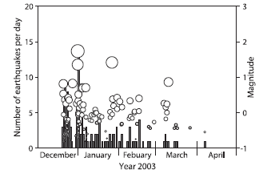
Terra Nova, 2009

Slide 23
The November 11 2019 M5 earthquake in Le Teil, France
Rupture controlled by material properties?
Limestones on top, marls at bottom
→ Soft layer beneath rupture in ambient-noise velocity model
Ritz et al. (2020)
Cornou et al. (2021)

Slide 24
(Tectonophysics, 2013)

Slide 25
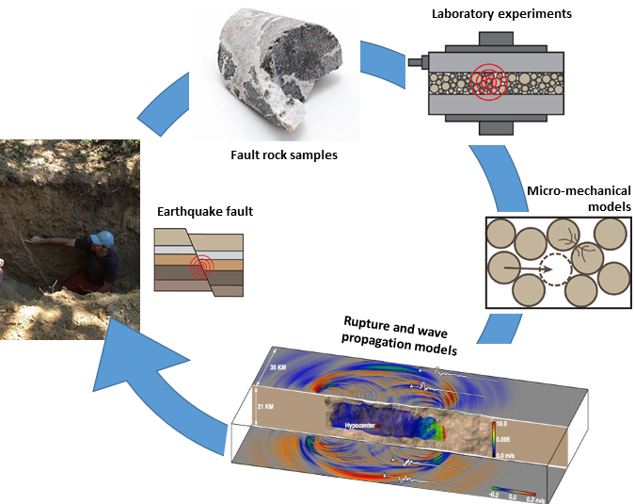
Exceptional opportunity in Le Teil to probe fault mechanics through drilling at hypocentral depth (ANR HYPERTEIL)
Integrated multi-scale fault modeling approach: sampling fault materials, laboratory testing, micro-mechanical modeling and large-scale earthquake modeling.
This approach is currently based on rock sampling at shallow depth and lab-and-physics-based extrapolation to seismogenic depth.
Owing to its exceptionally shallow rupture, a fault observatory at seismogenic depth is viable in Le Teil to validate this approach via direct observations.

