Slide 1


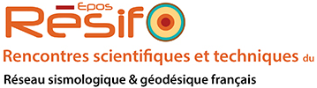


Vers une surveillance continue des zones de faille et des volcans à l'aide d'ondes de volume interférométriques reconstruites à partir de stations large-bande permanentes
Yixiao Sheng¹, Laure Brenot¹, Aurélien Mordret¹, Korbinian Sager^{2,3}, Florent Brenguier¹, Pierre Boué¹, Baptiste Rousset¹, Frank Vernon⁴, Yehuda Ben-Zion⁵
1. ISTerre, University Grenoble Alpes,CNRS, 2. Brown University, 3. Ludwig Maximilian University of Munich,
4. University of California San Diego, 5. University of Southern California

Slide 2
OUTLINES
A hidden slow-slip along the San Jacinto fault
(Y. Sheng et al.)
Preliminary results on the Piton de la Fournaise Volcano
(L. Brenot et al.)

Slide 3
METHODOLOGICAL PRINCIPLE
Standard noise correlations:
Coda-wave monitoring very precise but low spatial resolution
Ballistic-waves monitoring less precise, higher spatial resolution, more straightforward propagation, but very sensitive to noise sources distribution and variations
Solution: Opportune sources interferometry
Find strong, stable and repetitive noise sources
Only correlate the time windows when the sources are active
Monitor ballistic waves
Grobbe, Mordret et al., 2021

Slide 4
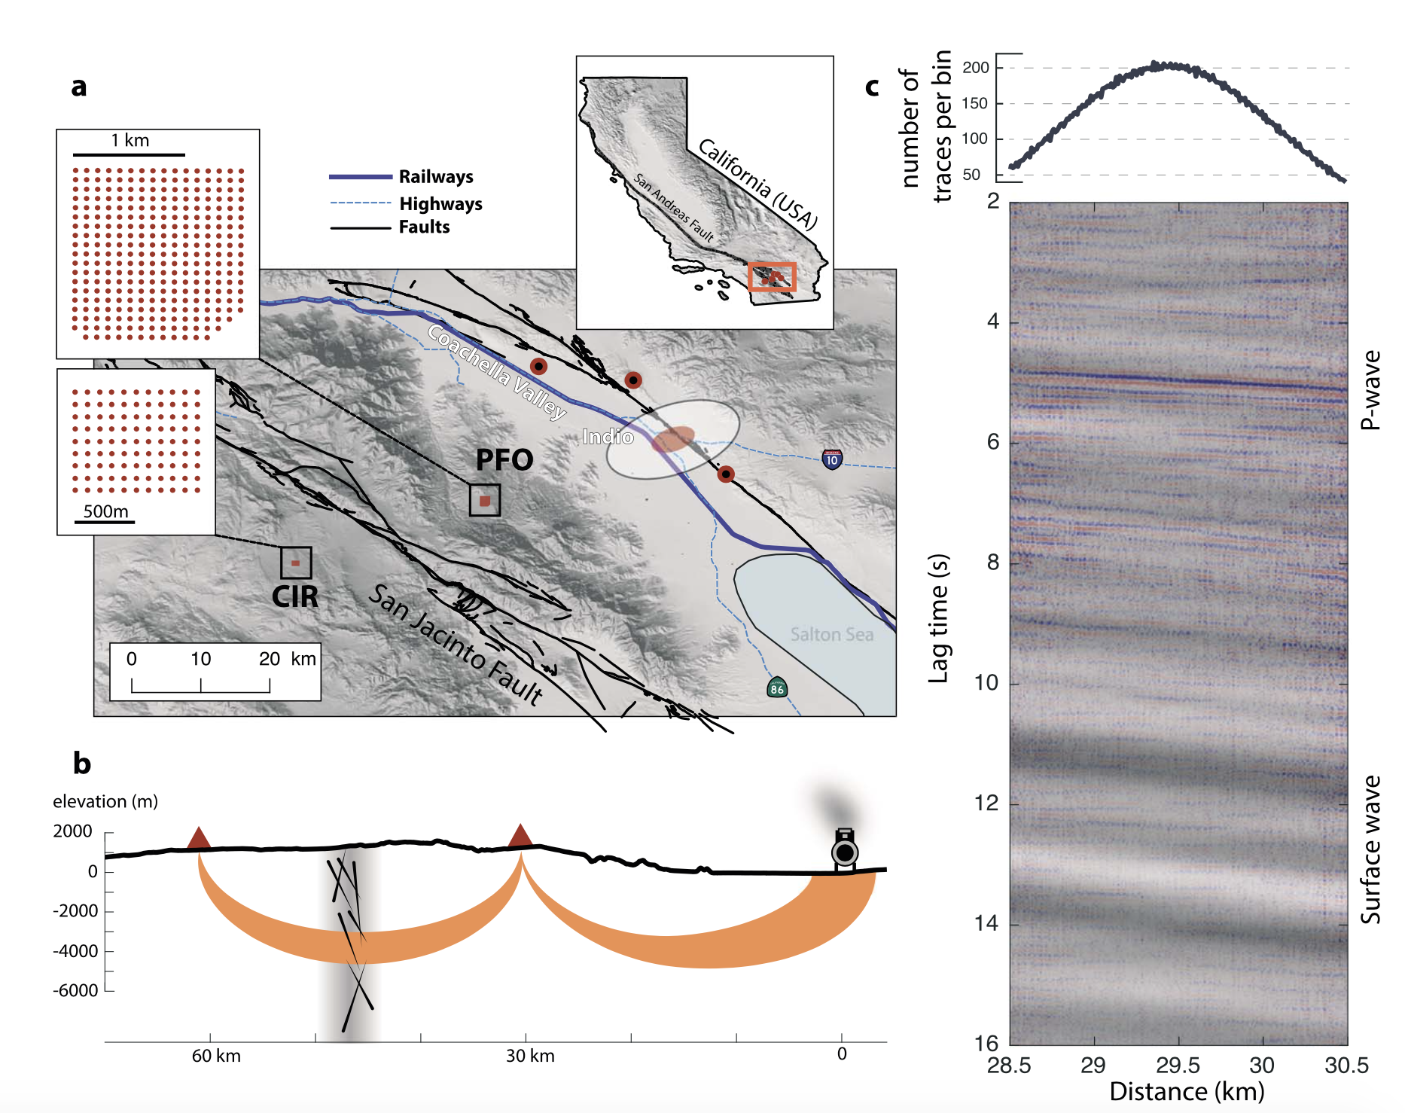
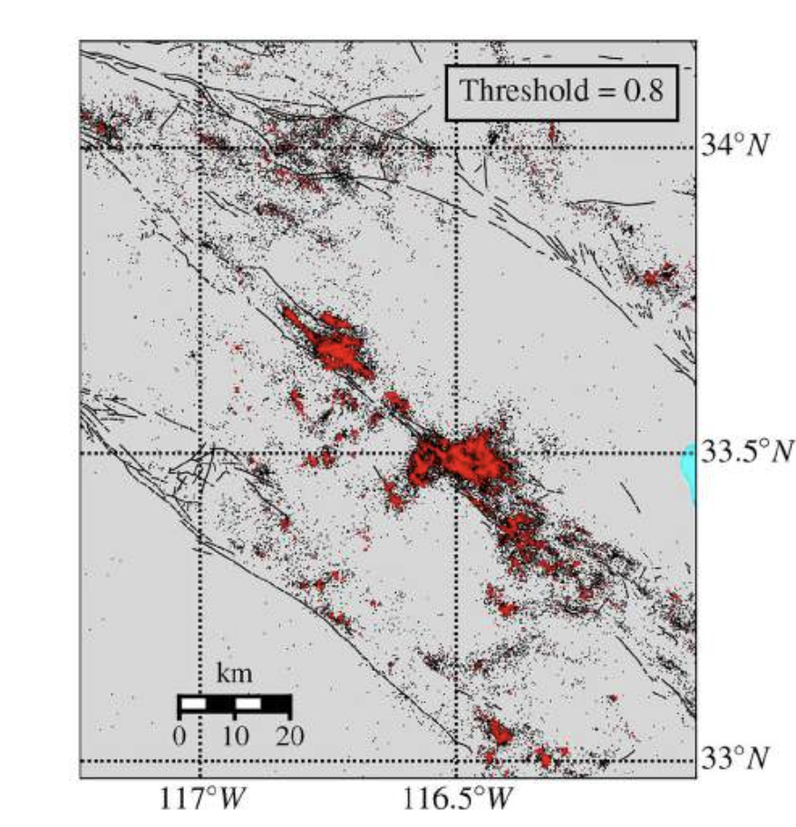
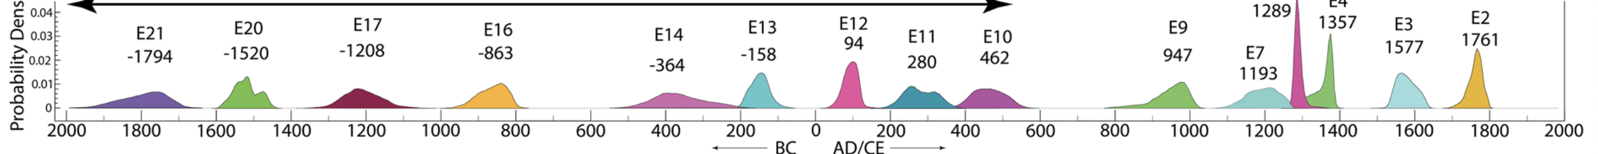
MOTIVATION
White et al., 2019
2009-2016
Most active area in California
Anza seismic gap potential M6.5+
Recurrence time = 254 ± 120 years
Last eq. in 1761, 260 year ago!!!
San Andreas
Anza Gap
San Jacinto
Elsinore
Rockwell et al., 2014

Slide 5
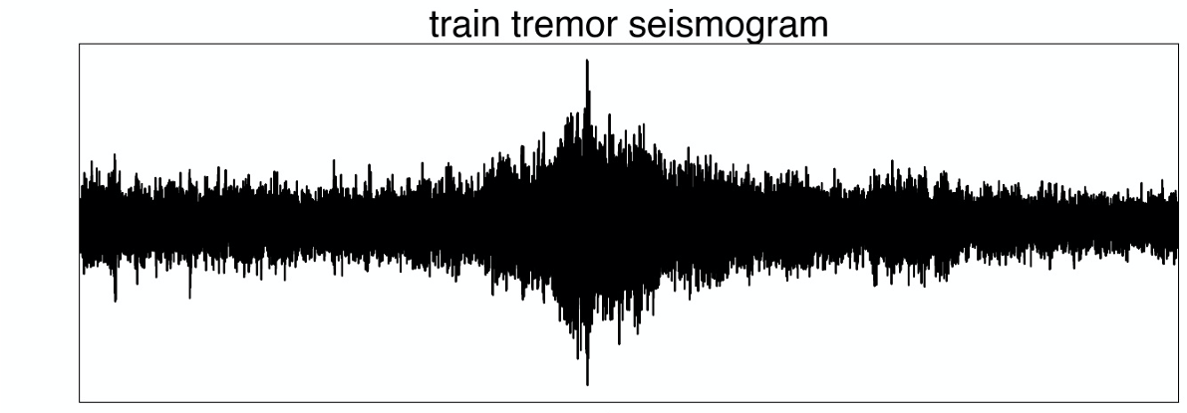
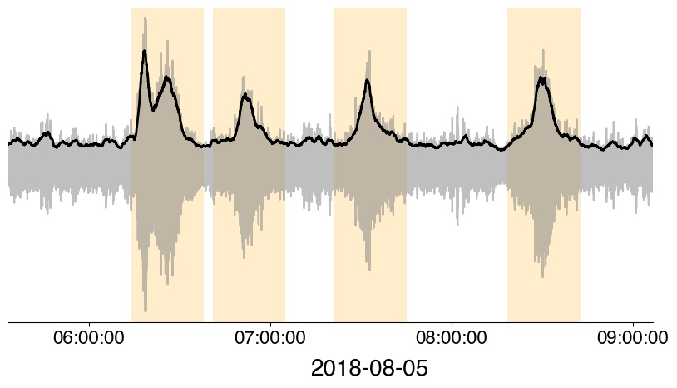
EXPERIMENTAL SETUP
CIR array
PFO array
Correlating train tremors for long-term seismic monitoring of the San Jacinto Fault
Brenguier et al., 2019

Slide 6
ARRAY-ARRAY CORRELATIONS
Clear P wave emerging from array-array cross-correlation
BUT:
Temporary arrays are not ideal for long-term seismic monitoring
CIR array
PFO array
Brenguier et al., 2019

Slide 7
ARRAY-ARRAY CORRELATIONS
Single-station correlations exploitable?
PFO array
Brenguier et al., 2019

Slide 8
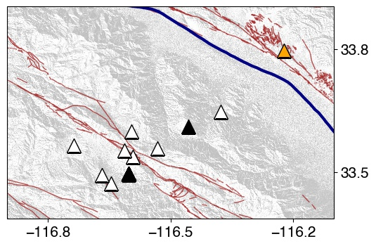
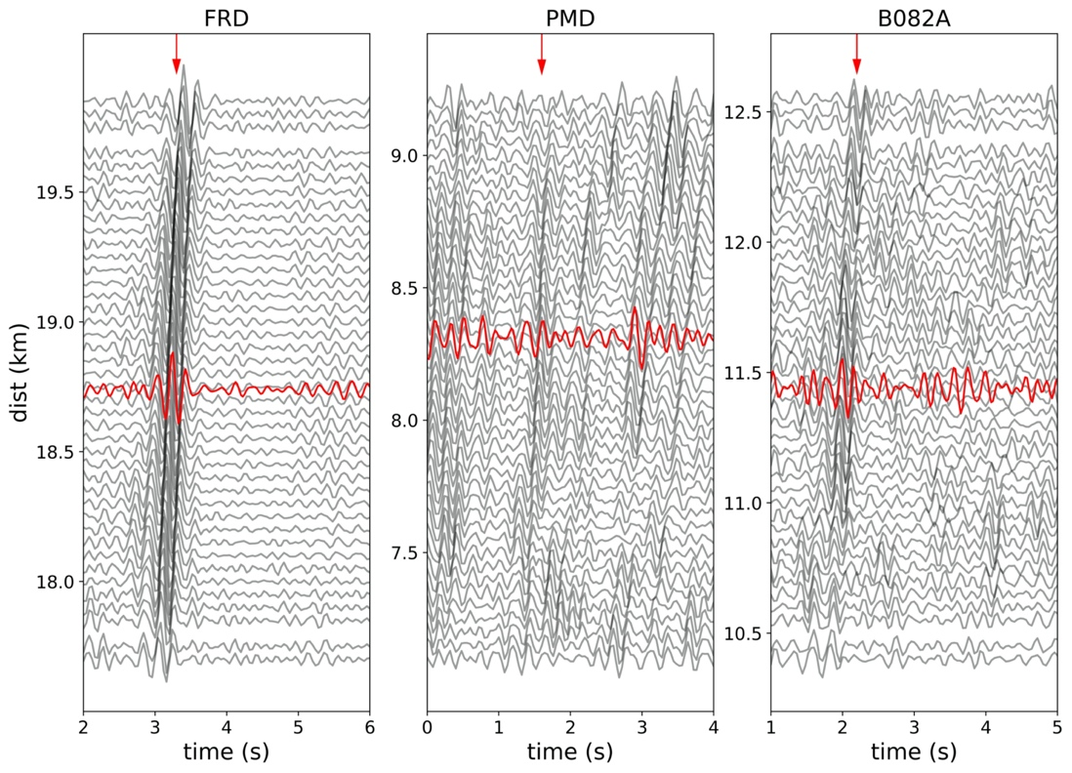
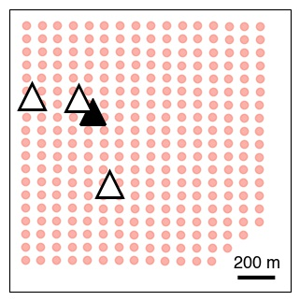
ARRAY vs. SINGLE-STATION CORRELATIONS
Filtered 3-8 Hz
PMD
B082A
FRD
IIPFO
IIPFO-PMD
IIPFO-FRD
IIPFO-B082A
Station-station correlations are promising for seismic monitoring
The temporary array is useful for phase identification

Slide 9
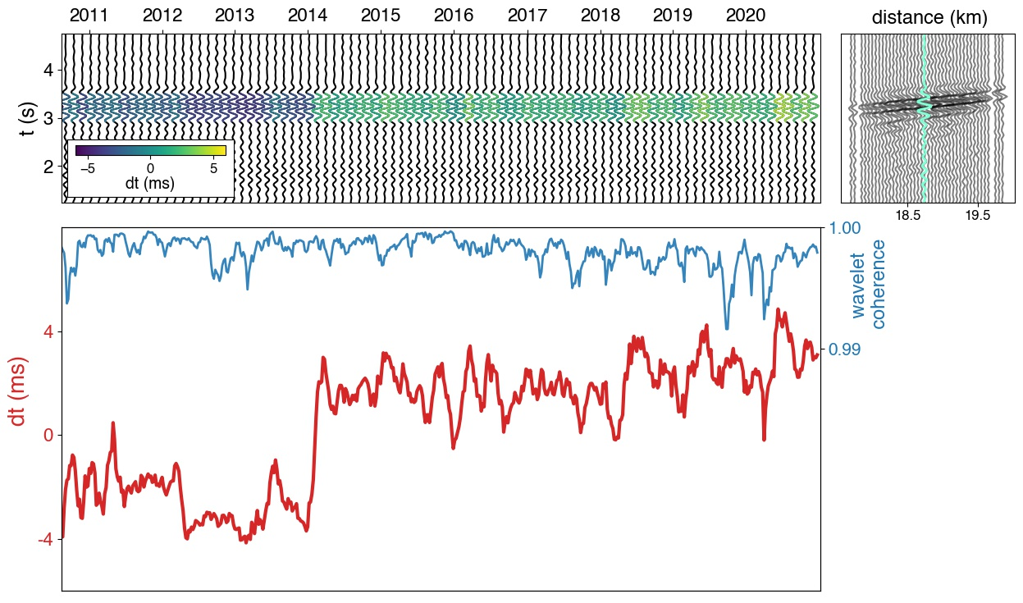
10-YEAR MONITORING – SINGLE PAIR
Reference xcorr = average 2011-2021
Time-shift calculated by the x-wavelet method (Mao et al., 2020)
Frequency range: 4-6 Hz
Array-FRD
IIPFO-FRD

Slide 10
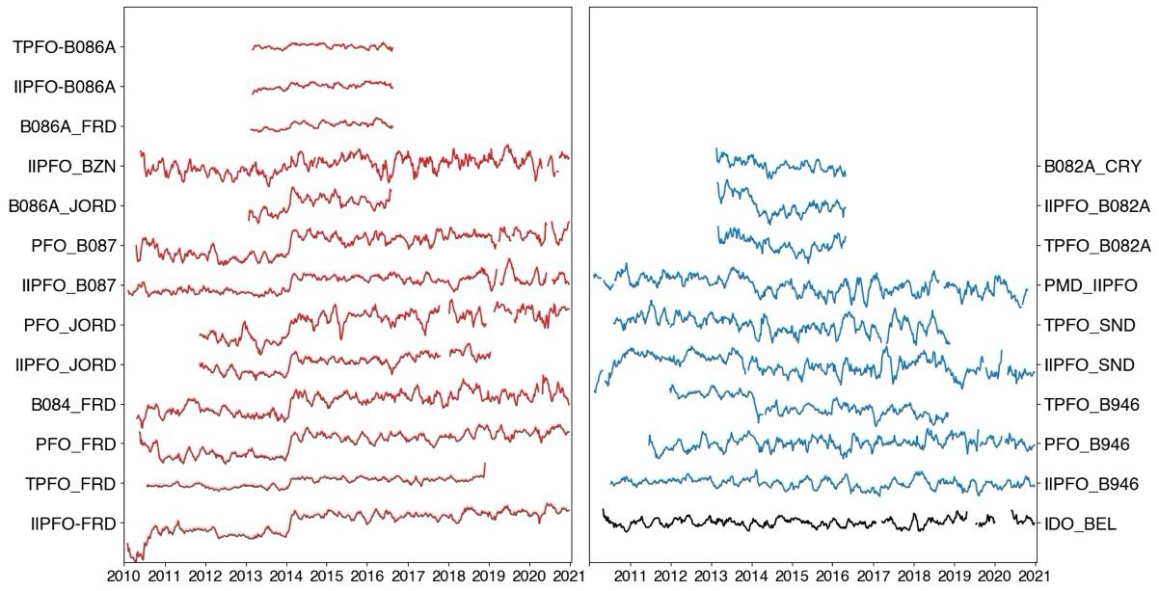
10-YEAR MONITORING – MULTIPLE PAIRS
Velocity decrease
Velocity increase

Slide 11
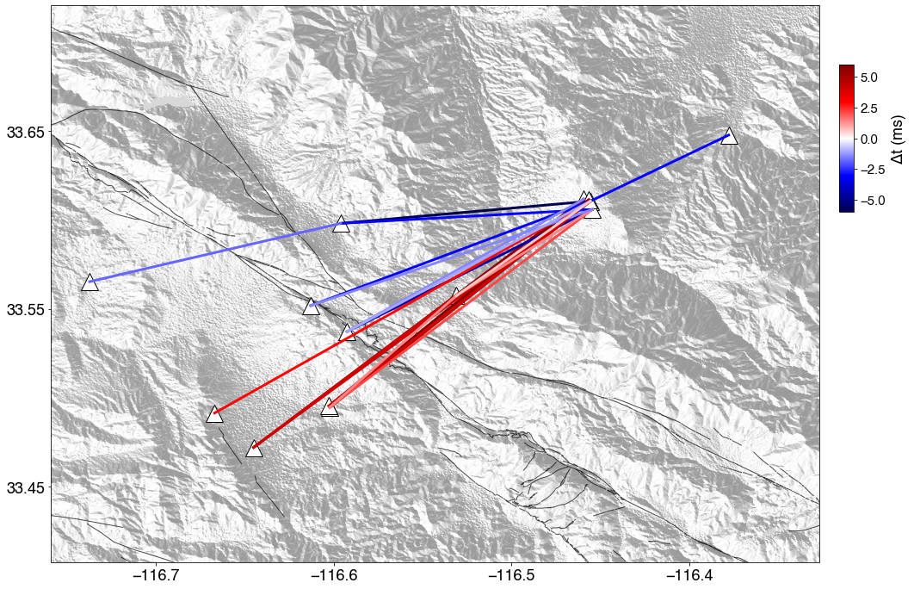
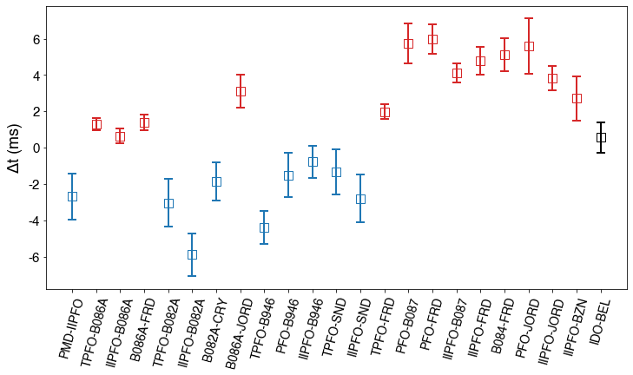
SPATIAL PATTERN

Slide 12
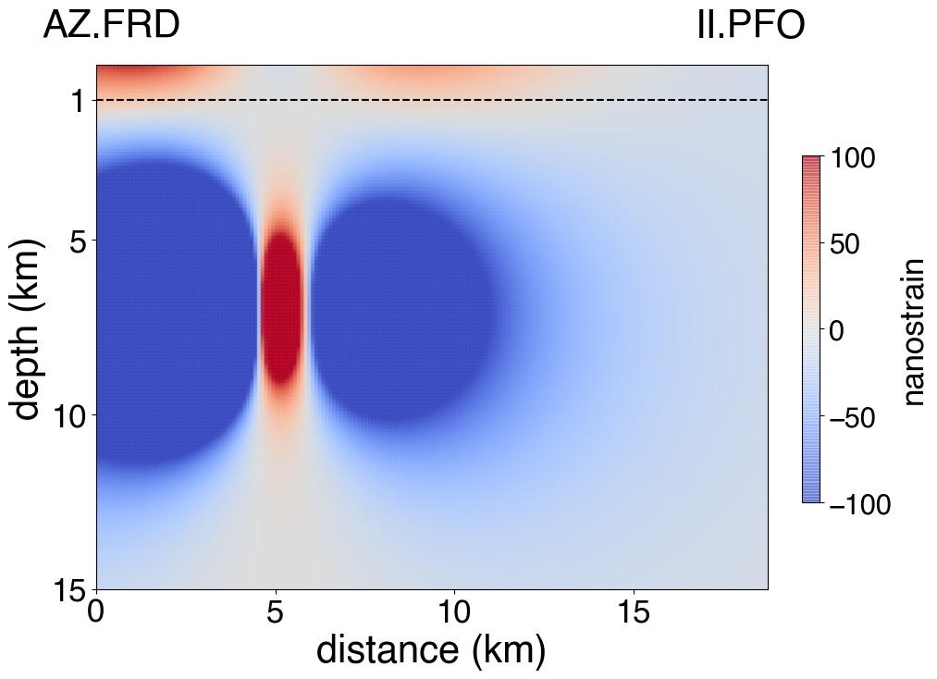
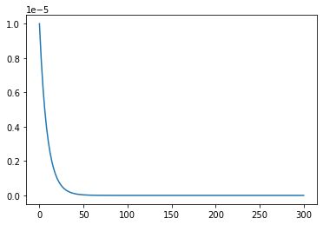
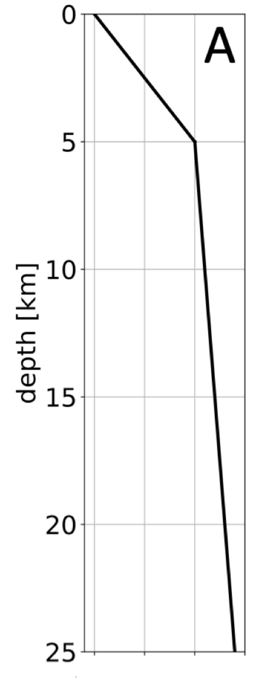
MODELLING
Interpretation: volumetric strain variation caused by aseismic slip
Volumetric strain simulation
(Coulomb software: isotropic, elastic medium)
Stress-velocity sensitivity
(10⁻⁹ -10⁻⁶ from literatures)
Correlation function Vp sensitivity
(layered base velocity model)
Lin and Stein, 2004
10^{-5-depth}
Yamamura et al., 2003
0
5
10
15
20
25
30
depth (km)
Sager et al., 2021
5.0
6.0
Vel km/s

Slide 13
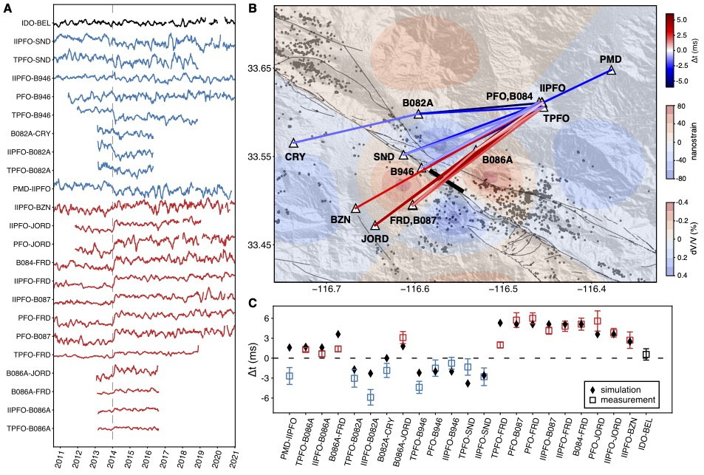
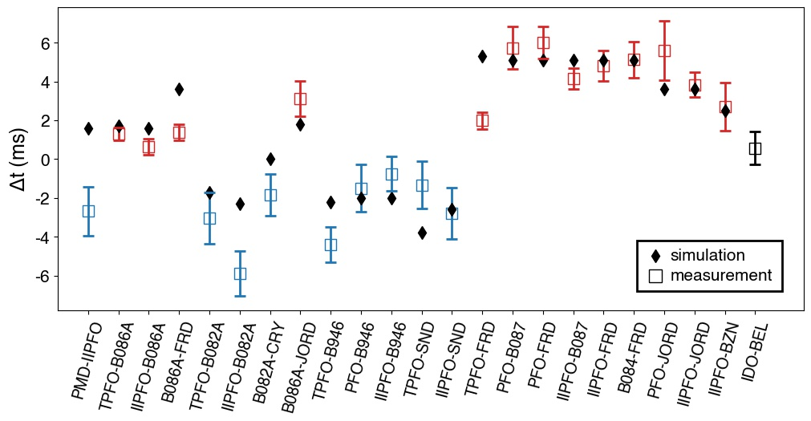
HIDDEN SLOW ASEISMIC SLIP
Body wave from station-station correlation
10-year seismic velocity monitoring
2-month-long transient
Aseismic slip near the edge of the seismic gap
Preferred dislocation:
Length: 4km
Depth: 6-8 km
Slip 0.2 m
Magnitude ~M5
QTM catalog, Ross et al., 2019

Slide 14
APPLICATION TO PITON DE LA FOURNAISE
24 eruptions since 2014
Colocated BB stations and dense arrays

Slide 15
ARRAY vs. BROADBAND
Array vs. array
Reconstruct P-wave from same time-span
Source toward the ocean but need further investigation to clarify the location
Nakata et al., 2016

Slide 16
BROADBAND vs. BROADBAND
FOR - CSS
Reconstruct P-wave
2013 to 2021
Removed eruptive periods for clarity

Slide 17
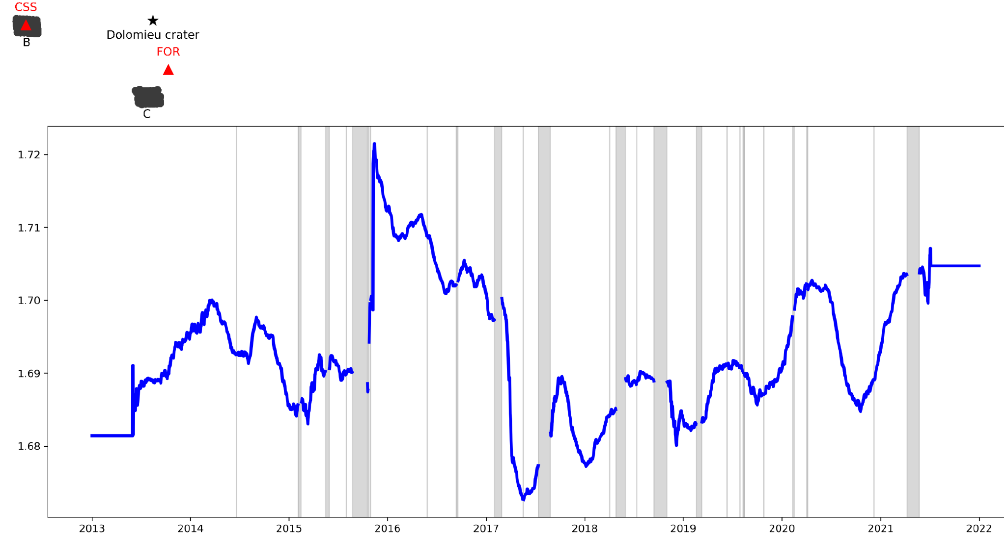
TEMPORAL VARIATIONS
FOR - CSS
Large variations for some eruptions located close to FOR
Travel-time (s)

Slide 18
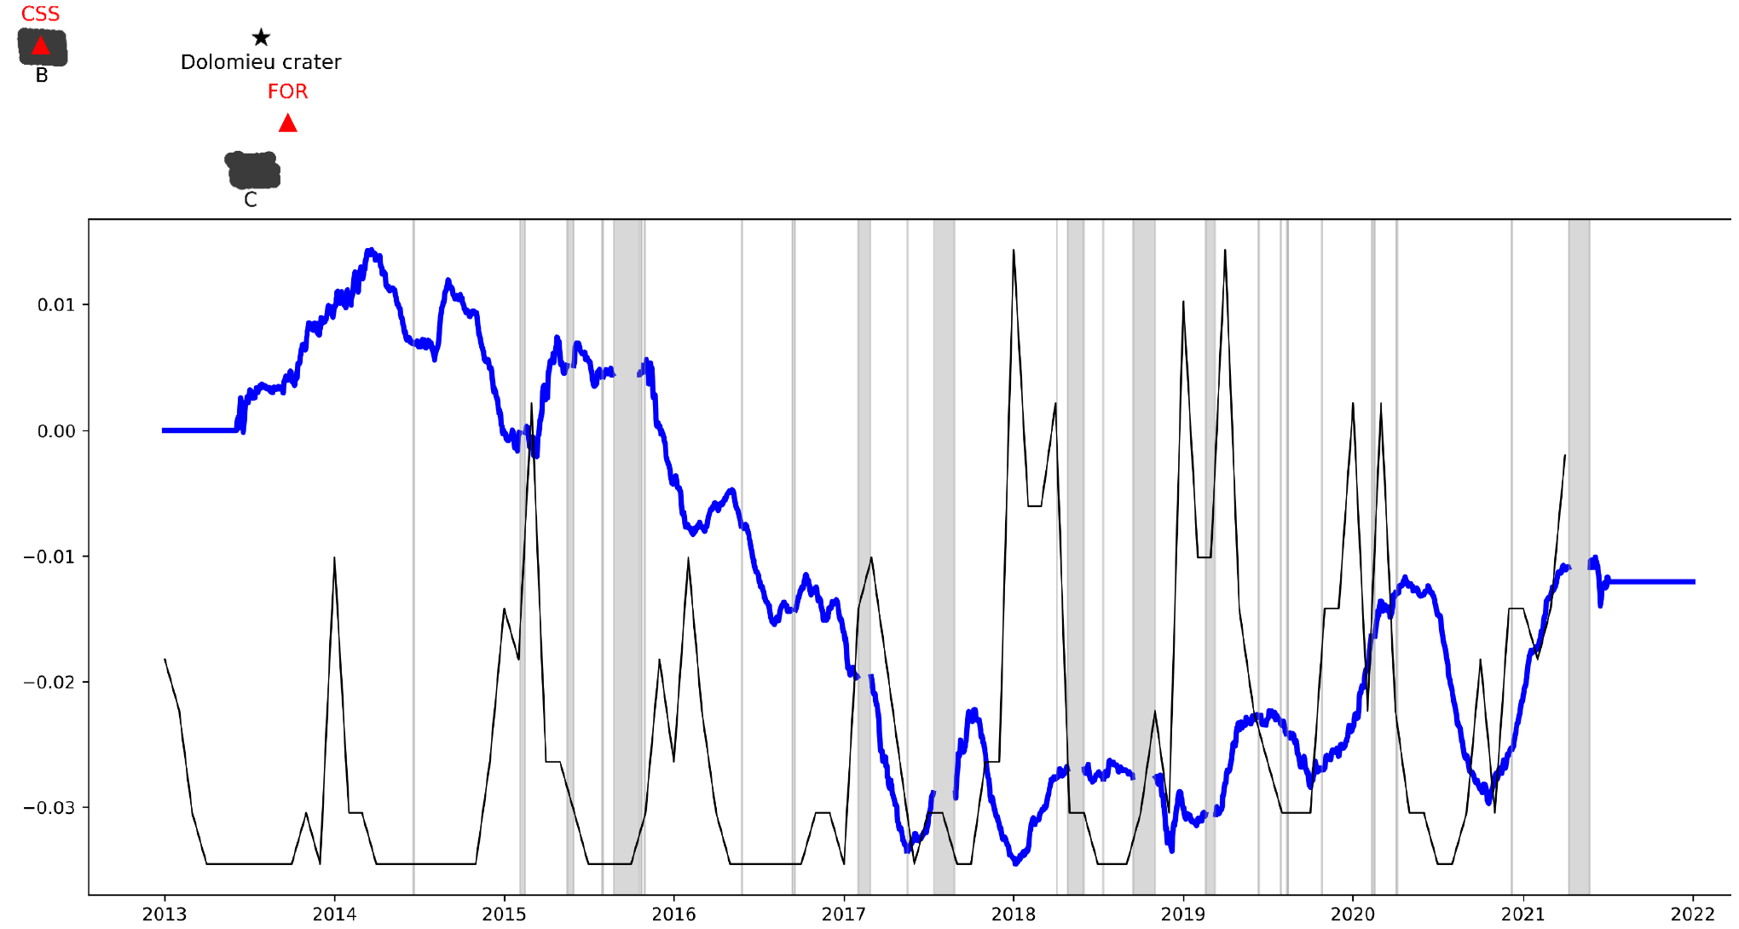
TEMPORAL VARIATIONS
FOR - CSS
Yearly period correlated with rainfalls
Longer trend to be investigated
Travel-time (s)

Slide 19
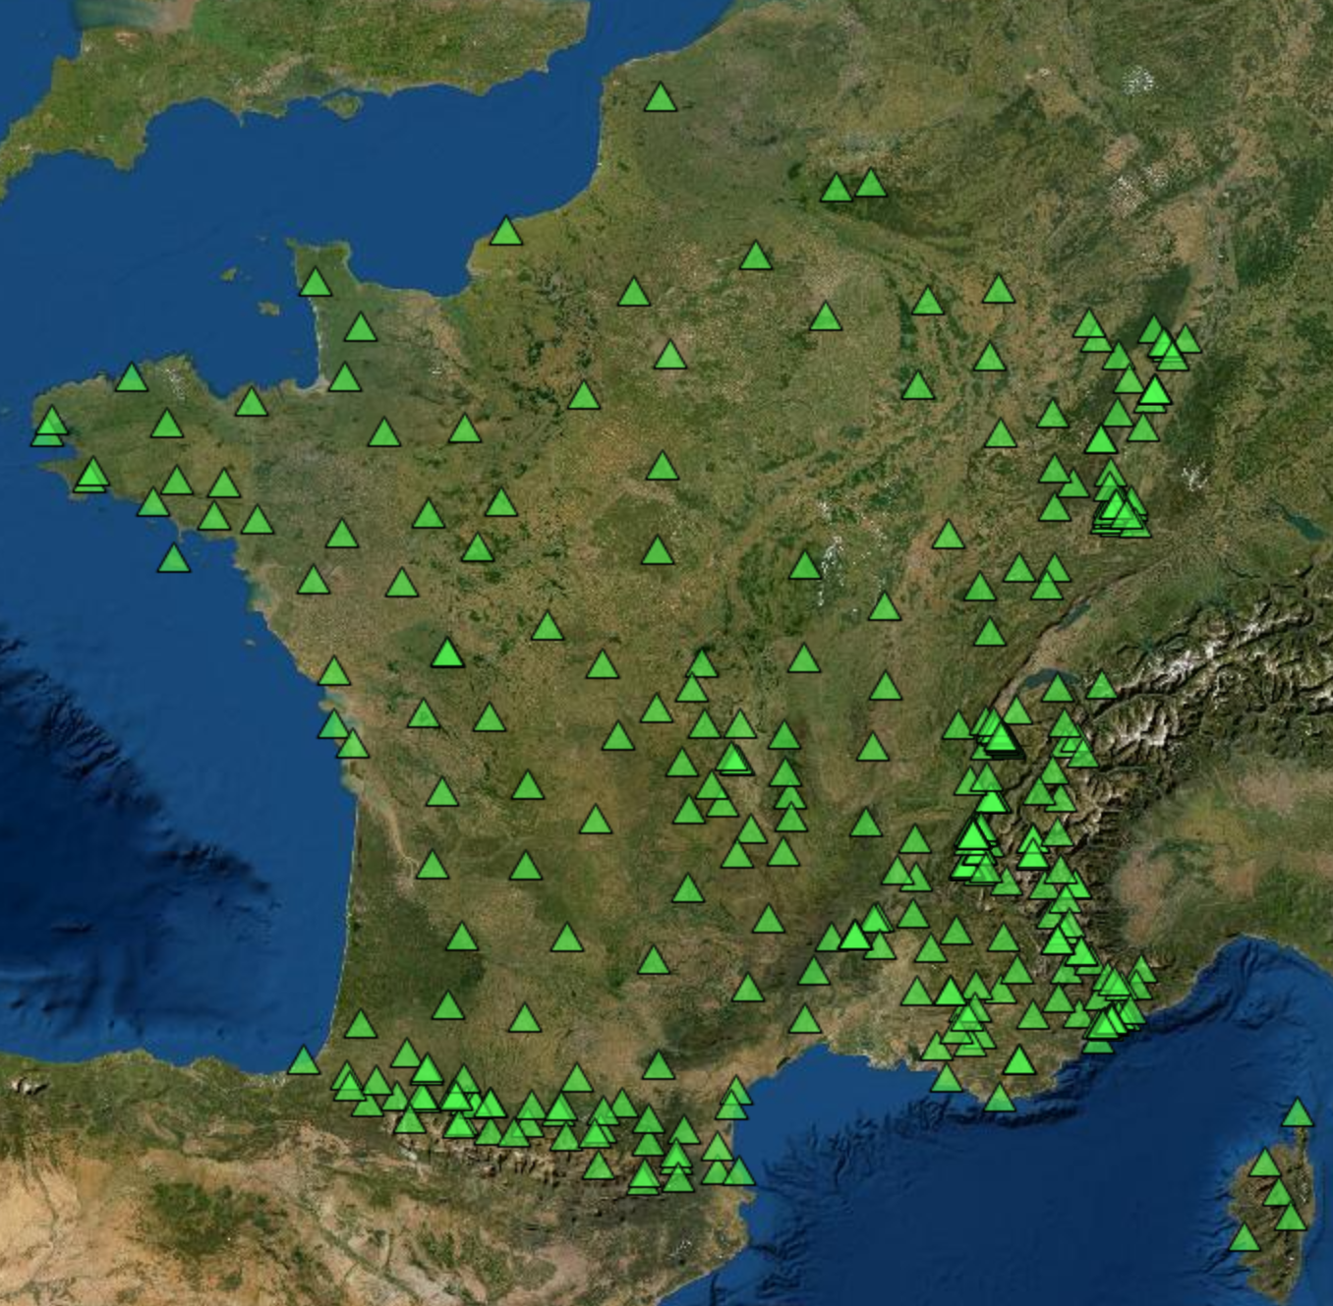
CONCLUSIONS
Detection of a hidden slow-slip of ~M5
Importance of colocated dense arrays and broadband stations for phase identification
Preliminary results on PdF
PERSPECTIVES:
Installation of temporary mini-arrays around permanent stations
  Characterization of the wavefield between station pairs for monitoring (imaging?)
  Station sites characterization

Slide 20
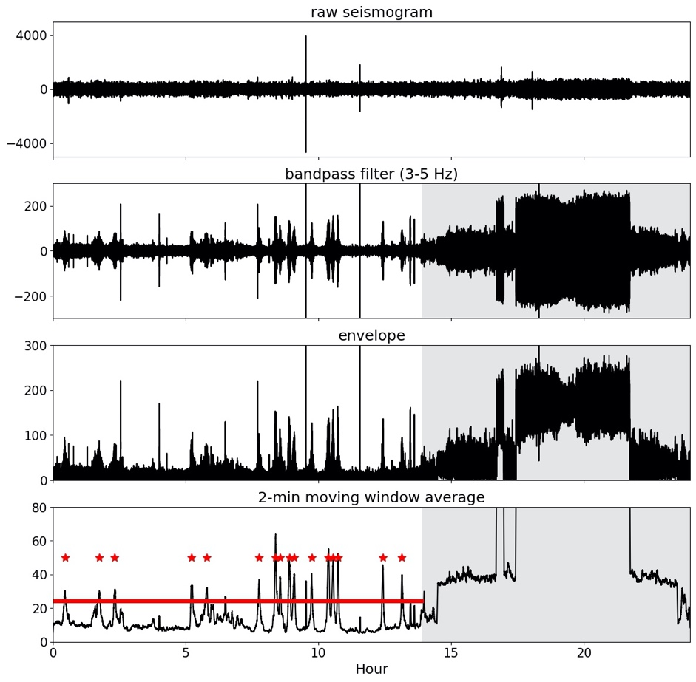
TRAIN-TREMOR DETECTION
12-min-long window for cross-correlation
Data processed: middle of 2010 – end of 2020

Slide 21
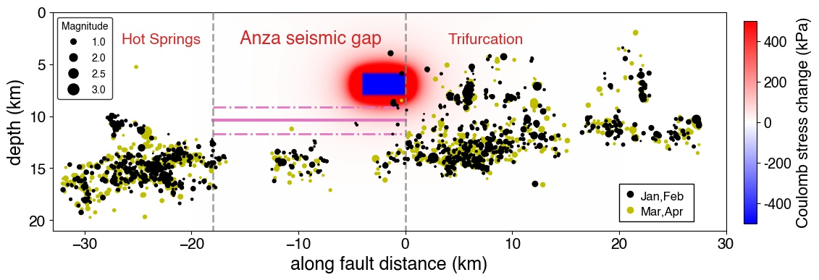
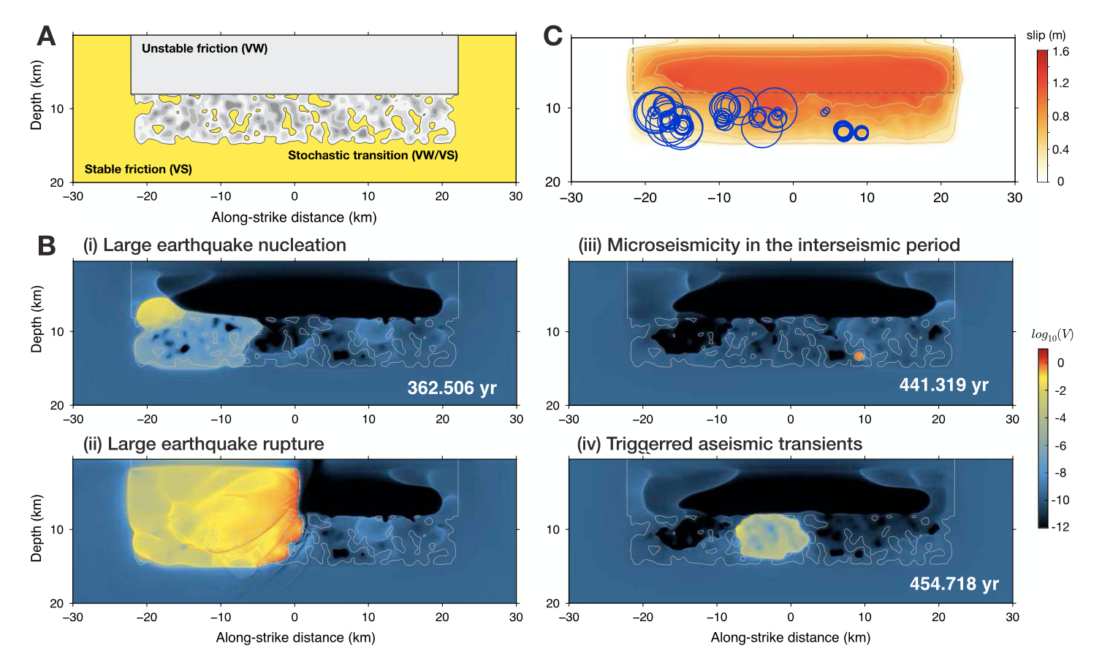
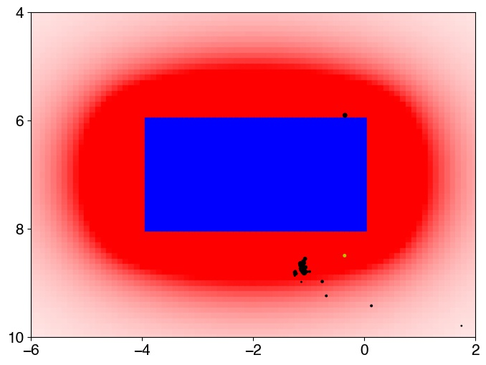
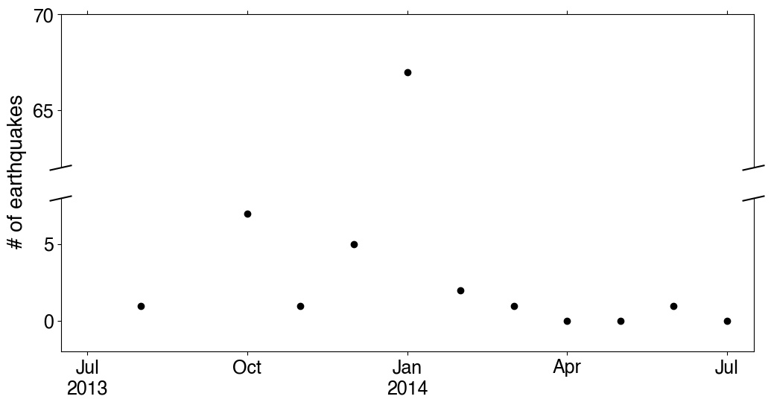
Aseismic slip in the transition zone
aseismic slip in a vw/vs transition zone
Jiang and Fialko., 2016
Geodetic locking depth: 7.7 ± 1.0 km / 10.3 ± 1.6 km (Lindsey et al., 2014)

Slide 22
GPS DETECTION THRESHOLD
Inverted dislocation is smaller than the threshold

Slide 23
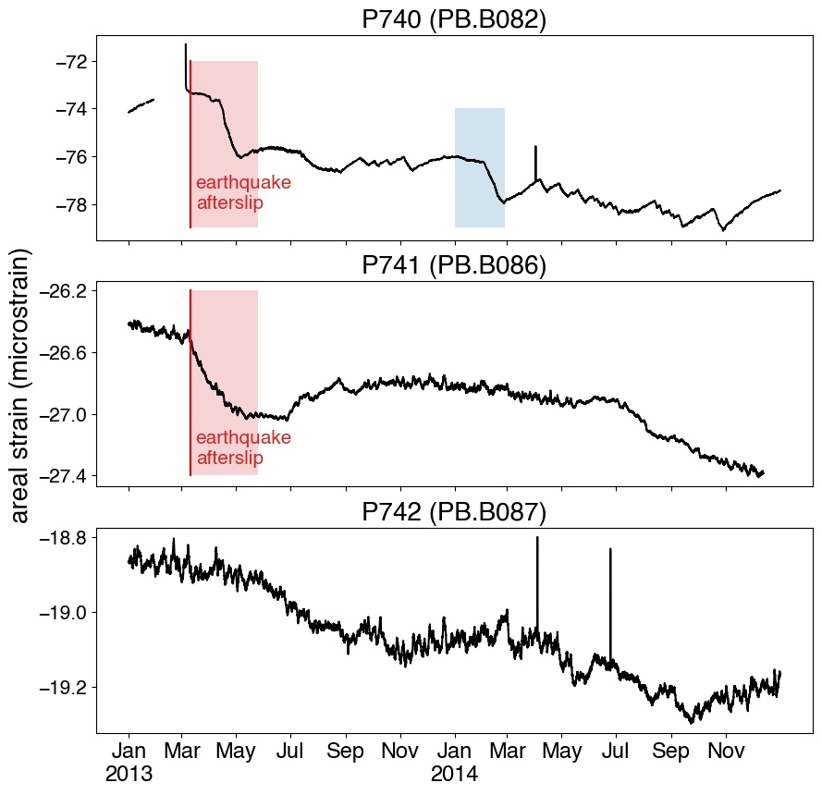
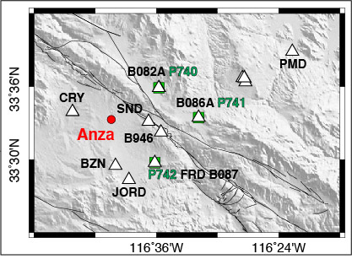
STRAIN MEASUREMENTS
The simulated volumetric strain is in the order of 10 ns at the sites of strainmeters
Strain transient
Earthquake afterslip obtained from Shaddox et al., 2021

